Slide 1
RTD Safety
Our Core Value
2017 MAX Program Presentation
Mike Meader
Chief Safety and Security Officer
Regional Transportation District – Denver, CO
Notes:
Do a brief intro of self, leadership style, personal leadership values, several objectives, for us to get to know each other a little better, to serve you and bring value to this time, and discuss safety attributes for leaders
Hopefully, what we’ll talk about today will get you thinking about safety in a different way, I also want to leave some time at the end to answer any questions you may have – about safety, leadership, security, facilities …about me, anything you may ask and I will try and answer.

Slide 2
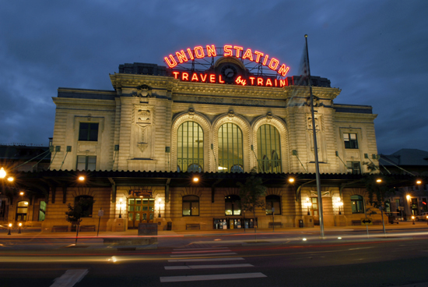
Presentation Overview
Safety, Security and Asset Management
What is safety?
SMS
Analysis tools
Barriers to safety
Safety Concern Reporting
Safety culture
Safety and leadership

Slide 4
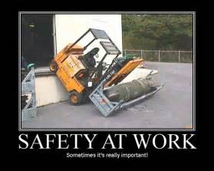
Safety

Slide 5
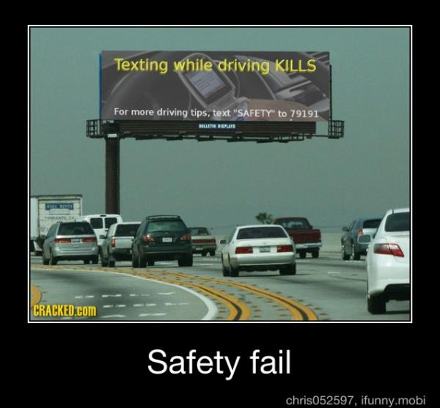

Slide 6


Slide 7
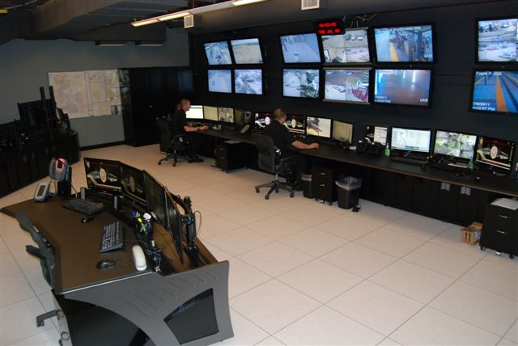
Security

Slide 8
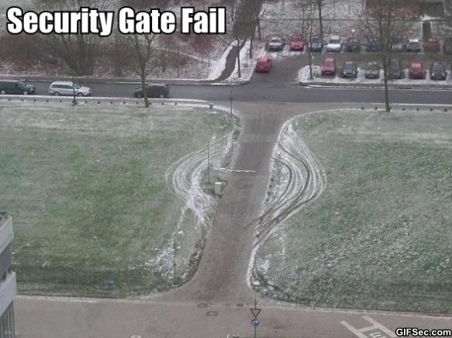

Slide 9
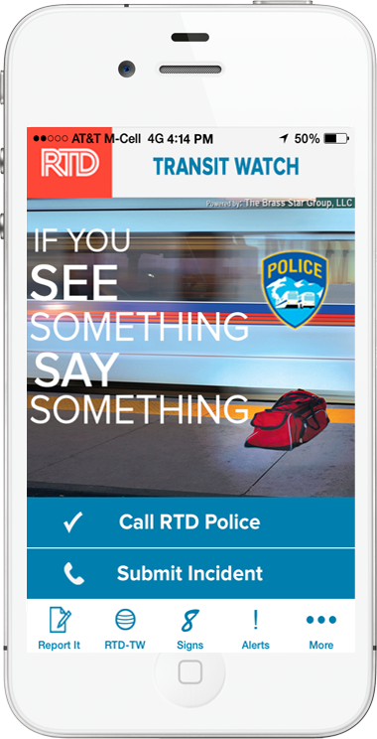
Features:
Easy to Use Buttons & Tabs
Call Transit Police Directly
Submit an Incident Report Form w/ Photo(s)
GPS
May be anonymous
Get Response and Feedback on Reports
Nearly 1000 downloads, 2-4 reports/day

Slide 10
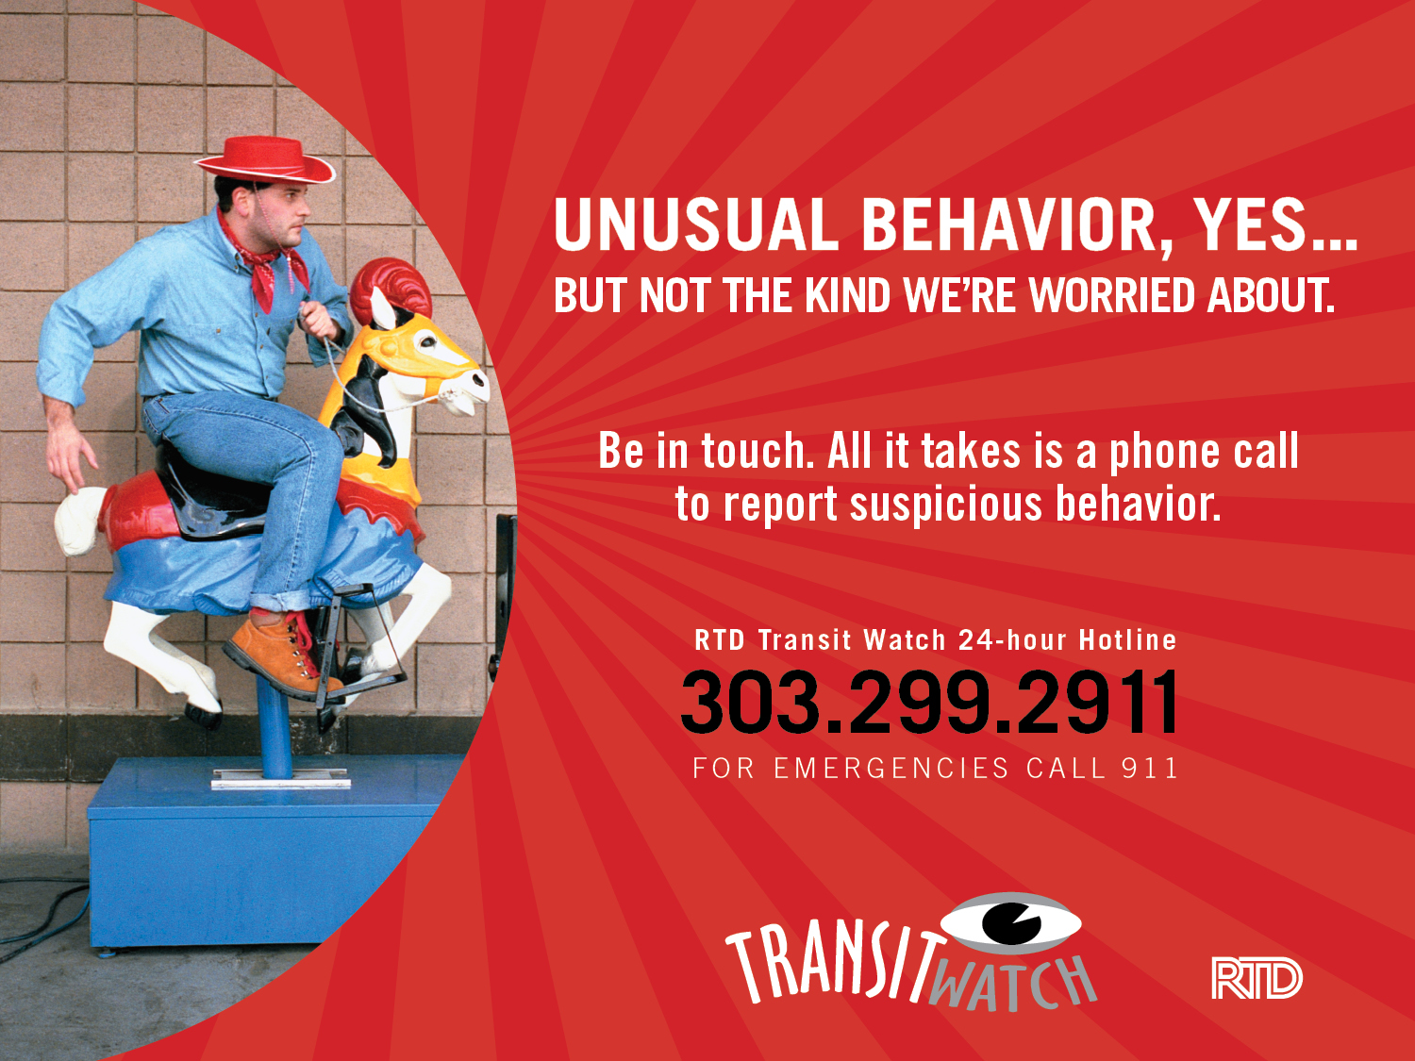

Slide 11
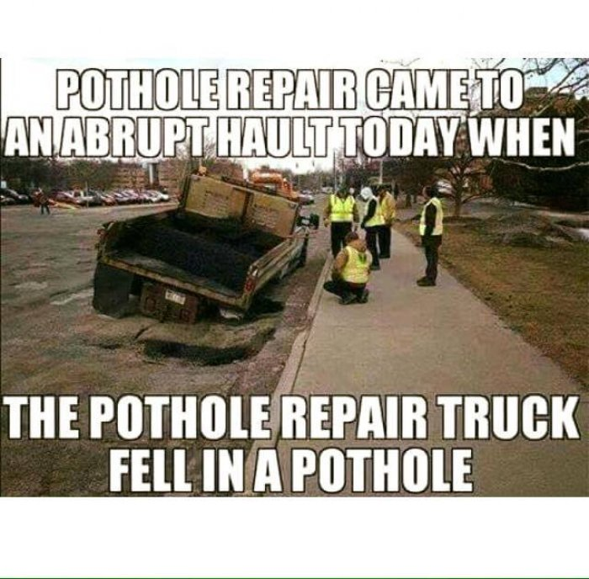
Asset Management

Slide 12
Questions?
Safety, Security & Asset Management

Slide 13
Barriers to Effective Safety Programs
Lack of Trust
Cost
Schedule
Politics - stakeholders
Buy-in, influencing others
Lack of cross-functional participation
Competing priorities
Culture.

Slide 14
What is Safety?
Safety – freedom from unintentional danger
Security – freedom from intentional danger
Are you always free from danger?
What about how you commuted to work today – safe?
“This is safe” –what does this mean?
“The design for this grade crossing is safe”
Risk and willingness to accept that risk.
Notes:
So know that most of what we’ll discuss today about safety and applying certain principles can also be done for security.
Ask several about their commutes.

Slide 15
Risk Assessment
How do we go about risk assessment?
Informally
  Your decision on how to get to work today
Formal hazard analysis process.
Executive Safety Security Committee

Slide 16
System Safety
The application of management and engineering principles applied to a system throughout it’s lifecycle to reduce or eliminate hazards to the lowest practical level with the use of existing resources.
Notes:
We’ll unpack this definition in terms of more meaningful chunks
Proactive approach to safety designed for accident preventability

Slide 17
System Safety
Definition of a “System”
  People
  Environment
  Policies
  Equipment and facilities

Slide 18
Safety Management Systems (SMS) Overview

Slide 19
What is SMS?
SMS is the formal, top-down, organization-wide, data-driven approach to managing safety risk and assuring the effectiveness of safety risk mitigations. It includes systematic policies, procedures, and practices for the management of safety risk.

Slide 20
Why SMS? – Practical Drift
Baseline Performance
Procedure
Practical Drift
“Work as designed”
Practice
“Work as actually done”
The difference between “where we are” and “where we thought we were”
Operational Performance

Slide 21
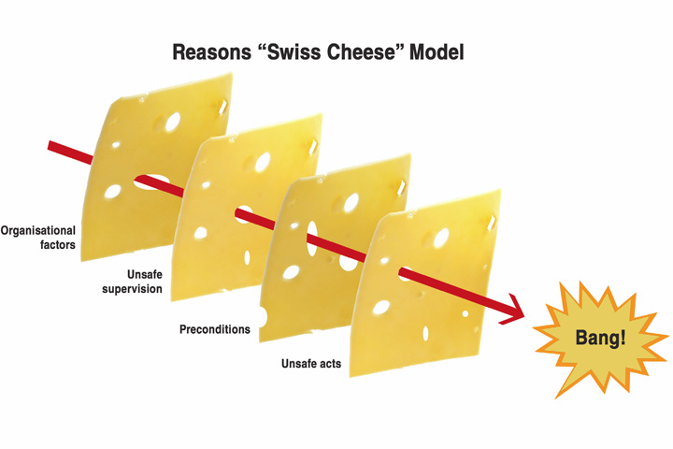
Why SMS?

Slide 22
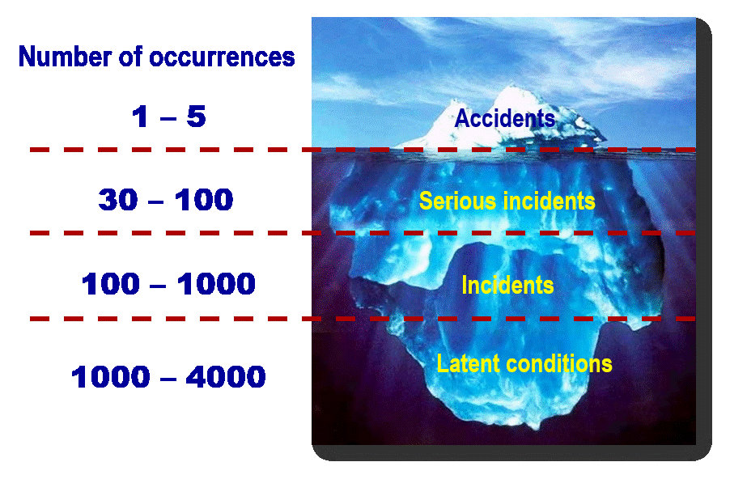
Why SMS?

Slide 23
Questions we need to ask that SMS helps answer
What are our most serious safety concerns?
How do we know this?
What are we doing about it?
Is what we are doing working?
How do we know what we are doing is working?
Notes:
SMS is designed to answer 5 critical questions.
It helps us determine what our most serious safety risks are.
It provides a documented methodology for identifying and prioritizing those safety risks.
It leads us down a path to decide what to do about mitigating our most serious risks.
It allows us to determine if our mitigation strategies are working.
And it allows us to empirically document our assurance that mitigations are effective, or if not effective, consider what other mitigations will work better.

Slide 24
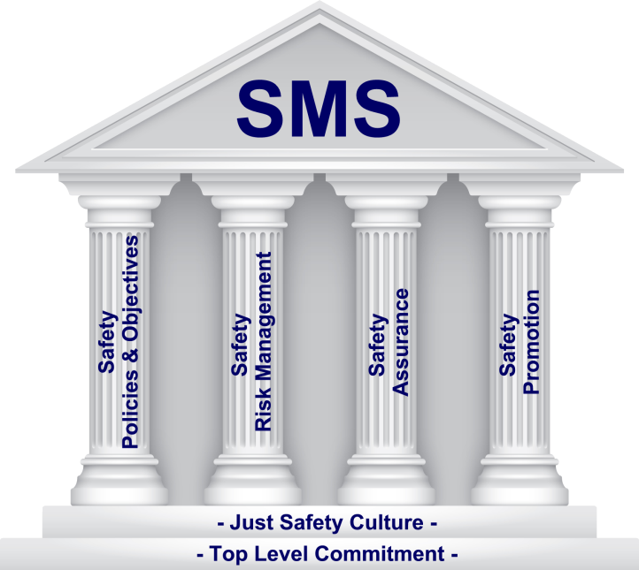

Slide 25
Safety Management Policy

Slide 26

Safety Management Policy Component and its Subcomponents
Establishes necessary organizational structures, roles, and responsibilities
Ensures safety is addressed with the same priority as other critical organizational functions
Provides direction for effective:
  Safety Risk Management
  Safety Assurance
  Safety Promotion
Helps ensure sufficient resources are provided to meet safety objectives
Safety
Management
Policy
Safety Management Policy Statement
Safety Accountabilities & Responsibilities
Integration with Public Safety & Emergency Management
SMS Documentation & Records

Slide 27
Safety Risk Management

Slide 28
SRM Component and its Subcomponents
Vital to the success of SMS
Before an SMS can be effectively built or improved, safety hazards must be identified in your operation and mitigations need to be in place to manage the safety risk
Safety risk management is a continuous process
Safety
Risk
Management
Hazard Identification & Analysis
Safety Risk Evaluation & Mitigation

Slide 29
Identifying Hazards
What is a hazard?
  Unsafe condition
  Unsafe act
Why concern ourselves with hazards?
  Unsafe condition (hazard) + stimulus (act) = accident
Leading indicators (Heinrich Ratio)
  Eliminate unsafe conditions and unsafe acts => eliminate accidents

Slide 30
Hazard Analysis
Informal or formal process of assessing risk
Probability of occurrence
Severity
Risk index.
Notes:
LA metro – do everything you can because you will be sued (no limits like we have) vs. do what is practical and reasonable

Slide 31
Hazard Severity
SEVERITY CATEGORIES
Description | Severity Category | Mishap Result Criteria
Catastrophic | 1 | Could result in one or more of the following: death, permanent total disability, irreversible significant environmental impact, or monetary loss equal to or exceeding $10M.
Critical | 2 | Could result in one or more of the following: permanent partial disability, injuries or occupational illness that may result in hospitalization of at least three personnel, reversible significant environmental impact, or monetary loss equal to or exceeding $1M but less than$10M.
Marginal | 3 | Could result in one or more of the following: injury or occupational illness resulting in one or more lost work day(s), reversible moderate environmental impact, or monetary loss equal to or exceeding $100K but less than $1M.
Negligible | 4 | Could result in one or more of the following: injury or occupational illness not resulting in a lost work day, minimal environmental impact, or monetary loss less than $100K.

Slide 32
Hazard Probability
PROBABILITY LEVELS
Description | Level | Specific Individual Item | Fleet or Inventory
Frequent | A | Likely to occur often in the life of an item. | Continuously experienced.
Probable | B | Will occur several times in the life of an item. | Will occur frequently.
Occasional | C | Likely to occur sometime in the life of an item. | Will occur several times.
Remote | D | Unlikely, but possible to occur in the life of an item. | Unlikely, but can reasonably be expected to occur.
Improbable | E | So unlikely, it can be assumed occurrence may not be experienced in the life of an item. | Unlikely to occur, but possible.
Eliminated | F | Incapable of occurrence. This level is used when potential hazards are identified and later eliminated. | Incapable of occurrence. This level is used when potential hazards are identified and later eliminated.

Slide 33
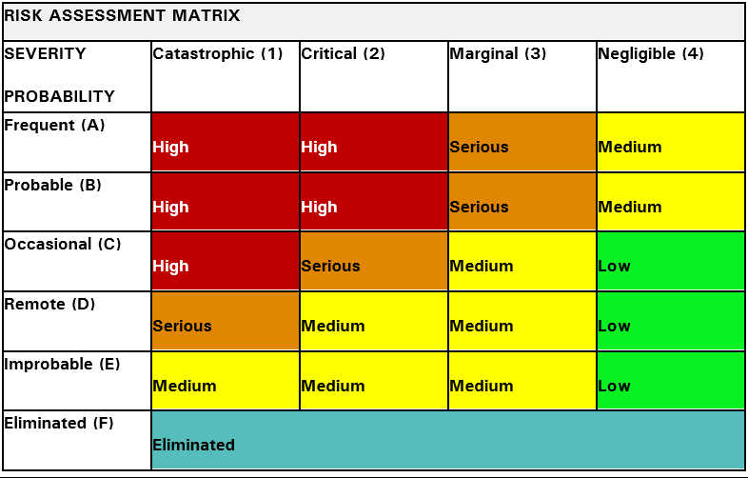
Hazard Resolution Matrix
1 UNACCEPTABLE
2 UNDESIRABLE (MGMT. RISK DECISION REQ’D)
3 ACCEPTABLE WITH REVIEW BY MGMT.
4 ACCEPTABLE WITHOUT REVIEW

Slide 34
Hazard Analysis -16th Street Mall
RTD’s Hazard Analysis Approach for Peoria Station
Item | Hazard Description | Hazard Cause(s) | Hazard Effect | Severity Category and Probability | Hazard Resolution / Reduction
1. | Bicyclist riding alongside Mall Shuttle with restricted sightlines | Allowing bicycles to utilize 16th Street Mall as a thoroughfare | Bicyclist unexpectedly meets a mall patron, mall shuttle, or opposing vehicular traffic possibly resulting in one or more of the following: death, permanent total disability | 1A 2D Residual | Do not allow anything other than Mall Shuttles, Emergency vehicles, maintenance vehicles, and commerce supply vehicles access to the transit way at all times
2. | Bicyclist violating traffic laws to reach their destination faster (i.e. running a traffic signal or weaving between other vehicles on the transit way) | Allowing bicycles to utilize 16th Street Mall as a thoroughfare | Bicyclist unexpectedly meets a mall patron, mall shuttle, or opposing vehicular traffic possibly resulting in one or more of the following: death, permanent total disability | 1A 2D Residual | Do not allow anything other than Mall Shuttles, Emergency vehicles, maintenance vehicles, and commerce supply vehicles access to the transit way at all times
3. | Bicyclist taking shortcuts through alleyways to reach their destination faster | Allowing bicycles to utilize 16th Street Mall as a thoroughfare | Bicyclist unexpectedly meets a mall patron, mall shuttle, or opposing vehicular traffic possibly resulting in one or more of the following: death, permanent total disability | 1A 2D Residual | Do not allow anything other than Mall Shuttles, Emergency vehicles, maintenance vehicles, and commerce supply vehicles access to the transit way at all times
4 | Distracted bicyclist (i.e. headphones, cell phone) | Allowing bicycles to utilize 16th Street Mall as a thoroughfare | Bicyclist unexpectedly meets a mall patron, mall shuttle, or opposing vehicular traffic possibly resulting in one or more of the following: death, permanent total disability | 1A 2D Residual | Do not allow anything other than Mall Shuttles, Emergency vehicles, maintenance vehicles, and commerce supply vehicles access to the transit way at all times

Slide 35
Risk Management Precedence
Design for minimum risk
Incorporate safety devices
Provide warning devices
Implement policies, procedures and training
Risk Appetite Decision

Slide 36
Safety Assurance

Slide 37
Safety Assurance Component and its Subcomponents
A continuous process, constantly interacting with Safety Risk Management
Where safety performance data is collected and analyzed
Systematic and ongoing monitoring and recording of an agency’s safety performance
Helps verify an agency’s safety performance is in line with safety objectives and targets
Safety
Assurance
Safety performance monitoring & measurement
Management
of
change
Continuous improvement

Slide 38
Safety Promotion

Slide 39
Safety Promotion Component and its Subcomponents
Safety
Promotion
Safety Communication
Competencies and Training

Slide 40
Safety Promotion - Communication
SMS relies on continuous management commitment to communication
One of management’s most important responsibilities under SMS is to encourage and motivate others to want to communicate openly, authentically, and without concern for reprisal
Safety
Promotion
Safety Communication
Competencies and Training

Slide 41
Procedure Name: | Safety Moments
PURPOSE AND SCOPE
PURPOSE
The Department of Safety, Security & Asset Management strives to enhance RTD’s safety culture through District wide safety awareness programs. One such program – RTD Safety Moment is a brief presentation or discussion about a safety issue or topic. Safety Moments are to be discussed at the beginning of all RTD held business meetings, Board meetings and shifts, and are designed to routinely inform employees of safety issues and be a reminder that Safety is RTD’s Core Value.
The purpose of this procedure is to ensure a Safety Moment is presented or discussed at the start of all RTD held meetings and shifts. As a result, safety will be routinely discussed and continue to be a District wide priority.
SCOPE
This procedure defines the process of including a Safety Moment in all RTD field meetings with four (4) or more participants. RTD held meetings include Board and Committee meetings, meetings held by RTD business units, and meetings held by contractors on RTD property. This procedure also outlines how to obtain Safety Moment topics.

Slide 42
SAFETY MOMENT: BACK TO SCHOOL
As students go back to school, drivers should be on the lookout for more young pedestrians and bicyclists and be particularly cautious when traveling through school zones and near school bus stops.
Some teens may be driving to school for the first time, so pay attention to new drivers especially around high schools.
The basic back-to-school safety tips for all drivers include:
Slow down and obey all traffic
laws and speed limits.
Stop for school buses that are loading or unloading children. This applies to on-coming buses as well. Watch for red flashing lights
Do not stand in the roadway while waiting for the school bus.
If you walk to school, follow the safety rules for pedestrians.
Walk on the sidewalk that faces
traffic.
Cross the street only at crosswalks and follow the directions given by crossing guards.
If you ride a bike to school, wear your helmet, follow all safety rules for bicyclists including walking your bike at crosswalks.
Always be a good role model for younger siblings and fellow students. Avoid horseplay on sidewalks, while riding a bus or bicycle, and while traveling in a vehicle.
Students who drive or ride to school must avoid speeding and minimize distractions from cell phone usage, loud music, eating and passengers.
Remember that every passenger must use a safety belt.
By following these rules, everyone can have a safe school year!

Slide 43
Competencies and Training
Departments | SMS Awareness (TSI) | SMS Safety Assurance (TSI) | Curbing Distracted Driving (TSI) | Your SMS Role/Responsibility | Safety/Security Reporting | Intro to Incident Command System (ICS) | Intro to NIMS | Active Shooter | Evacuation Procedures | OTST
Board | Required |  | Required | Required | Required |  |  | Required | Required
SLT | Required | Required | Required | Required | Required | Required | Required | Required | Required | Required
Senior Managers | Required | Required | Required | Required | Required | Required | Required | Required | Required | Required
Managers | Required | Required | Required | Required | Required | Required | Required | Required | Required | Required
Supervisors | Required | Required | Required | Required | Required | Required | Required | Required | Required | Required
Administrative Staff | Required |  | Required | Required | Required |  |  | Required | Required
Dispatchers | Required | Required | Required | Required | Required | Required | Required | Required | Required | Required
Customer Service | Required |  |  | Required | Required |  |  | Required | Required
Operators | Required |  | Required | Required | Required |  |  | Required | Required
All Other Employees | Required |  | Required | Required | Required |  |  | Required | Required

Slide 44
Employee Safety Reporting

Slide 45
Competencies & Training
Subcomponent
Executive management responsibility because of allocation of resources to training
Safety training development process
Relationship between safety training and Safety Risk Management and Safety Assurance
Safety
Promotion
Safety Communication
Competencies and Training

Slide 46
Two Types of Incidents/Accidents
Individual incidents/accidents
  those resulting from the actions or inactions of people
Organizational incidents/accidents
  those resulting from actions or inactions of organizations

Slide 47
Individual Incidents/Accidents
Human Error
Individuals do not cause organizational accidents
Individuals trigger conditions leading to organizational accidents
Organizational accidents have deeper and broader roots
“The discovery of human error should be considered the starting point of the investigation, not the ending point.”

Slide 48
Organizational Incidents/Accidents
“Organizational accidents have multiple causes involving many people operating at different levels of their respective companies.”
  James Reason, Managing the Risks of Organizational Accidents

Slide 49
SMS and Safety Reporting: Facts
SMS does not work without data
Nobody knows actual system performance better than the employees delivering the service
Power of safety reporting
  Safety data capture on previously unanticipated safety deficiencies
  Safety data to confirm the effectiveness of existing safety risk mitigations
Notes:
.

Slide 50
Reporting Safety Concerns at RTD
RTD Hub – Safety Concern Reporting Form
Email – Safety@rtd-Denver.com
Hotline – 303-299-2258
Safety Concern /Suggestion Box
Safety Committees
Talk to your friendly neighborhood Safety Professional

Slide 51
Effective Safety Reporting - Attributes
TRUST
Ease of reporting
  Simple requisites
Timely, accessible, and informative feedback
  Feedback is motivational tool
Protection
  Information only used for the purposes it was collected
Vehicle for change
  Issues reported are solved; validates employee reporting

Slide 52
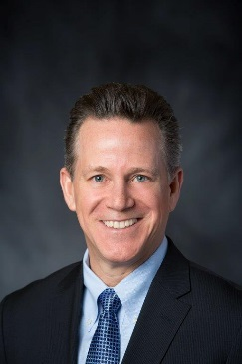


Safety Concern Reporting Principles
At RTD, we are cultivating and fostering a “just” safety culture in which employees are comfortable and encouraged to bring safety concerns to the attention of management.
No person will be penalized or disciplined for bringing safety issues to the attention of management.
Safety Concern Reporting at Denver RTD is founded on the following key principles:
A Safe environment for employees, customers, and the community we serve is RTD’s most important commitment, in fact it is a Core Value. To ensure this commitment to our Core Values, it is imperative that we have uninhibited reporting of all safety concerns or occurrences that could compromise the safety of our operations. The reporting of safety concerns is fundamental to a strong safety culture, and to understanding what must or can be done to improve RTD’s system.
We expect each employee to accept the responsibility to communicate any information that may affect the integrity of safety. Employees can be assured that this communication will never result in discipline or reprisal, thus allowing a timely, uninhibited flow of information to occur.
All employees are advised that RTD management will not penalize or discipline any employee who discloses a concern or occurrence that could or does impact the safety of RTD employees, customers or the general public.
RTD has developed several ways for employees to report information concerning safety. They are designed to protect the identity of the employee who provides information, yet provides the opportunity for two-way communication with safety professionals and those required to mitigate or eliminate the concern.
We expect all employees to openly report concerns to help RTD continue to provide our employees, customers and the general public we serve, with the highest level of safety.
It is important to understand that these principles cannot apply to situations that include a wanton disregard for accepted policies, involve intentional harm, or are criminal in nature.
Dave Genova, RTD General Manager and CEO

Slide 53
Just Safety Culture
An environment where safety and trust is fostered
Employees feel empowered and valued
Expectations are clear
Starts at top
Tools to Report
Hazards/issues addressed quickly
Follow through and follow-up – emails for all
Goal - Continuous Safety Improvement

Slide 54
Just Culture
Asks the question
“What are we doing or not doing (systemic), that is putting you in a position to make a poor decision, or feel unsafe?”

Slide 55
Assessing Safety Culture
Is the organization a reporting culture
  Employees encouraged to report
Is the organization an informed culture
  Leading indicators of safety performance
Is the organization a learning culture
  Addressing trends, resolving issues, trained to competency
Is the organization a just culture
  Accountable yet not unduly punishing

Slide 56
Safety and Leadership
As leaders, what is your role in safety…
Establish a positive safety culture
Serve
Lead by example
Do the right thing
Open communication – information gathering - feedback.

Slide 57
Changing Regulatory Environment
MAP 21 – Moving Ahead for Progress in the 21st Century
  October 1, 2012
  Expand FTA’s safety regulations and authority over all modes (light rail, metros, subways, bus, etc.) (not commuter rail and ferry)
  TRACS, APTA Rail committees

Slide 58
Safety Regulatory Authority
FTA is developing four rules to implement the safety requirements of MAP-21:
National Safety Program
Establishes SMS as foundation for FTA’s safety regulatory framework
Transit Agency
Safety Plan
Introduces SMS into practice
Safety Certification Training Program
Establishes new requirements for SSO Programs
State Safety Oversight (SSO) Program
Introduces SMS concepts and provides training
Develops safety performance criteria and definition for State of Good Repair (SGR)
Agencies set performance targets for safety and SGR based on requirements in the National Safety Plan
Improves technical competencies of safety oversight professionals
Integrates SMS and provides technical assistance to implement MAP-21 requirements
Requires FTA to develop a National Safety Plan
Notes:
- THE NATIONAL PUBLIC TRANSPORTATION SAFETY PROGRAM RULE is the CORNERSTONE upon which all else is built.
- TSO envisions a transition of the National Public Transportation Safety Plan (National Plan) rule into a comprehensive, integrated and overarching National Public Transportation Safety Program (National Program) rule that guides all other transit safety activities. We see all of TSO activities as part of the broader National Public Transportation Safety Program, and believe a National Plan is only a subset of the broader National Program umbrella. A National Safety Program rule would establish a national program, and incorporate National Safety Plan in the appendix. It would also address Agency Plan requirements. Program rule verbiage would be broad and strategic in nature, while the actual National Safety Plan itself can be revised as times, equipment, standards, etc change. The National Plan can be developed before the rules are finalized, and submitted along with the Final Rule, AND possibly distributed by FTA before rulemaking has been completed.
- The National Program rule will establish a National Program, specify the requirement to adopt SMS, incorporate the TAM rule definition of the State of Good Repair (SGR), outline issues to include in the National Plan, address Safety Performance Monitoring, and provide guidance regarding Agency Plan implementation (tentatively agencies will draft their first Agency Plan NLT one year from effective date of the rule). This NPRM defines FTA’s investigative and enforcement authorities, establishes Safety Performance Criteria, Safety Performance Standards, and Safety Training Certification Program requirements to be addressed in Agency Safety Plan. It addresses the agency requirement to manage the connection between safety, SGR and training. A National Plan will be developed to deliver alongside the Final Rule (to OMB, prior to approval).

Slide 59
Cultural Shift
From Compliance Approach |  | To SMS Approach (Data driven)
Documentation of current procedures and practices |  | Documentation of strategies to address priority safety risks
Safety regulators as primary audience |  | Agency leadership, employees and stakeholders as primary audience
Focus on compliance to prescriptive regulations |  | Focus on measurement of effectiveness of risk control strategies and achieving safety outcomes
Reactive response to lagging indicators such as accidents |  | Proactive focus on accident precursors such as close calls and near/real time data

Slide 60
Questions
Mike Meader
Mike.meader@rtd-denver.com
303-299-4038

