Slide 1
August 21, 2017
DAVE GENOVA GM & CEO
REGIONAL TRANSPORTATION DISTRICT Denver, Colorado

Slide 2
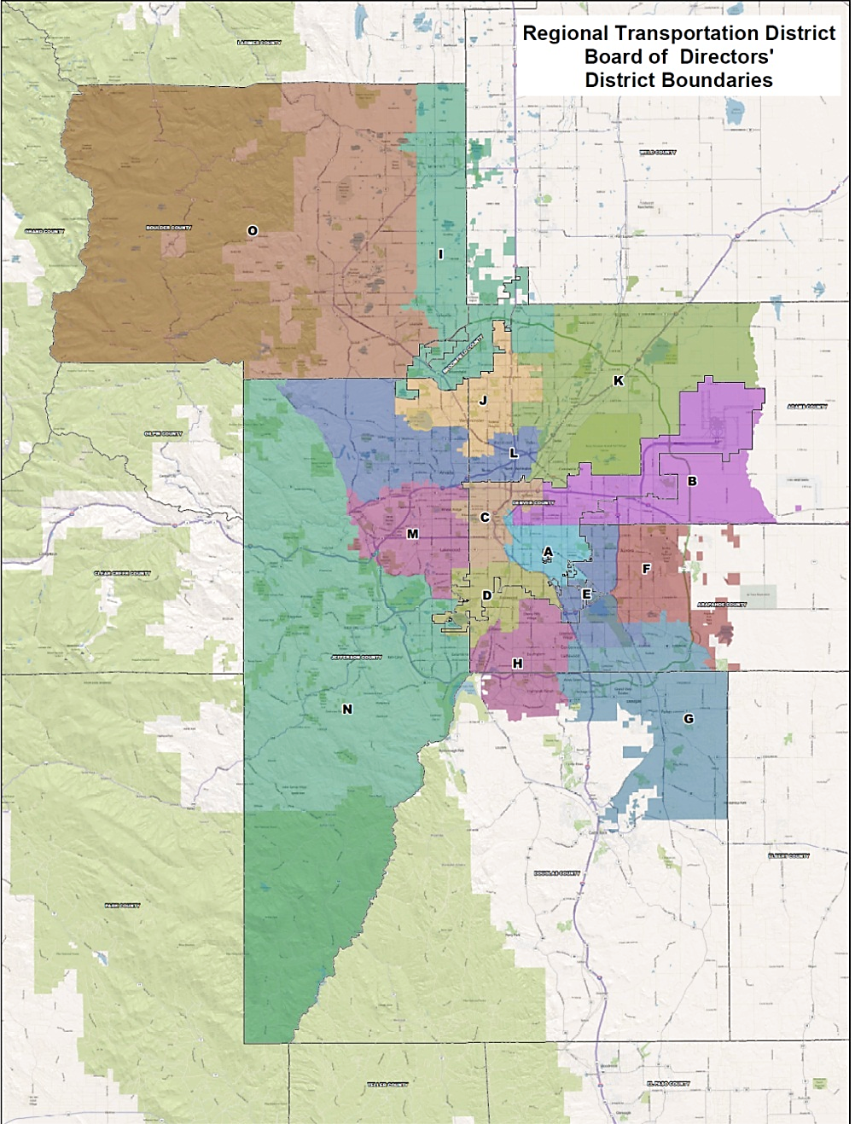
RTD Overview
Created in 1969
Eight-county service area
Service area: 2,342 sq. miles
2.92 million population
15 elected Board members
1 percent sales tax
0.6% base system
0.4% FasTracks
2,813 employees
2

Slide 3
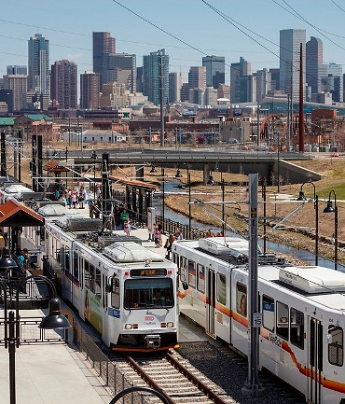
RTD Overview (cont.)
1,023 buses
172 light rail vehicles
66 commuter rail vehicles
80 park-n-Rides/31,000 parking spaces
58.5 miles of light rail
62 light rail stations
100 million annual boardings
3

Slide 4
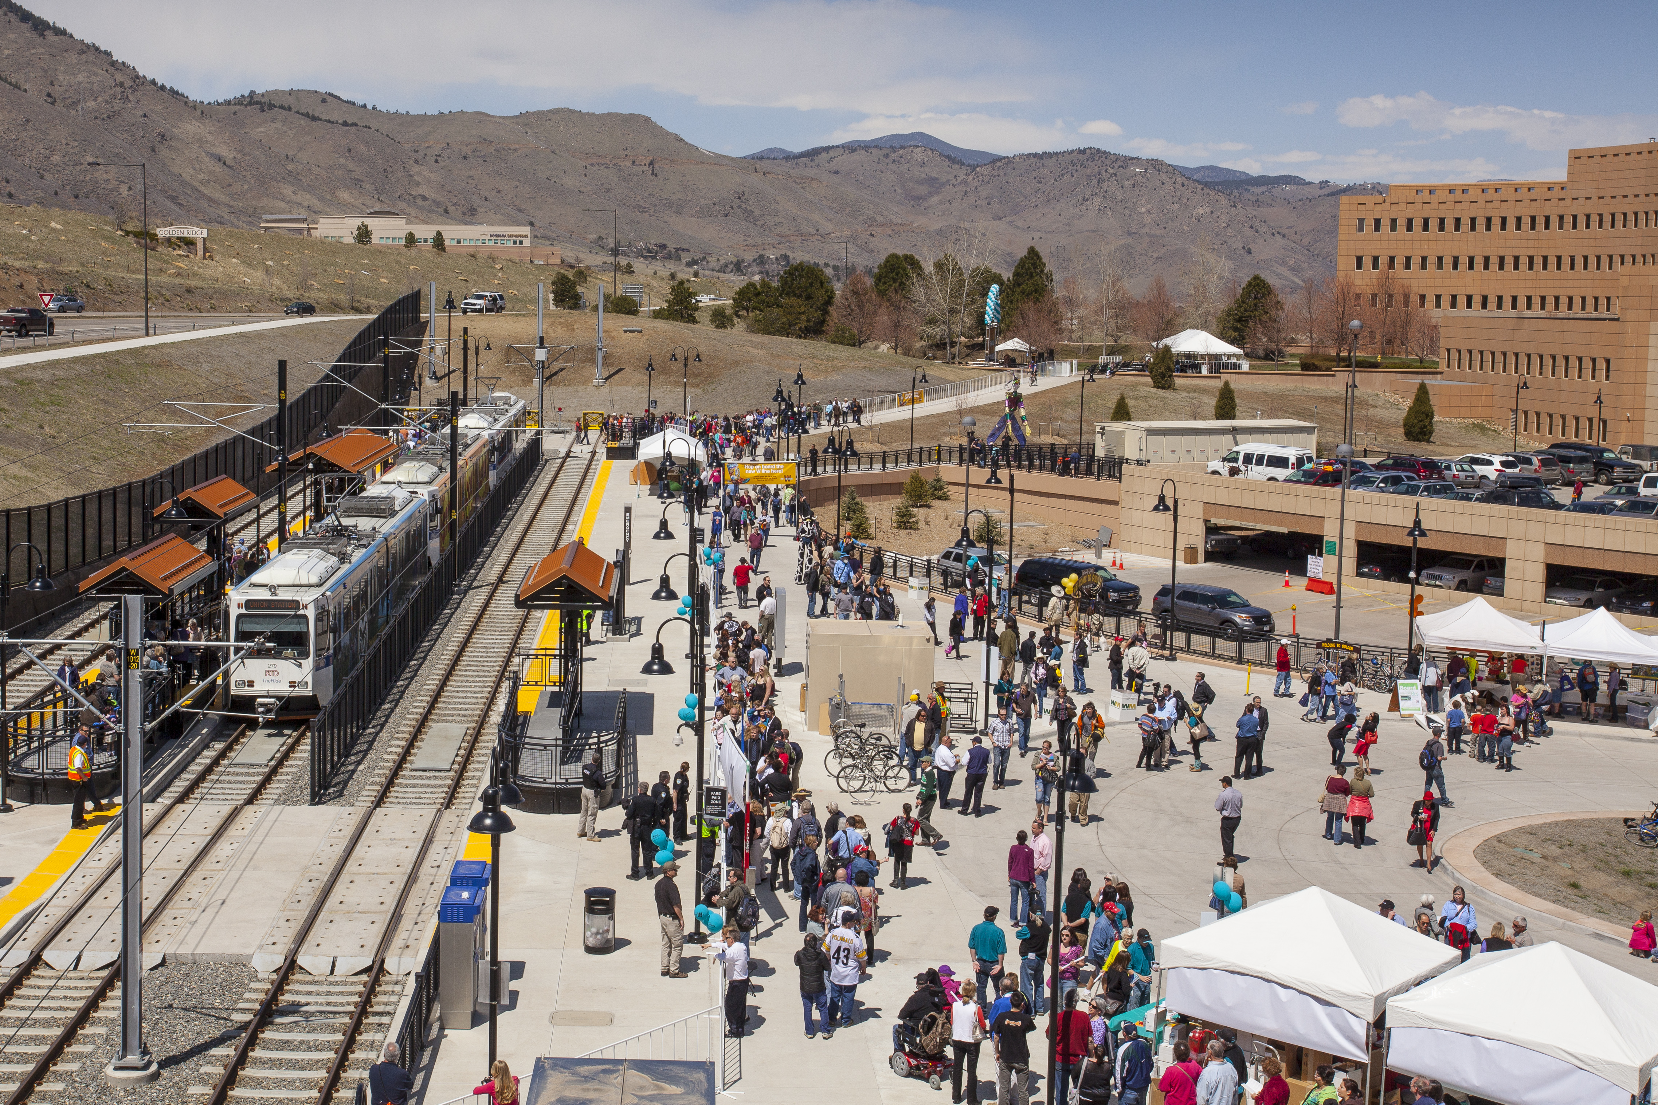
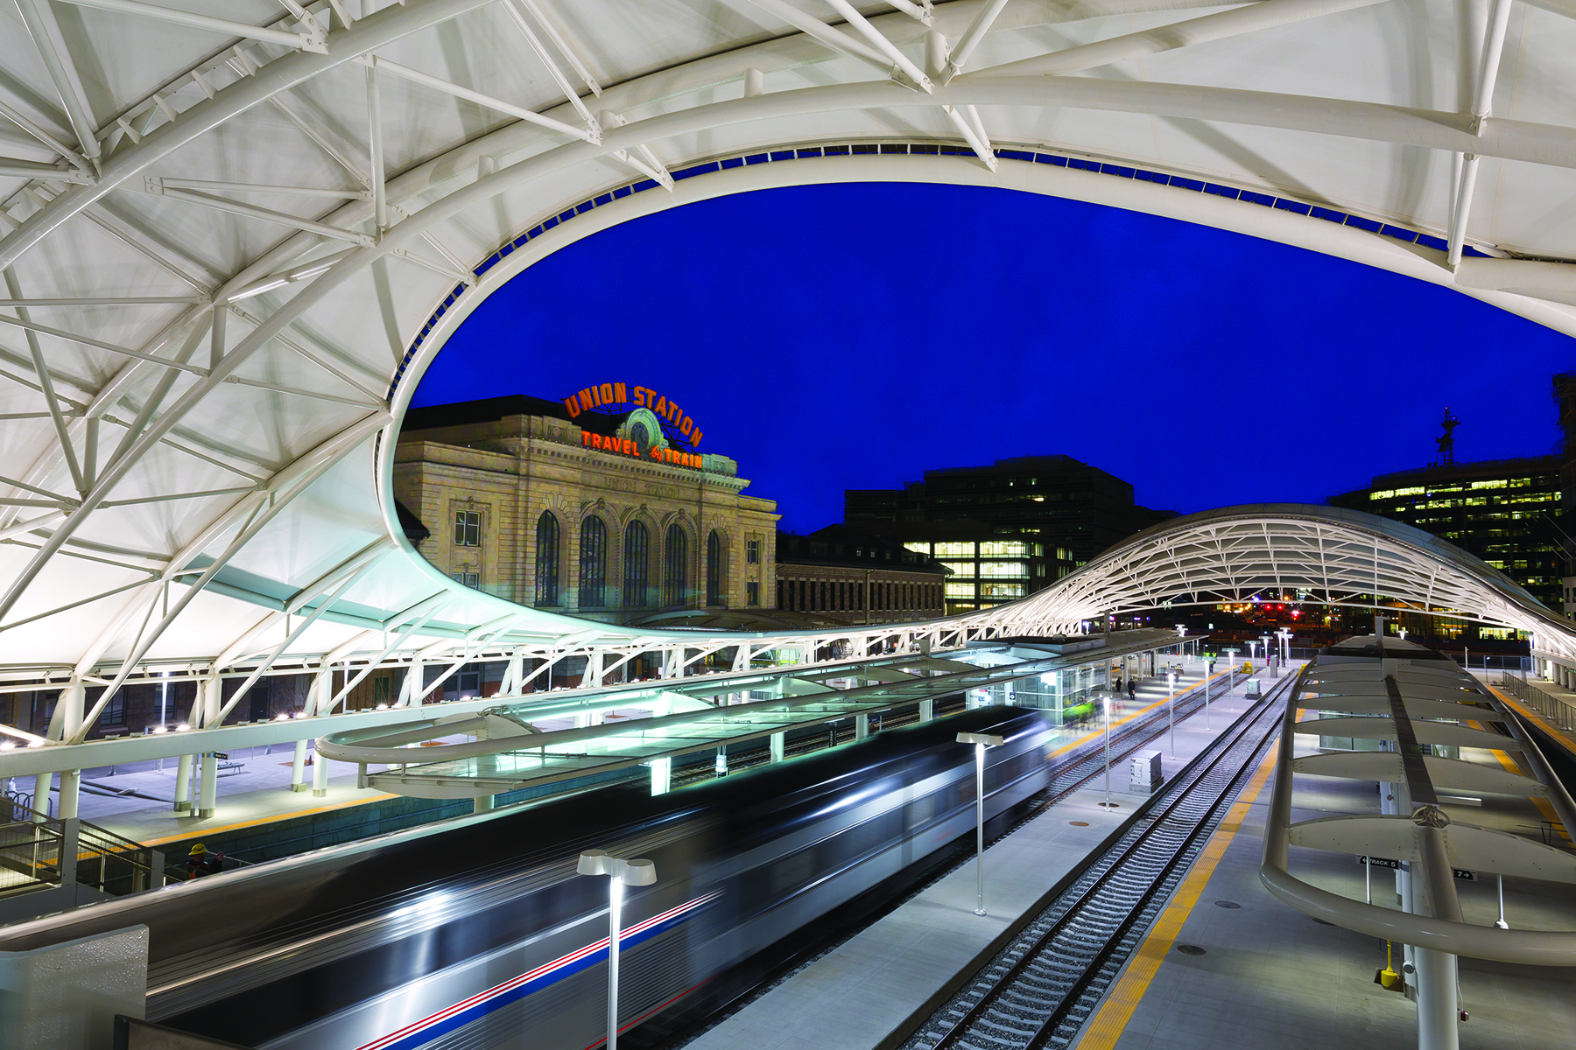
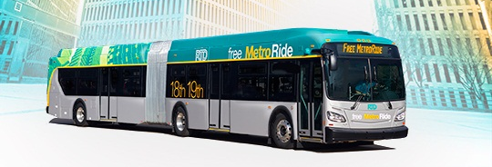
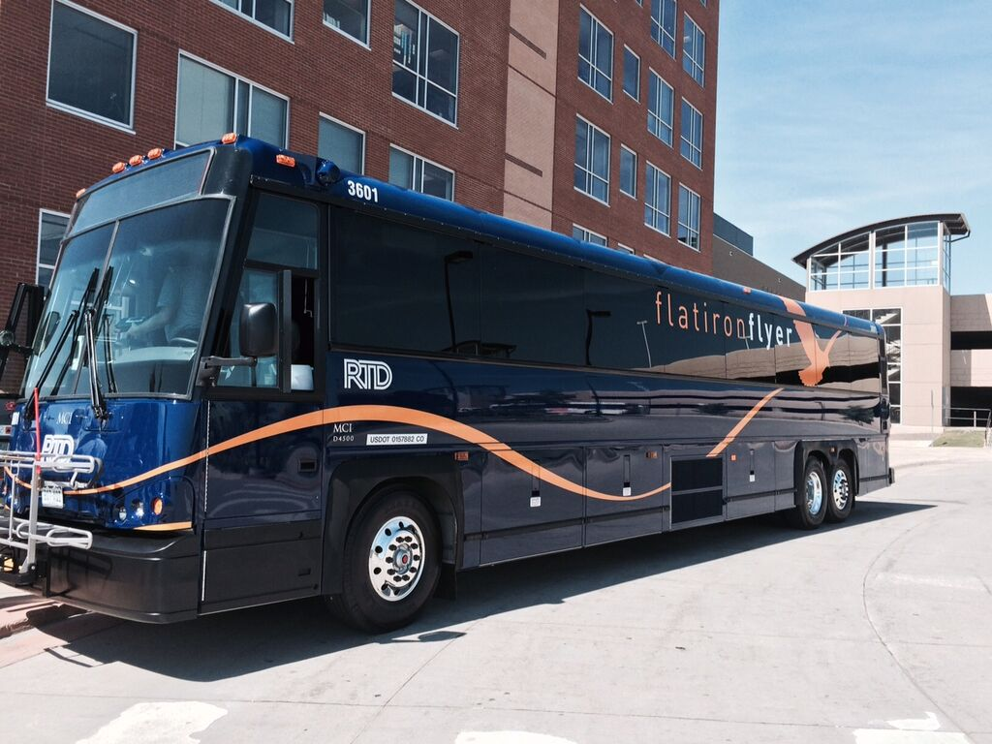
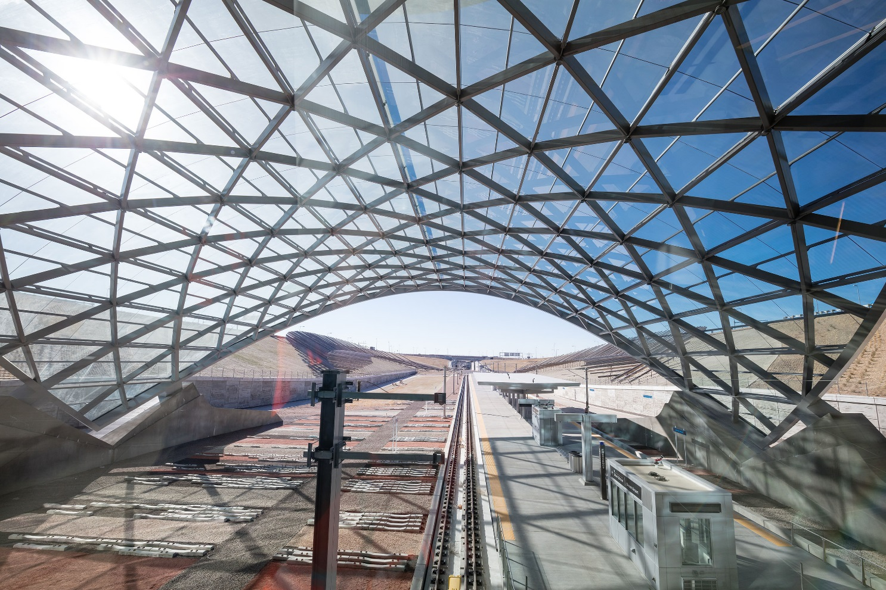
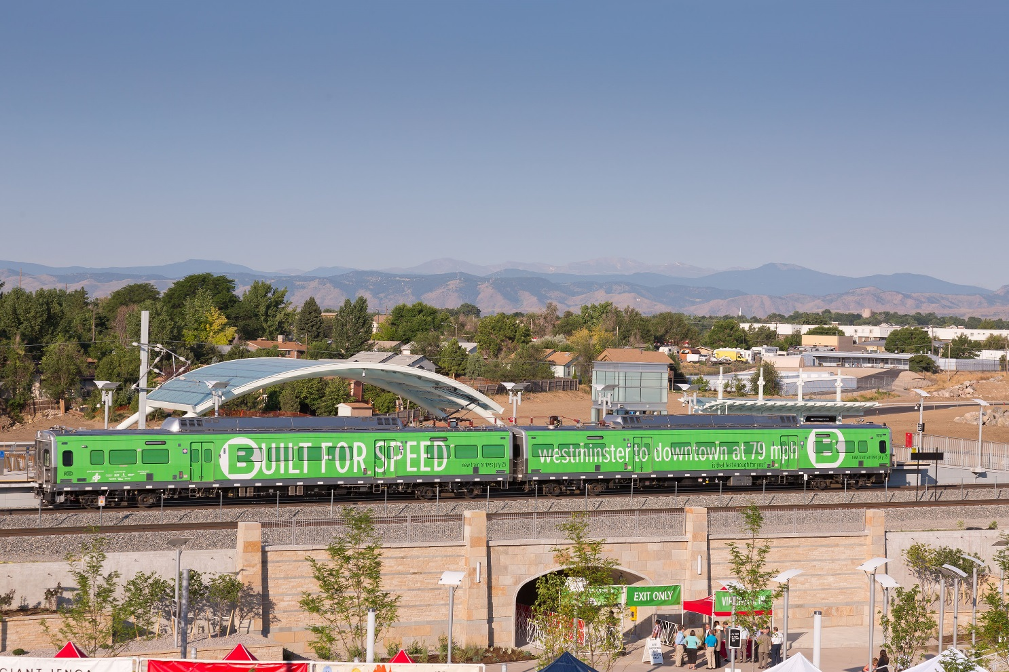
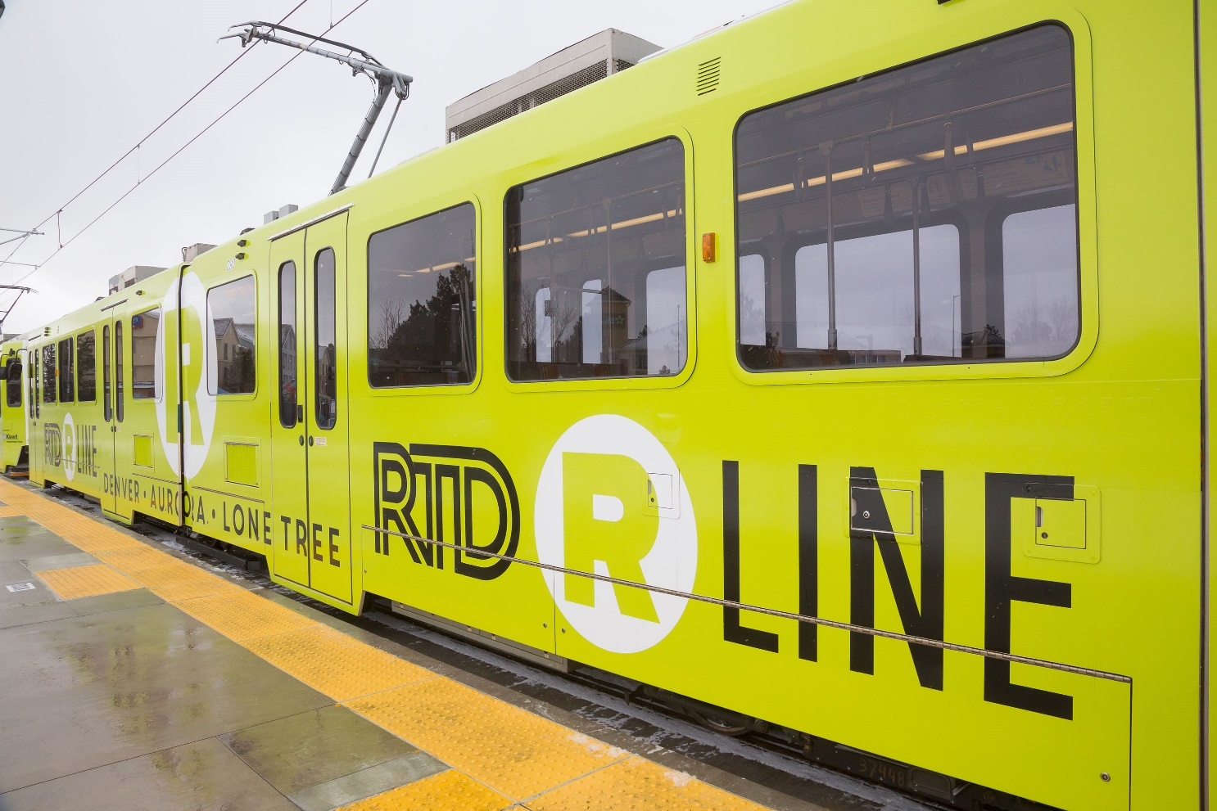
FasTracks Update
W Line – 2013
Union Station – 2014
Free Metro Ride – 2014
Flatiron Flyer BRT – 2016
University of Colorado A Line – 2016
B Line – 2016
R Line – 2017

Slide 5
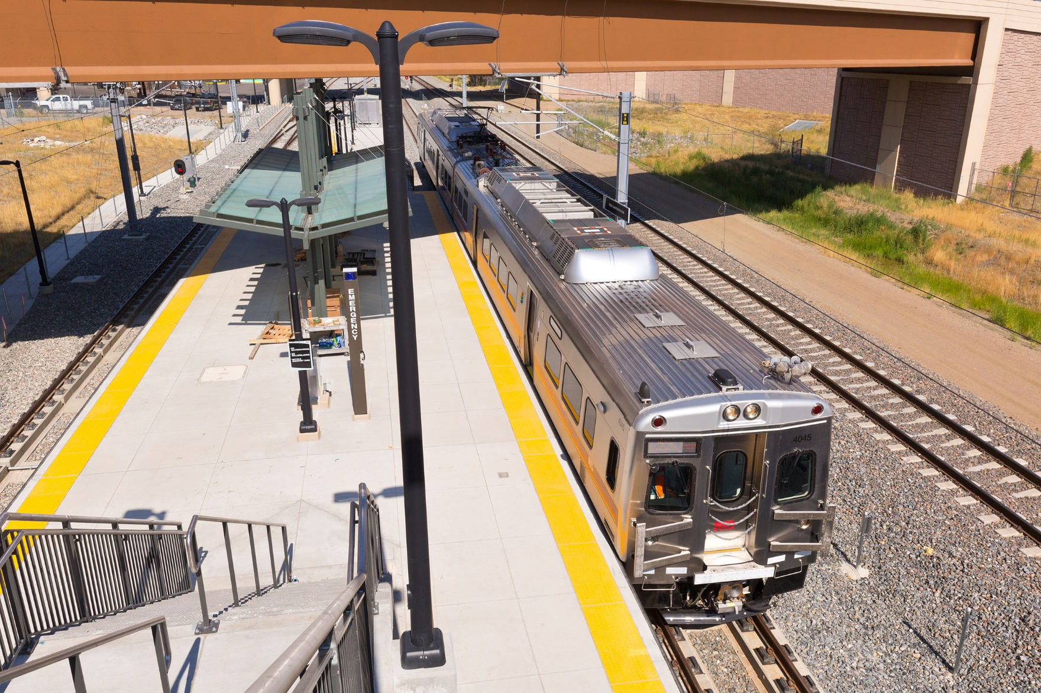
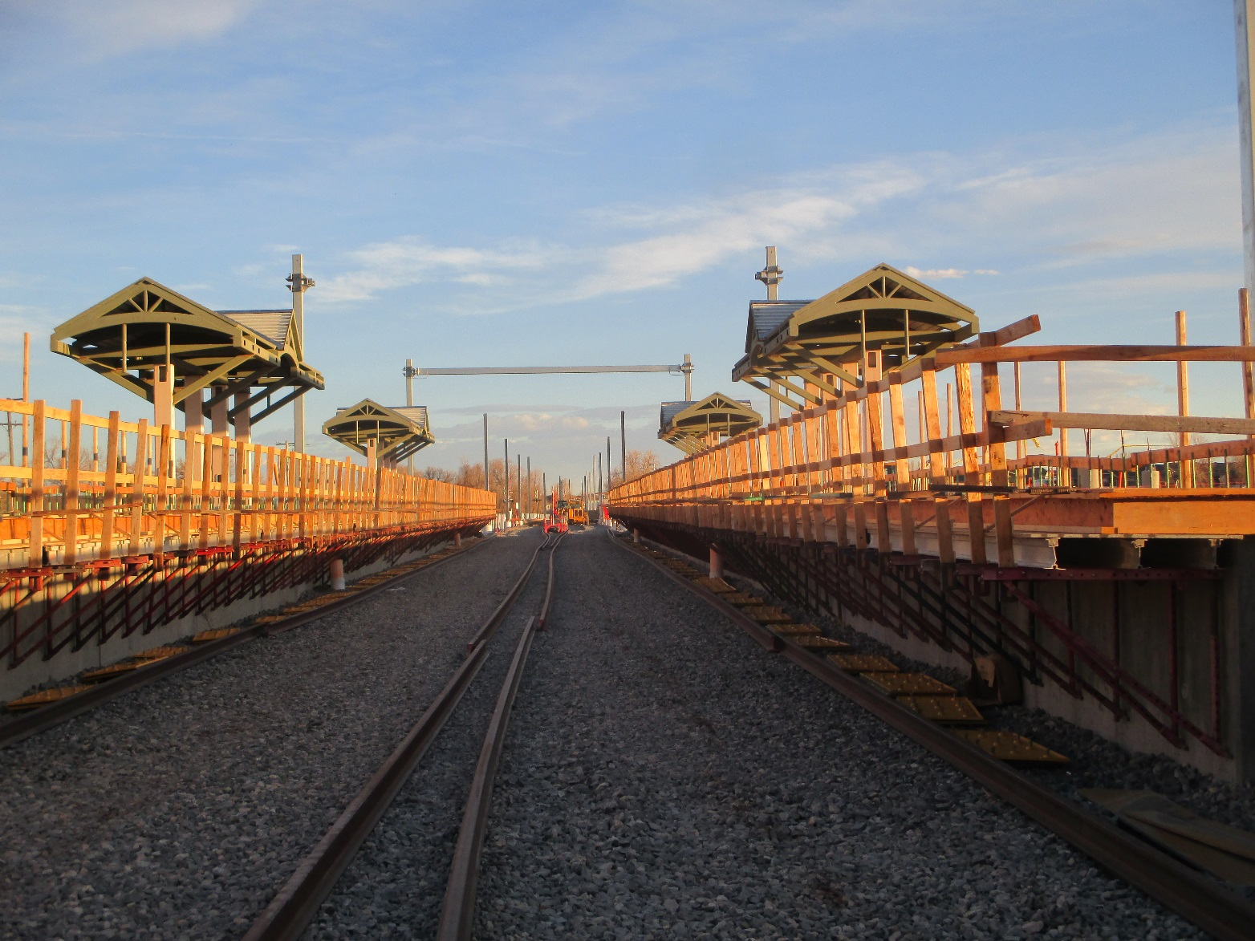
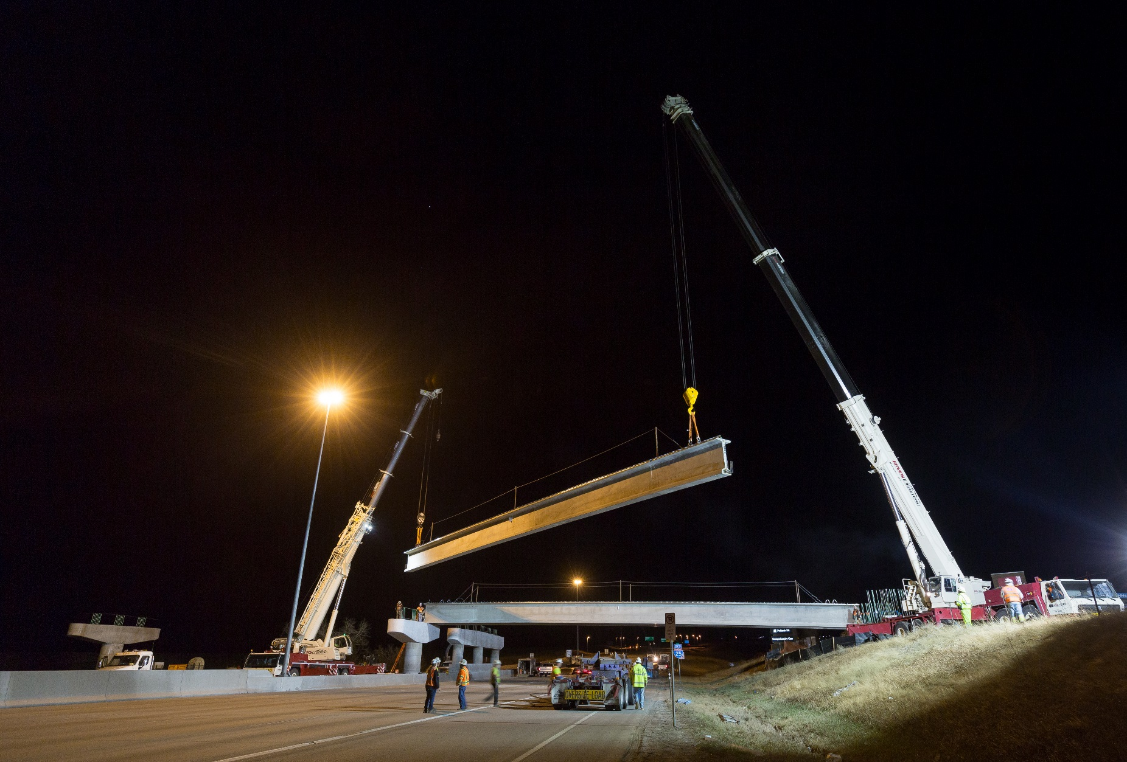
FasTracks Update
G Line – Testing
N Line – Construction
E/F/R Lines (SERE) – Construction

Slide 6
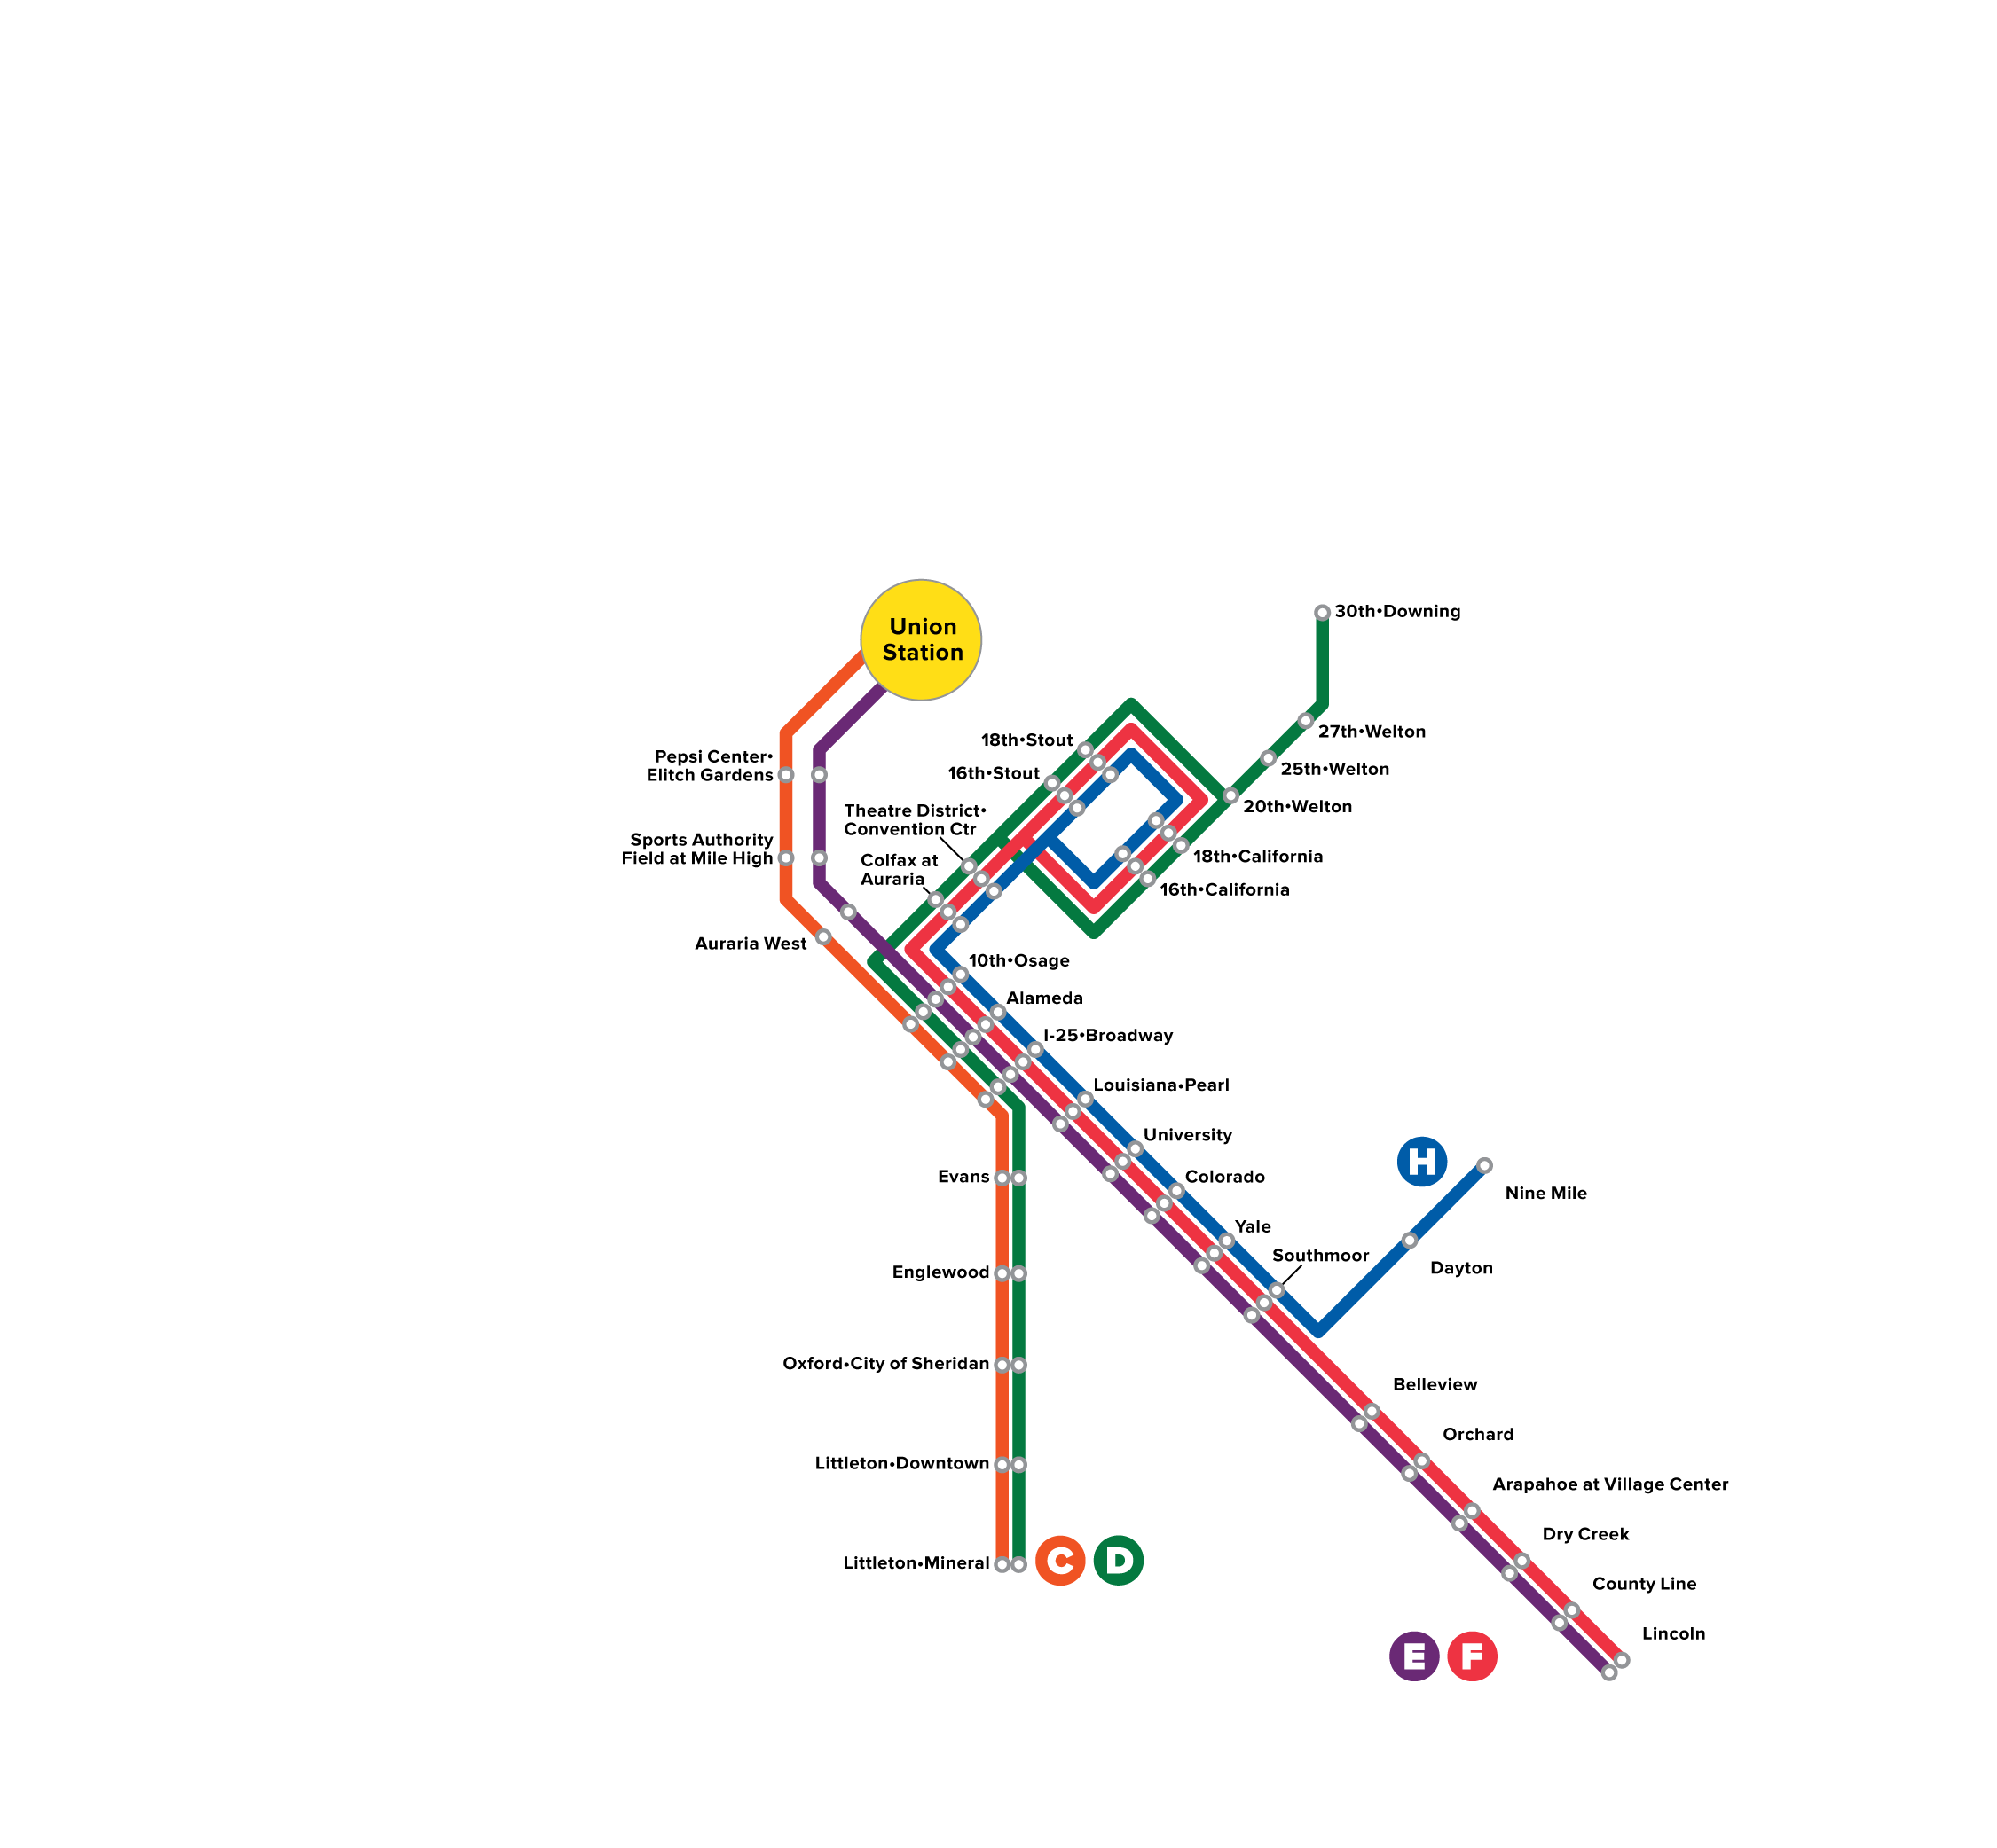
System Map 2013 - 2019

Slide 7
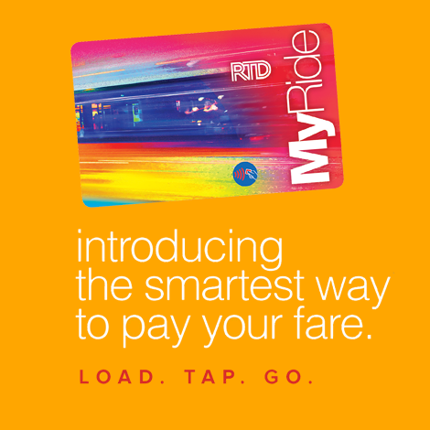
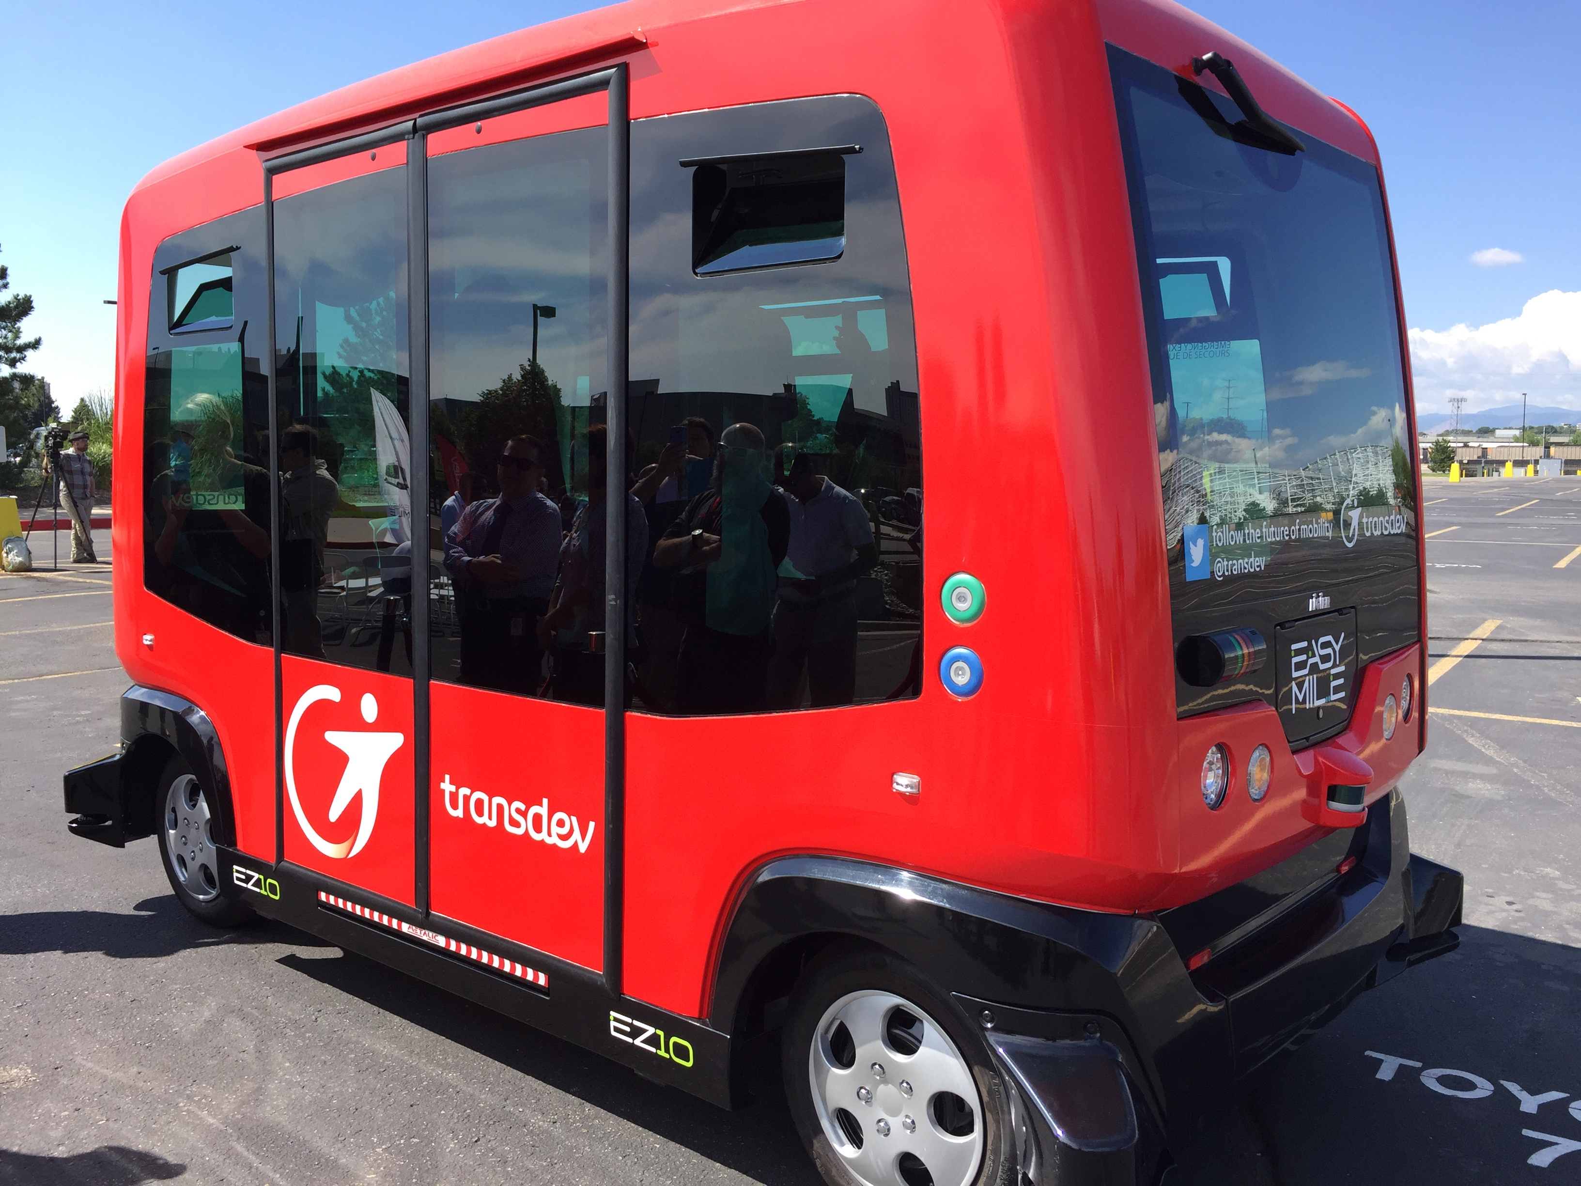
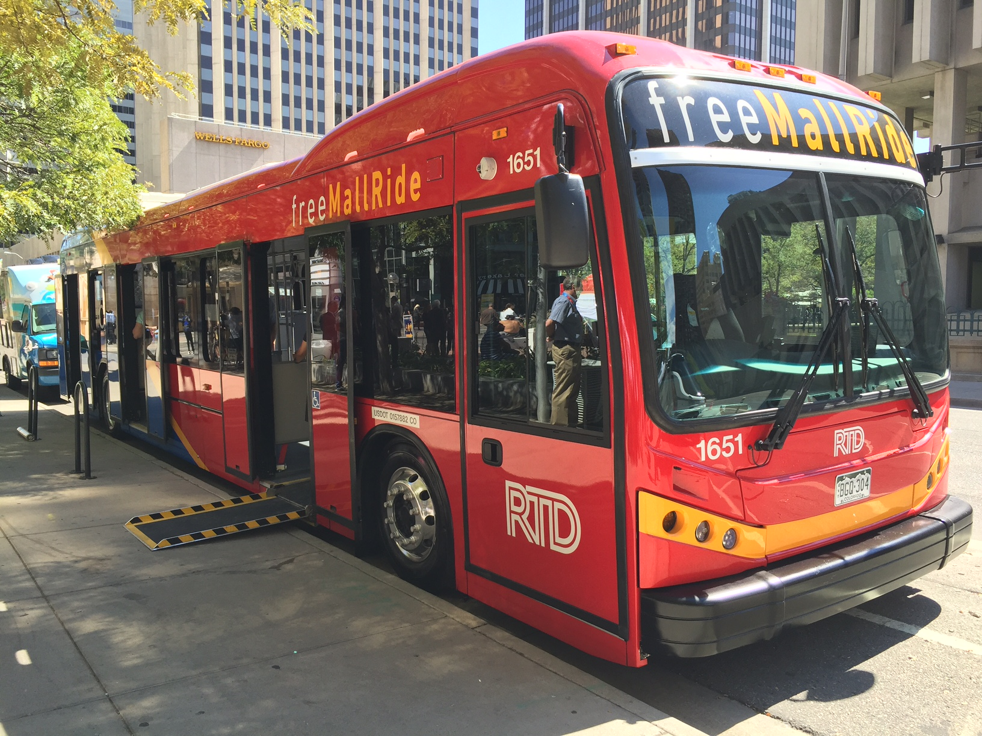
Other Updates
Stored-value smart card
AV demonstration
36 bus all-electric 16th Street Mall Fleet
16th Street Mall process
Pass Program Working Group
Renovated Civic Center
Mobile ticketing
RFI – mobility on demand
New improved real-time bus and rail information (Trip Planner, Next Ride)

Slide 8
DAVE GENOVA GM & CEO
REGIONAL TRANSPORTATION DISTRICT Denver, Colorado

