Slide 1
Asset Management Team
Regional Transportation District
1600 Blake Street, BLK-40 | Denver, CO 80202
Notes:
Introductions

Slide 2
Introductions
This is a conversation
AM Team

Slide 3
Presentation Goals
Asset Management (AM)(TAM)(SGR) – What & Why
Review AM as a business process
Background – How did we get here?
History of RTD’s AM / State of Good Repair (SGR) program
FTA MAP21 TAM Final Rule Making
TAM Requirements
Discuss how Assets Deliver our agency objective

Slide 4
Asset Management is Sexy
Evidence – See video clip

Slide 5
Insert Infrastructure Video

Slide 6
RTD’s Asset Management history
Notes:
Vision from Dave Genova and Board of Directors to create Asset Management division with an SGR component. (we all have heard the news about WMATA and MBTA’s systems and how they have fallen into disrepair…) ( Its easy to think about RTD’s newest assets but its important to remember we must maintain these and the assets we have had since the 70’s to provide services – we don’t want to end up like the legacy systems)
2011 – Proof of concept pilot program proposed and accepted by the Board
2012 – MAP-21 federal regulation was signed into law
2013 – Asset Management team was assembled.
Department processes, procedures, standards, and training occurred
Data warehouses were expanded
Performance metrics were identified
2014 – Early implementation of rolling stock assessments
2015 - Facilities Maintenance and Infrastructure – First Annual Report
2016 – FTA Final Rule Making Oct 1st
Equipment and non- revenue vehicles
2017 – Audit of inventory, TAM, IS0 55000 Gap assessments

Slide 7
What is an Asset?
Any tangible item of a defined value; based on cost or criticality to service, that is owned, leased, or maintained by RTD, or a subcontractor, which may at some point after it’s useful life require a capital repair or replacement.
Notes:
Now that you have the background you may have asked yourself, What is an asset? An asset is…

Slide 8
Asset Management involves the balancing of costs, opportunities and risks against the desired performance of assets, to achieve the organizational objectives.
Source: ISO55000
Notes:
People often think of “financial asset management” when they hear AM. There are some distinct differences that are important.

Slide 9
Notes:
Now that you understand how an asset is defined and what asset management is, it’s important that we understand what the FTA’s “State of Good Repair” represents.
You will notice that I have pulled in several FTA slides because they provide the exact language used in the final rule making.

Slide 10
Shifting Perspective
“MAP-21 fundamentally shifted the focus of Federal investment in transit to emphasize the need to maintain, rehabilitate, and replace existing transit investments.” FTA
“Deciding how to best balance and prioritize reasonably anticipated funds (revenues from all sources) towards improving asset condition and achieving a sufficient level of asset performance within those means” FTA
Notes:
The FTA is shifting focus nationally from building to maintaining our transportation infrastructure.

Slide 11
Long Term Thinking
Long range vision and performance planning
Improvements, focused investments
Savings
Reduced risks
Better decisions
Notes:
Asset management encapsulates long term thinking. It is much like a 401k or retirement investments. We need a good return but at a low risk. The constant care and feeding of these accounts can over time yield great rewards. Without long-term thinking, it is easy to become over exposed to risk or lose track of the opportunities for improved performance.
Asset Management and performance improvement functions are often thought to live inside agencies and not part of a larger picture. AM is that has an regional perspective with long range vision and goals which are nationally aligned can provide additional value.
Conversation with Dave G. our CEO / Accountable Executive - He said even though we are not approving any new funding, he is willing to invest in asset management. This is because he sees it as a good investment that will return him more than it costs. Asset management is Safe, proven ideas that pay off in the long run. Its Not a get rich quick idea. Like all sound investments, you may need to come up with some capital to get off the ground. The returns are not immediate or large, but over time they add up and the risk is low.
Changing lanes on you a bit…

Slide 12
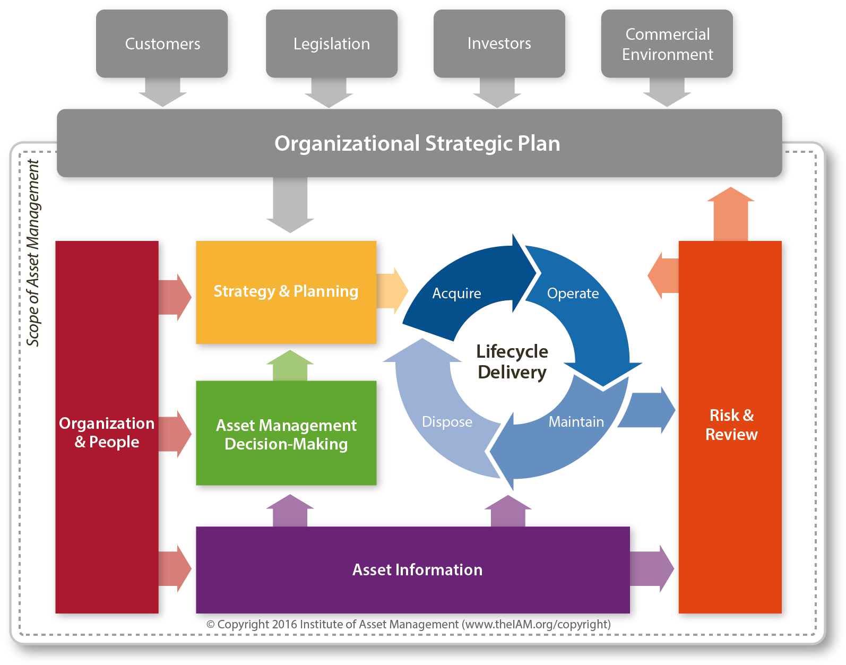
The Institute of Asset Management “Conceptual Model”

Slide 13
Notes:
Here is a video from the IAM (Institute of Asset Management) that provides an excellent overview of asset management.
Some key take always include balancing cost, risk, and performance over a specific time frame against the single line of site objective of moving people. RTD is an asset intensive organization and a coordinated activity to realize the greatest value from our assets is needed. Making the best decisions about our assets based on our primary objective and purpose support this mindset. We can improve our decision making by answering the question of how will this help us achieve our objective and purpose? Asset Management provides information to decision makers to help with that alignment and monitors and reviews past decisions to ensure we achieved desired results. All the time balancing the cost, risk and performance of our assets.

Slide 14
CFR Part 625 Transit Asset Management Final Rule
A. General Provisions
B. National Transit Asset Management System
C. Transit Asset Management Plans
D. Performance Management
E. Recordkeeping and Reporting Requirements
Notes:
The final rules are in CFR “Code of Federal Regulations” Part 625 – 633 . These are all about reducing risks and providing options

Slide 15
TAM Final Rule includes the following components:
Defines “state of good repair”
Requires grantees to develop a TAM Plan
Establishes performance measures
Establishes annual reporting requirements to the National Transit Database (NTD)
Requires FTA to provide technical assistance
TAM Rule is part of a larger performance management initiative
Notes:
What is important here is that we understand that TAM Final Rule is part of a larger performance management initiative and we have deliverables.

Slide 16
Notes:
This slide from FTA’s July 26th 2016 roundtable they see TAM, Planning and Safety Management Systems (SMS) fully integrated into business practices and RTD is well structured to fully integrate TAM into our core business practices . The common thread between ALL is more transparent data driven decisions and prioritization.

Slide 17
Timelines
Final Rule Oct 1, 2016
SGR Targets Jan 1, 2017
Initial TAM Plans Oct 1, 2018
Plan covers 4 years
Updated entirely every 4 years
Amended during the 4 years
Targets for Performance Measures
Set and reported annually for each asset class
Supported by Data (Condition, Performance and financial projections)
Reporting Inventory and Condition 2018
Narrative Report 2019
Notes:
Because of leadership commitment RTD well positioned and compliant.
Targets are set by the “Accountable Executive” Set by the FTA as the CEO/GM (Document available for review)
RTD’s involvement at “national level” – support of FTA (guidebooks)

Slide 18
Notes:
RTD is a Tier I agency.
Inventory of Capital Assets: Rolling Stock / Facilities / Infrastructure / Equipment $50K
Condition Assessments: Rate all inventoried assets TERM 1-5 score – Age, Condition, Performance
Condition assessments are only required for assets with capital responsibility
Ratings should be sufficiently detailed to monitor performance and plan capital investment
May included vulnerabilities to climate and hazards
Decision Support Tools
Process used to make prioritization decisions (estimate capital investment needs over time / assist in prioritization) Doesn’t need to be software
Investment Prioritization. Ranked listing of proposed projects and programs ordered by year planned. Prioritization local (Adequately considers – Unacceptable safety risks / accessibility requirements) Fiscally constrained based on estimated funding levels
TAM and SGR Policy
Executive level direction to support the goals of the TAM Program. Documented commitment to achieving SGR Defined TAM objectives / SMART goals / Implementation Strategy / Operational level process for implementing TAM Plan
List of Key Annual Activities / Description of actions needed to implement TAM for each year
Identification of Resources - Staff, technology requirements, funding…
Evaluation of Plan - How activities will be monitored, evaluated, and updated to ensure the continuous improvement of TAM

Slide 19
MAP 21: FTA requirements for TAMP elements
No. | TAMP Element | Description
1 | Asset inventory | All capital assets owned by agency, including equipment (construction, maintenance, service vehicles), rolling stock (rail cars, buses, ferries), infrastructure (fixed guideway, signal systems, structures, power), facilities (support, passenger, parking)
2 | Condition assessment | A rating of the inventoried assets with direct capital responsibility (age, condition, percentage of residual life, vulnerability to natural/climate hazards etc). At the individual or asset class level.
3 | Decision-making approach / support tools | List analytical processes used to make investment prioritization, does not have to be software tool
4 | Investment prioritization | A financially constrained ranked listing of proposed projects ordered by year of planned implementation, prioritized based on local policy, needs, safety risks, etc
5 | TAM and SGR Policy | The agency’s vision for TAM, SMART objectives, roles and responsibilities
6 | Implementation strategy | Operational level process for implementing TAM Plan
7 | Roadmap activities | Description of actions needed to implement TAM Plan for each year of the plan’s horizon
8 | Needed resources | Staffing, technology, funding, etc
9 | Evaluation plan for continuous improvement | How TAM activities will be monitored, evaluated, and updated to ensure the continuous improvement of TAM practices
* Source: https://www.transit.dot.gov/sites/fta.dot.gov/files/docs/TAMFinalRule_Presentation.pdf
Notes:
I’d start with an inventory. At RTD we may have laid these out in a different order but where do we start to better manager our Asset Risks? We need a complete inventory of what we own, where it is, its age, and other related asset attributes. Along with this we need to understand its condition – lets unpack condition… What about identification of resources,? We would need clarity in what our purpose is and how it aligns with nation goals. We would need a plan and strategy to deliver our objectives. Some of these are risks to our Asset Management system – your ability to manage assets and related risks to your system could be impacted if you didn’t have adequate resources

Slide 20
Annual Reporting / Records Requirements
Data Reports
Projected performance targets
System Condition and Performance Reports
Narrative Report
Change in condition
Progress toward targets
Maintain Records support TAM Plan
Share with MPO (TAM Plan, Performance targets, Investment strategies, Annual condition assessments)
Notes:
(Bring Targets / Annual report summary document)

Slide 21
Data Quality
If the quality of data is low then decisions based on this data without external input cannot exceed our level of confidence in the data.
Notes:
Agency focus towards improving the quality and availability of data will build creditability and transparency. Improve the likelihood of achieving the intended outcomes.

Slide 22
Data Work-Flow
Notes:
Here is what that looks like as a work-flow

Slide 23
“If information were the answer, we’d all be billionaires with perfect abs”
Derek Sivers
Notes:
I liked the quote from Derik Sivers – He started a company called CD Baby , you many not have heard of it but now Apple owns it. Why this quote? Now we have better information but making it actionable is where the value is. I believe this is part of the reason why better performance based planning including an asset management component is the answer to constrained budgets and increasing demands. It helps us make better decisions and get people to act.

Slide 24
Data to Information
Notes:
We often times use these two words interchangeably however we like to think that we convert data to information for decision making.
I want to touch on these quickly. With all the information out of our systems we are able to produce scores and targets.

Slide 25
Hard to read slide to make a point
Notes:
I know this slide is hard to read but I’ll bet even at a quick glance you know which Driver’s Relief Station needs work. This is where we turn all that data from information into action.

Slide 26
The Institute of Asset Management “Conceptual Model”

Slide 27
Notes:
RTD is a Tier I agency.
Inventory of Capital Assets: Rolling Stock / Facilities / Infrastructure / Equipment $50K
Condition Assessments: Rate all inventoried assets TERM 1-5 score – Age, Condition, Performance
Condition assessments are only required for assets with capital responsibility
Ratings should be sufficiently detailed to monitor performance and plan capital investment
May included vulnerabilities to climate and hazards
Decision Support Tools
Process used to make prioritization decisions (estimate capital investment needs over time / assist in prioritization) Doesn’t need to be software
Investment Prioritization. Ranked listing of proposed projects and programs ordered by year planned. Prioritization local (Adequately considers – Unacceptable safety risks / accessibility requirements) Fiscally constrained based on estimated funding levels
TAM and SGR Policy
Executive level direction to support the goals of the TAM Program. Documented commitment to achieving SGR Defined TAM objectives / SMART goals / Implementation Strategy / Operational level process for implementing TAM Plan
List of Key Annual Activities / Description of actions needed to implement TAM for each year
Identification of Resources - Staff, technology requirements, funding…
Evaluation of Plan - How activities will be monitored, evaluated, and updated to ensure the continuous improvement of TAM

Slide 28
Next steps
With Leadership investment, sustained effort and a organizational approach to Asset Management we will increase system safety and performance; while reducing risk and cost.
Notes:
The goal today was to help everyone understand the purpose of an Asset Management program, the legislation around AM/SGR and clarify some of the terms used.

Slide 29
Asset Management Team
Regional Transportation District
1600 Blake Street, BLK-40 | Denver, CO 80202
Lou.Cripps@RTD-Denver.com

