Slide 1
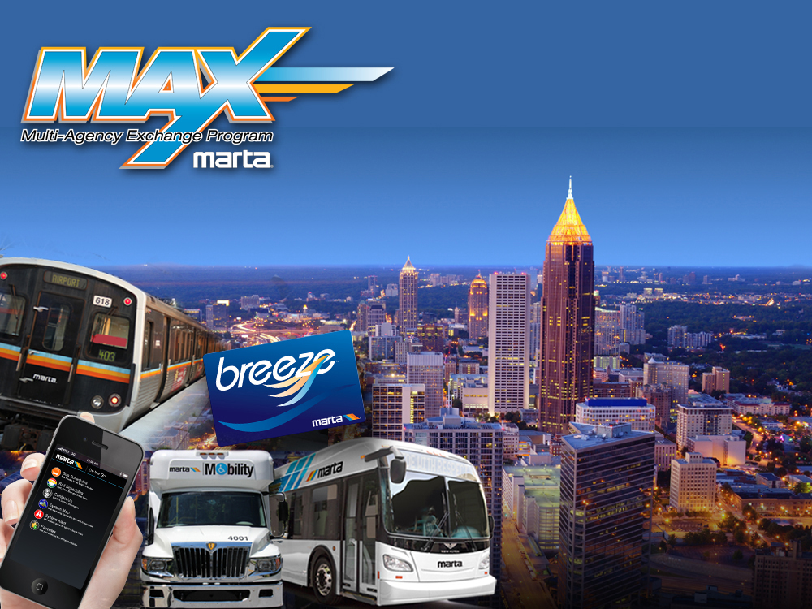
Welcome to MARTA’s Travel Training Center!

Slide 2
MARTA, Travel Training
MARTA’s Travel Training…
Who We Are
What We Do
History of the Program
Notes:
1. On November 6, 2013, MARTA launched its new Travel Training Facility. The facility and program were designed to assist customers with disabilities learn how to use MARTA’s fixed routes independently.
2. We provide transportation related services to persons with disabilities, seniors and the general population.
3. MARTA’s Travel Training initiative was funded through a New Freedom grant. Our initiative promotes greater independence and confidence for individuals with disabilities to travel anywhere within the MARTA service area.

Slide 3
MARTA, Travel Training
Travel Training Video

Slide 4
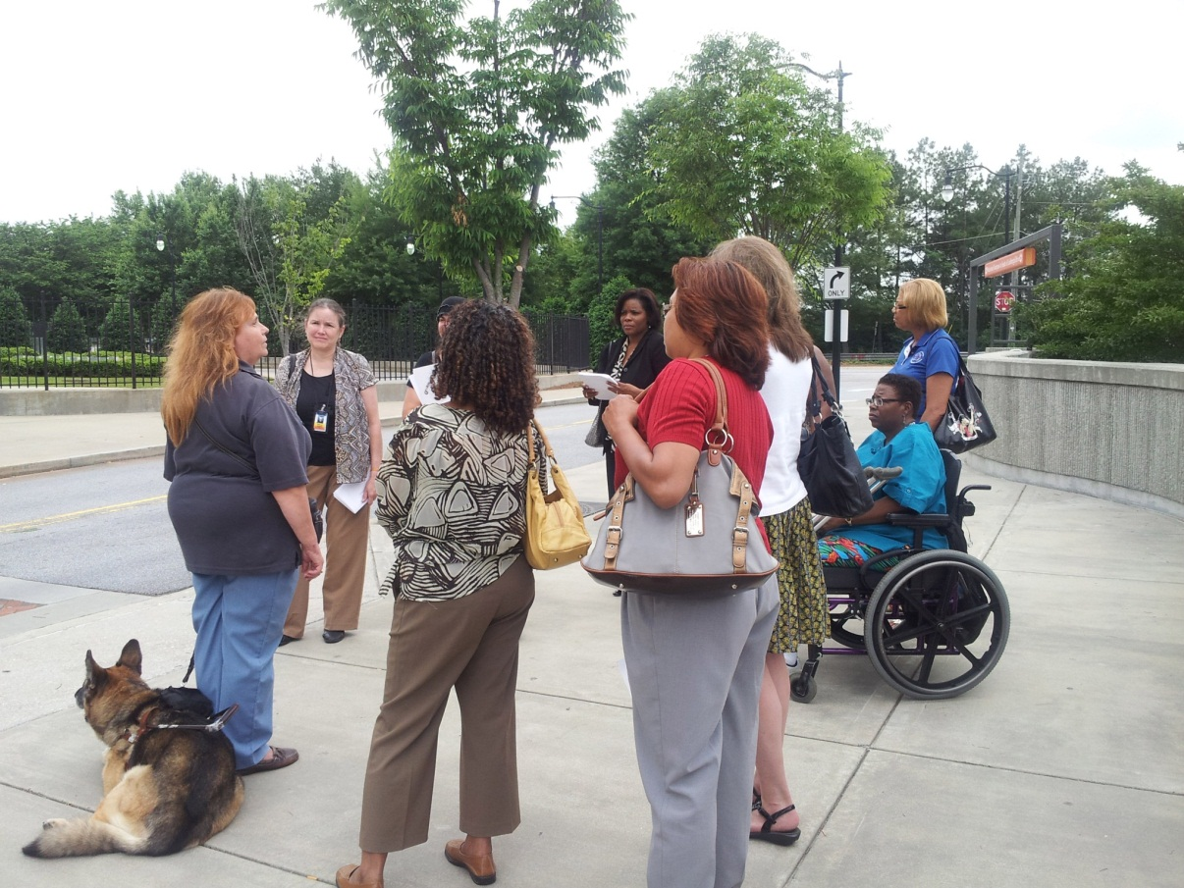
MARTA, Travel Training
Type of Training Provided
Individual or group
Real-world, classroom, or training facility
Training on one route or many
Notes:
One-on-one, Make your regular trips on MARTA buses and trains, Trainer comes to your home to help you plan your route, Trainer will ride with you, until you can confidently travel on your own.
Groups of 3 or more individuals, Learn the basics of Travel Training,Trainer will come to the specified location, Training may take place at the Travel Training Center, The basics of safety, map reading, BVM usage and trip planning are taught. Basics of Reduced Fare as well as trips to the Reduced fare Office are included in Group Training

Slide 5
MARTA’s Travel Training Application Process
MARTA, Travel Training
Notes:
1. Assessment in person…then develop an ITTP (Individualized Travel Training Plan) and a Travel Schedule. The ITTP will contain goals and objectives that meet the needs of the trainee.
2. The Travel Trainers meet with the trainee and complete an Overview of Information. This process includes completing an Emergency Plan and reviewing MARTA safety materials and brochures
3. The trainer who is assigned to the trainee will meet with the trainee and begin the process of travel training

Slide 6
Could this travel training program/facility be useful to your agency?
MARTA, Travel Training
Discussion:

Slide 7
Ride Guide to using MARTA’s System
MARTA, Travel Training
Handout:
Notes:
General Info…

Slide 8
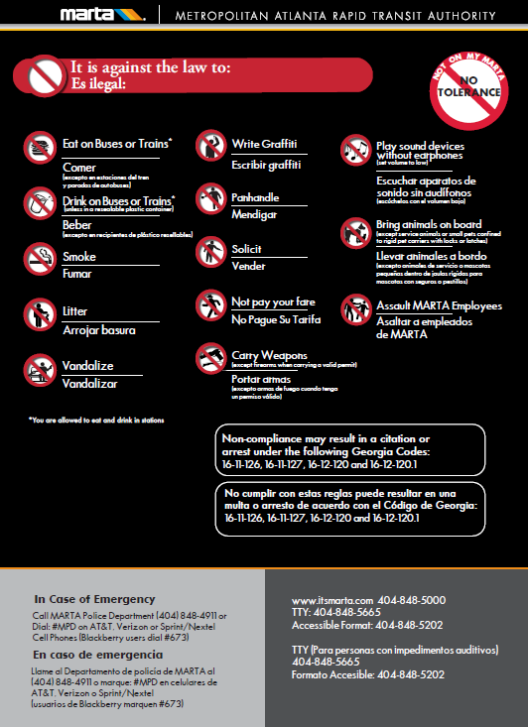
Rules of Riding MARTA
MARTA, Travel Training
Handout:

Slide 9
Safety
MARTA, Travel Training
Handout:
Notes:
We place a huge emphasis on safety during travel training. All MARTA buses and trains are accessible. Ramps and lifts are available on all vehicles. All rail stations have elevators.

Slide 10
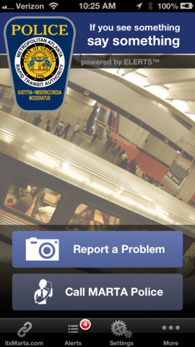
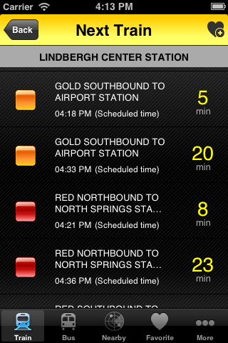
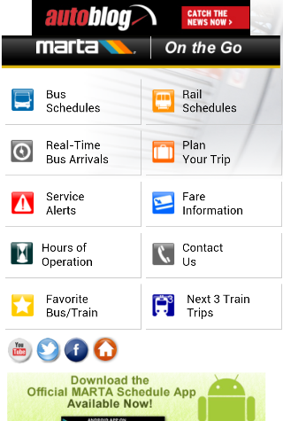
MARTA, Travel Training
MARTA See & Say App
MARTA On the Go App
Itsmarta.com On the Go
Notes:
There are many apps and web based services that allow one to access MARTA schedule information. The apps listed are available via smart phone or tablet. Explain what each app does. We use these apps extensively in training.

Slide 11
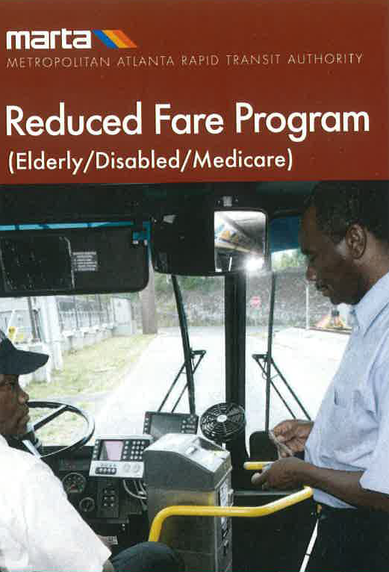
Reduced Fare Brochure
MARTA, Travel Training
Handout:
Notes:
MARTA services for the elderly, disabled or those with Medicare are discussed during training sessions.

Slide 12
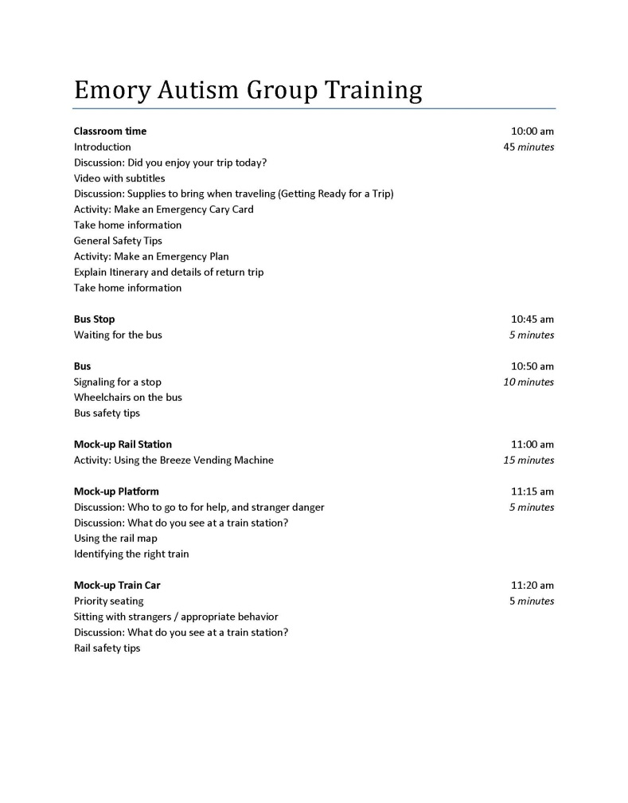
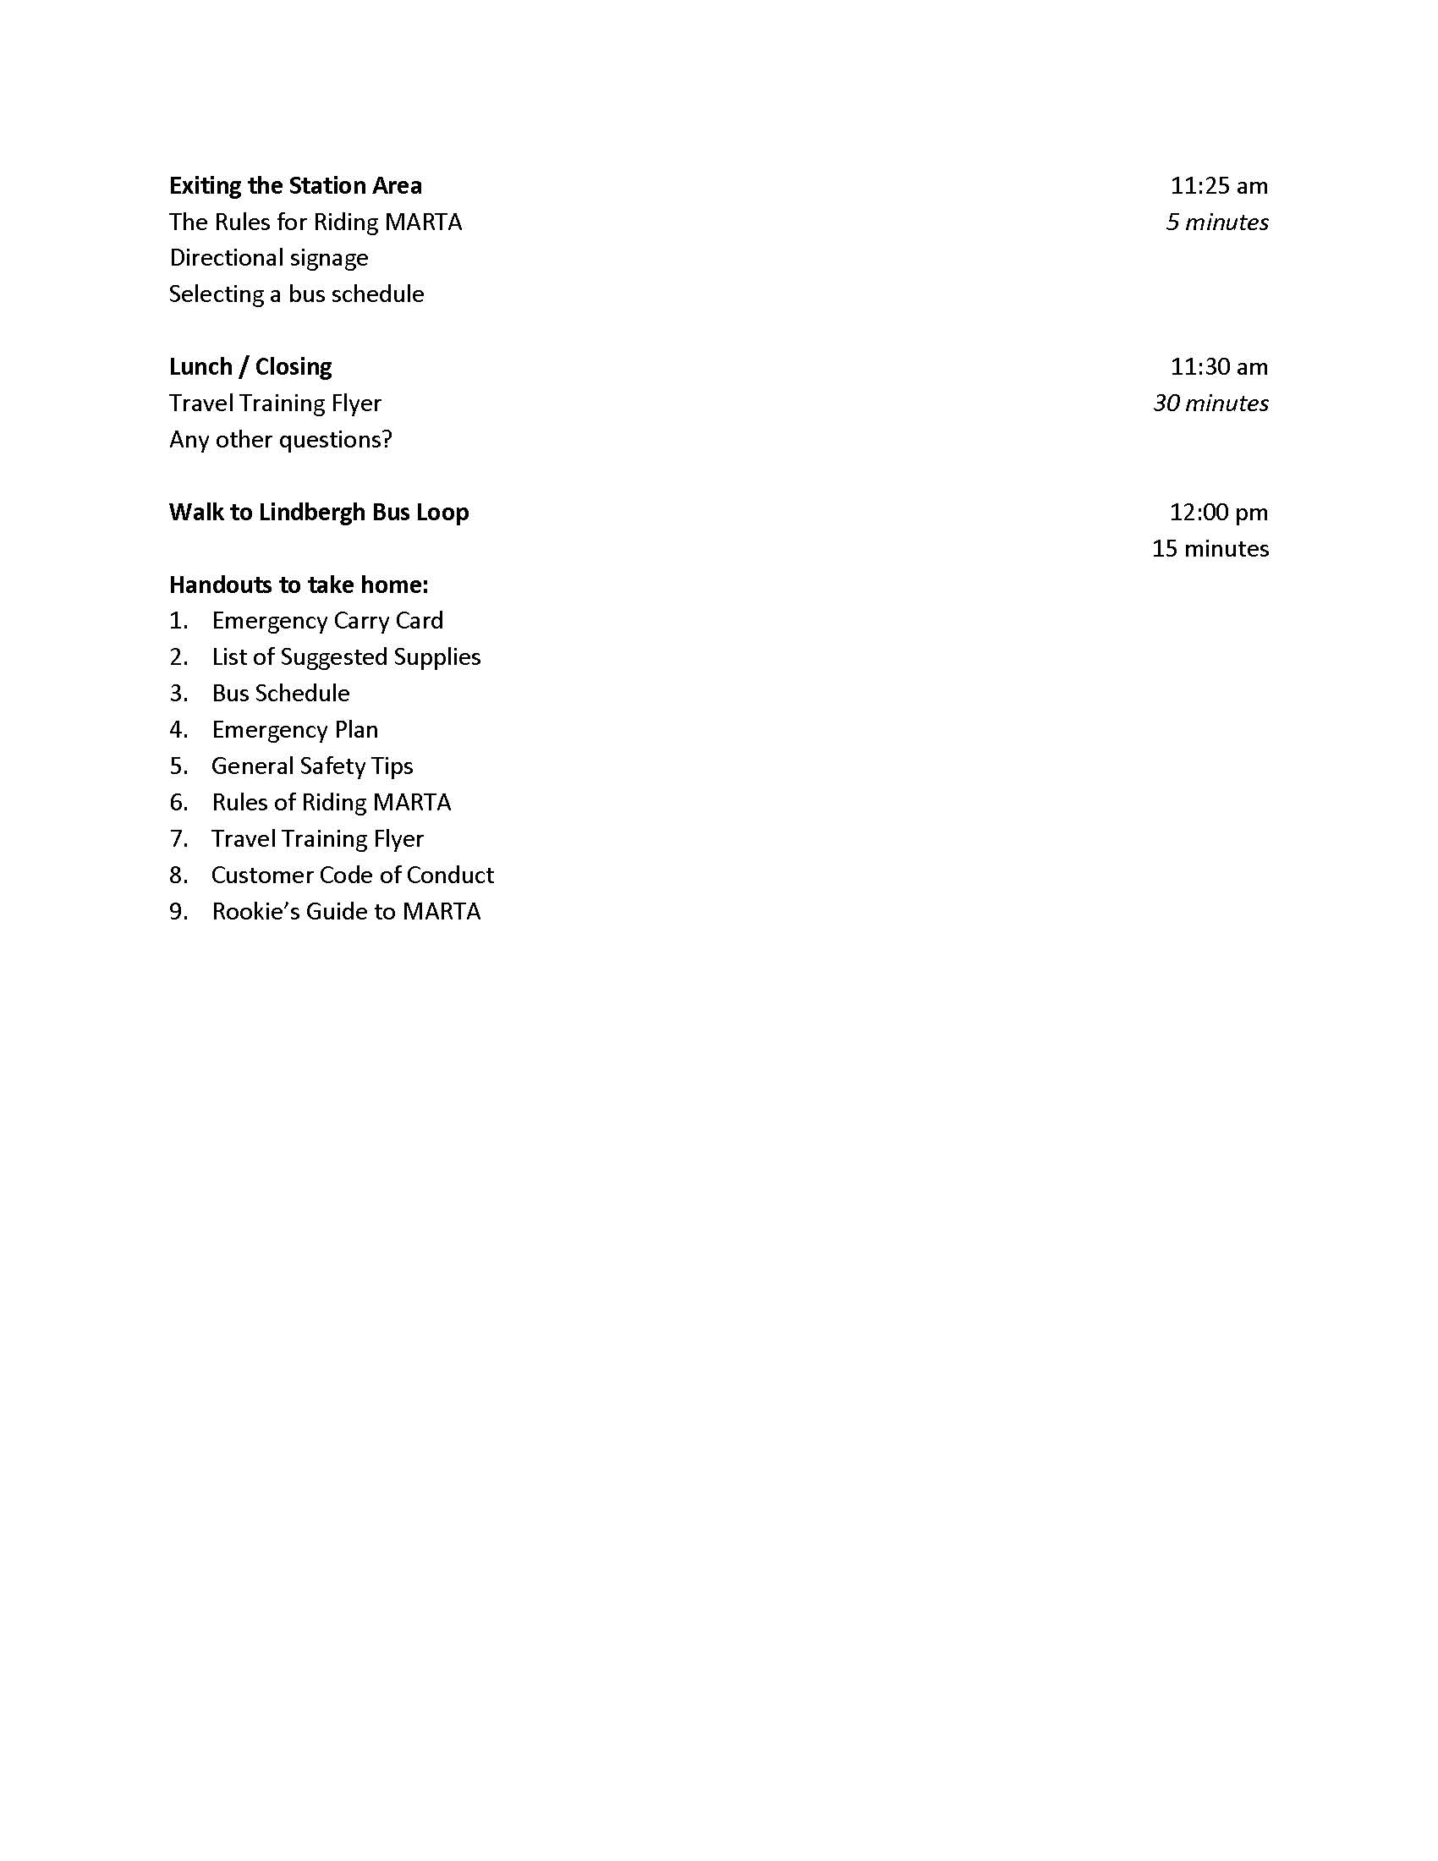
MARTA, Travel Training
Sample of an agenda used for group training:
Notes:
I have given you a sample agenda for group training. This is what we do when a group comes into the center for training.

Slide 13
Travel Training Flyer
MARTA, Travel Training
Handout:
Notes:
Here’s a Travel Training Flyer for you take with you….The flyer is an overview the Travel Training program. If you want more information, there’s a phone number for you or you to call.

Slide 14
Thank you!
MARTA, Travel Training
We appreciate that you have taken the time to visit with us today. If you need assistance with anything we discussed today, don’t hesitate to call MARTA’s Travel Training Center at, 404-848-5193.
Notes:
Answer any additional questions…

