Slide 1
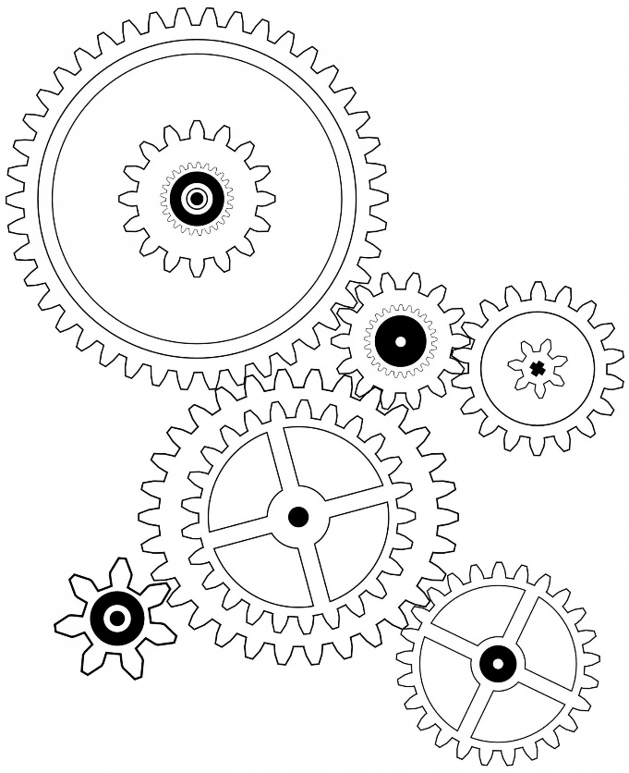
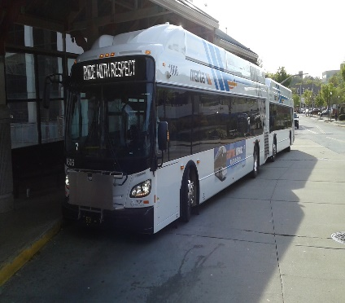
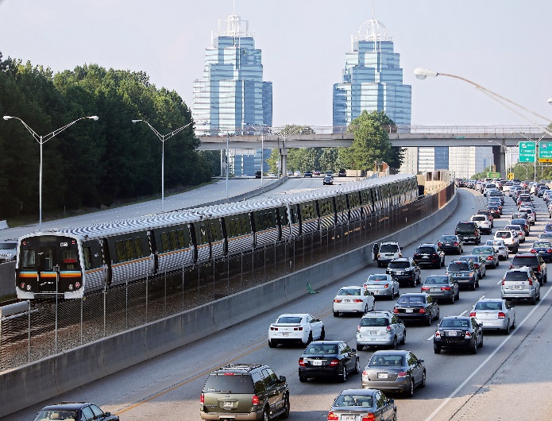
SAFETY & QUALITY ASSURANCE
PRESENTED BY
ELAYNE BERRY, AGM
Department of Safety & Quality Assurance
May 18, 2017

Slide 2
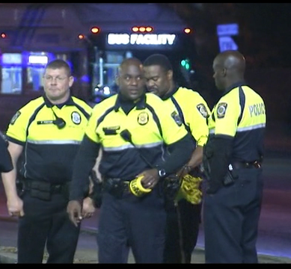
Safety vs. Security
freedom from harm resulting
from UNINTENTIONAL acts or circumstances
GOAL:
Provide the highest level of safety that is practical
BUS EXAMPLES: Person caught in bus doors
RAIL EXAMPLE: Person falling on escalators or stairs
freedom from harm resulting
from INTENTIONAL
acts or circumstances
GOAL:
Reduce the rate of crime and the fear of crime
RAIL EXAMPLES: Trespassers, suicide/
attempted suicide
SECURITY
SAFETY

Slide 3
The Department of
Safety & Quality Assurance
Safety and QA: What’s the Connection?
DSQA
System Safety Programs
Operational Safety
Configuration Management
Quality Assurance

Slide 4
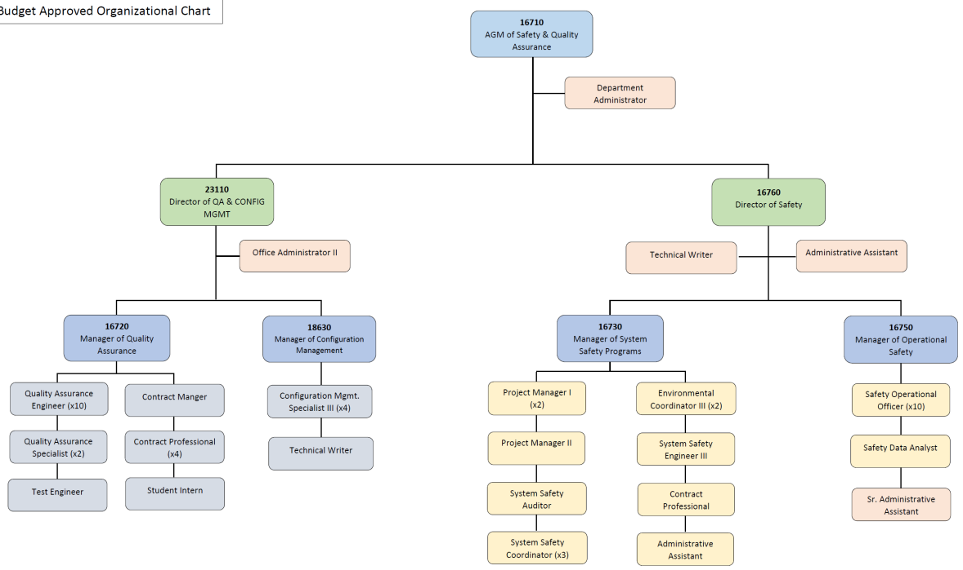
FY2017 DSQA Organization Chart
56 Full-Time Employees
Safety: 25
QACM: 26

Slide 5
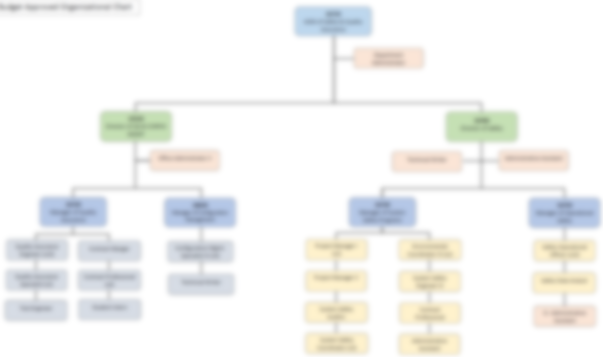
Mission, Vision & Core Beliefs
Identify, measure, control,
and continuously improve mission critical processes
Mission
Vision
Create a closed-loop safety & quality assurance culture
Educating Employees
Accountability
Measure It
CMDB-Based Repository
Everyone Should Make It Home Safely
Core Beliefs

Slide 6
Office of the AGM
The Assistant General Manager (AGM) of DSQA is responsible for:
direction and sustainability of DSQA
ensuring safety and quality goals and objectives are met

Slide 7
DSQA Offices
OPERATIONAL SAFETY (OS)
● Manages Accident/ Incident Program Plan
● Identifies Unsafe Conditions & Trends
● Eliminates Hazards
SYSTEM SAFETY PROGRAMS (SSP)
● Manages Compliance With Regulatory Requirements
● Develops Safety Plans
QUALITY ASSURANCE (QA)
● Manages Quality Assurance Program Plan
● Ensures Properties are Designed & Installed Properly
CONFIGURATION MANAGEMENT (CM)
● Manages Configuration Management Program

Slide 8
DSQA Goals & Objectives
Safety
Quality Assurance
Maximize Safety Programs & Business Continuity
Comprehensive Safety Dashboard
Expand ISO 14001:2015 to 5 Total Locations
Develop Effective Partnerships to Proactively Mitigate/ Eliminate Hazards
Benchmarking & Measuring Contract Oversight Performance
Improvement of Bus/Rail Customer Satisfaction
Improve Employee Safety
Visualization of Progress Towards Performance Goals & Objectives
Ensure Contractual Compliance
Improvement of Bus/Rail Facility Operations

Slide 9
DSQA Deliverables
Safety
Quality Assurance
GDOT Tracking Logs (Hazard and Internal Audits)
Station & Facility Safety Inspection Reports
Accident/Incident Weekly Reporting
Environmental Audit Reports
Safety Educational Materials (i.e. Toolbox Topics)
Safety Hotline Log & Resolution
Contract Feedback & Adherence Monitoring
Ride Along Survey Reports & Feedback Loop
Dashboard Performance Management
Test Witnessing & Subject Matter Expertise
Operational Support via Audits, Inspections, Corrective Actions, & Root Cause Analysis

Slide 10
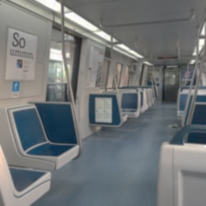
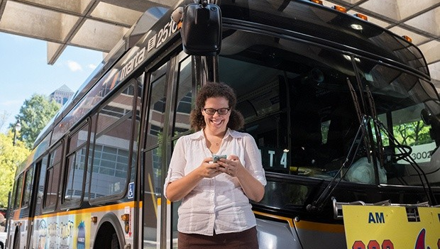
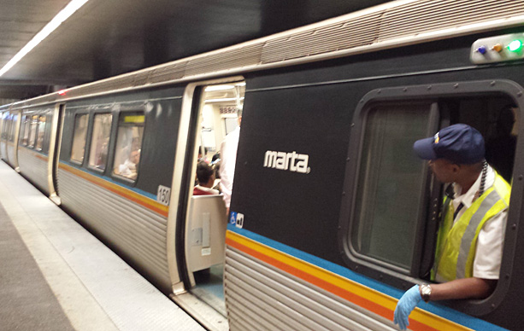
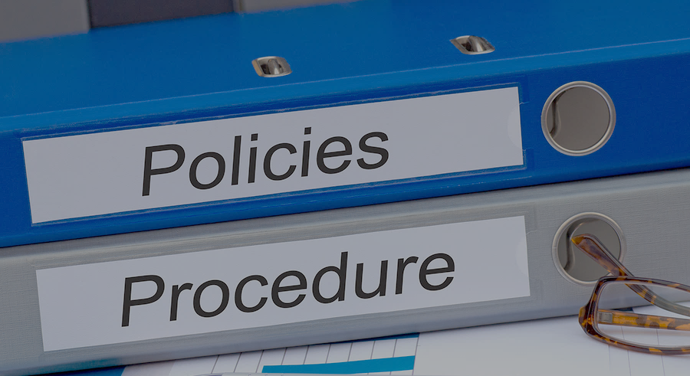
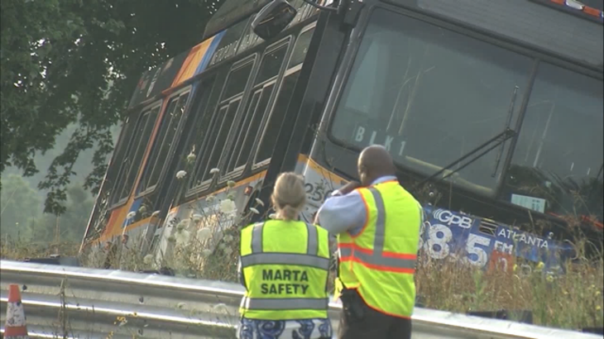
Staffing & Activities
DSQA WORKS 24/7
DSQA PROTECTS PATRONS & EMPLOYEES
DSQA
INVESTIGATES & EDUCATES
ONCALL

Slide 11
FY2017 DSQA Staffing & Activities
System Safety
Activities
Operational Safety Activities
Safety Staffing
(21 Total)
Managers: 3
Administrators: 3
Data Analysts: 1
Safety Officers: 8
Safety Engineers: 1
Environmental Professionals: 2
Safety Coordinators: 3
Review New System Documents
Safety Certification
Construction Safety Oversight
Industrial Safety Inspections
Safety Awareness Training
Deliver Employee Safety Training
Facility Safety Inspections
System Modification Oversight
Accident/Incident Investigation
Accident Grading

Slide 12
FY2017 DSQA Staffing & Activities
Configuration Management
Activities
QA & Configuration Management Staffing (26 Total)
Quality Assurance Activities
Managers: 3
Administrators: 1
Test Engineers: 4
Quality Assurance Engineers: 11
CM Specialists: 4
QA Specialists: 2
Business Intelligence Analysts: 1
Audits, Assessments, Tests, and Inspections for Safety Practices
Identify Safety Concerns on Incoming Products
Test Oversight
Compliance Checks for Adherence to Safety Policies and Standards
Tunnel Ventilation Plan & CAD Review
Supply Infrastructure Engineering Resources
Review of Drawings Early & At All Major Milestones
Train Control System Upgrade
Library of Infrastructure Assets & Legacy Data

Slide 13
SAFETY & QUALITY ASSURANCE
The Path Going Forward
Continuous Improvement
(QACM)
Mitigate Risks
(Safety)
Evaluate Risks
(Safety)
Process Design
(QACM)
Measuring Process Performance
(QACM)
Identify Hazards
(Safety)

Slide 14
Thank You
QUESTIONS?

