Slide 1
MARTA Revenue Operations

Slide 2
The Office of Revenue Operations
Garnett Overview
Responsibilities
Security Measures
Cubic Contract

Slide 3
Branches of Revenue Operations
Revenue Administration
Maintenance Oversight
Revenue Collection
Revenue Processing
Media Encoding
Media Sales
Revenue Settlement/Clearinghouse
Ride Stores

Slide 4
AFC Equipment and Applications
Automated Fare Collection system (AFC)
Equipment
AFC Reporting systems

Slide 5
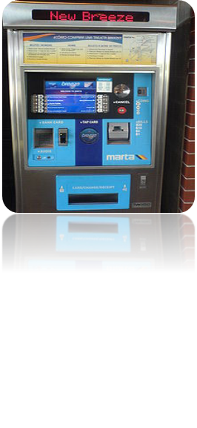
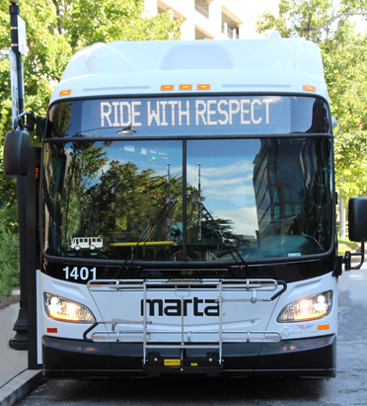
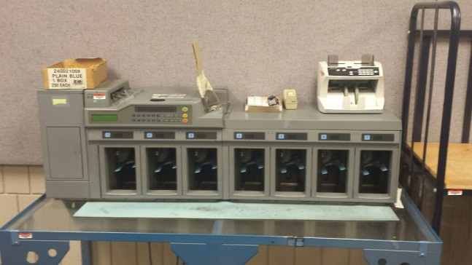
Garnett Cash Handling Overview
Staffing
Facilities
Revenue Serviced

Slide 6
Revenue Statistics
Daily Average
Annually Average
Other Revenue

Slide 7
Questions?

