Slide 1
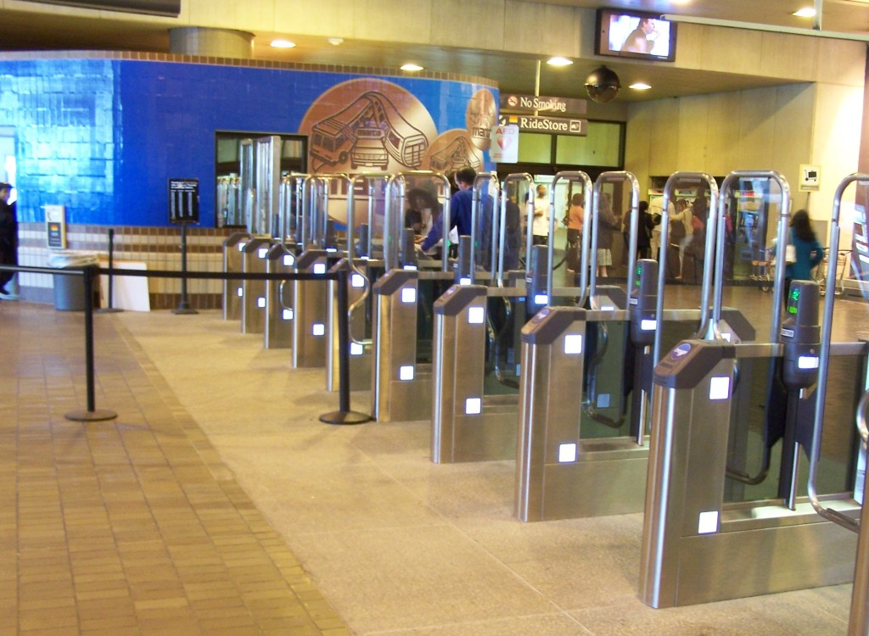
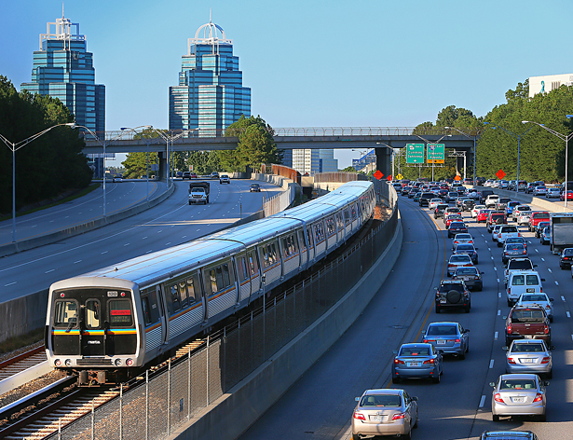
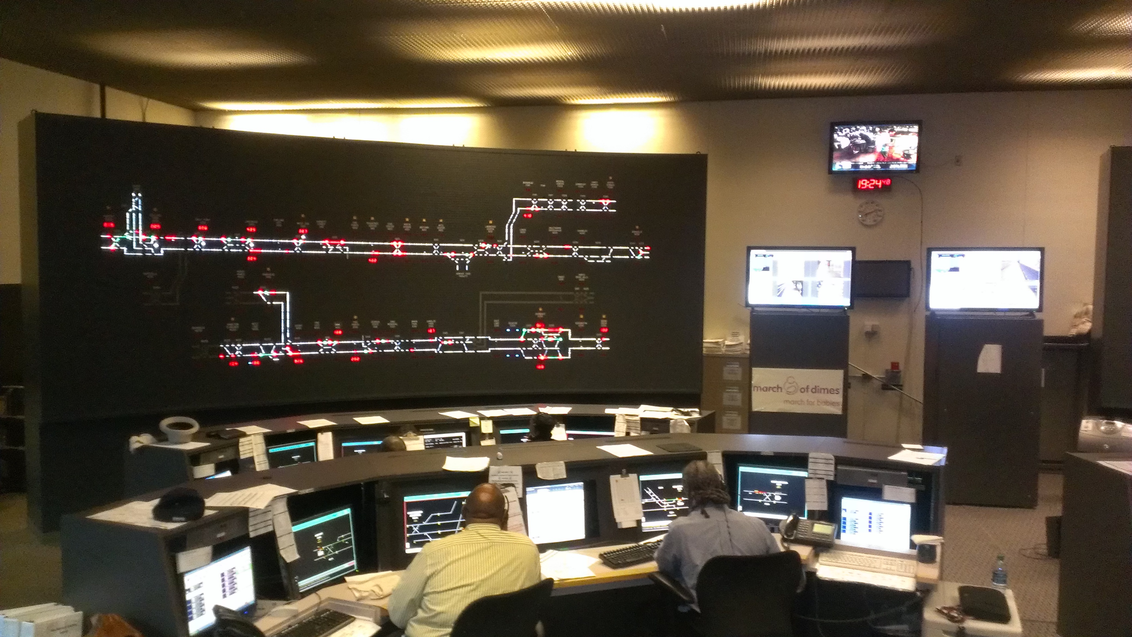
Rail Transportation
And Station Services
4DX Physical Scoreboards

Slide 2
Rail Transportation and Station Services WIG
Defined as:
Wildly important goal:
Reduce Absenteeism by 1%
from 6% to 5%
by June 30,2017

Slide 3
Current Attendance Score for Rail Transportation
Current Attendance Score for Rail Transportation and Station Services is :
4.69%

Slide 4
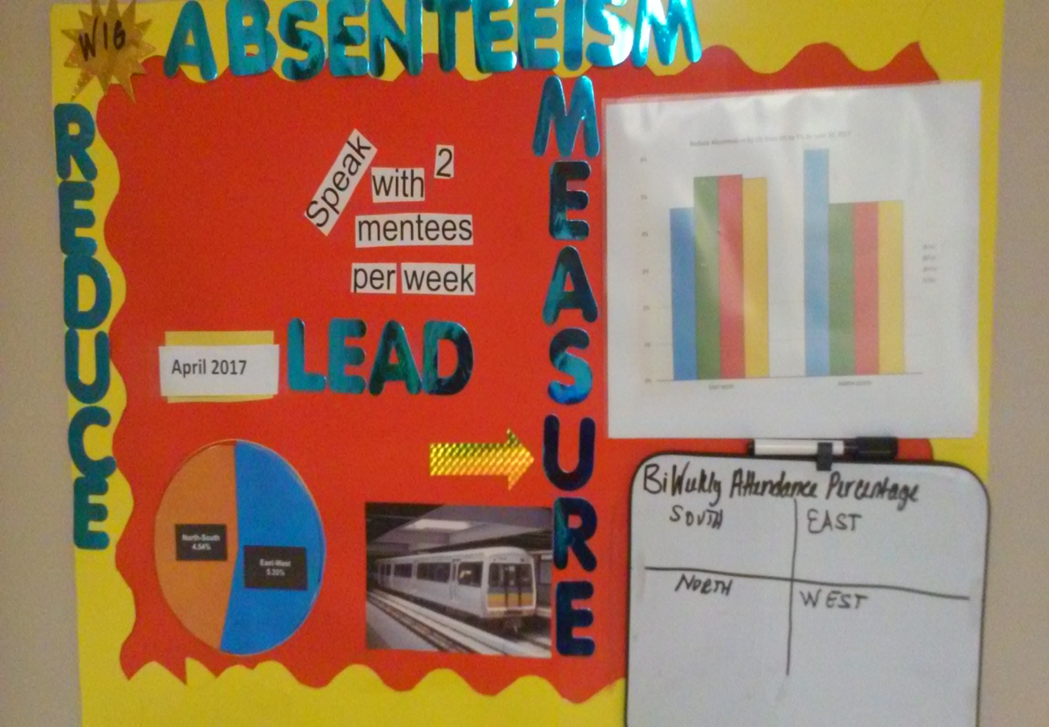
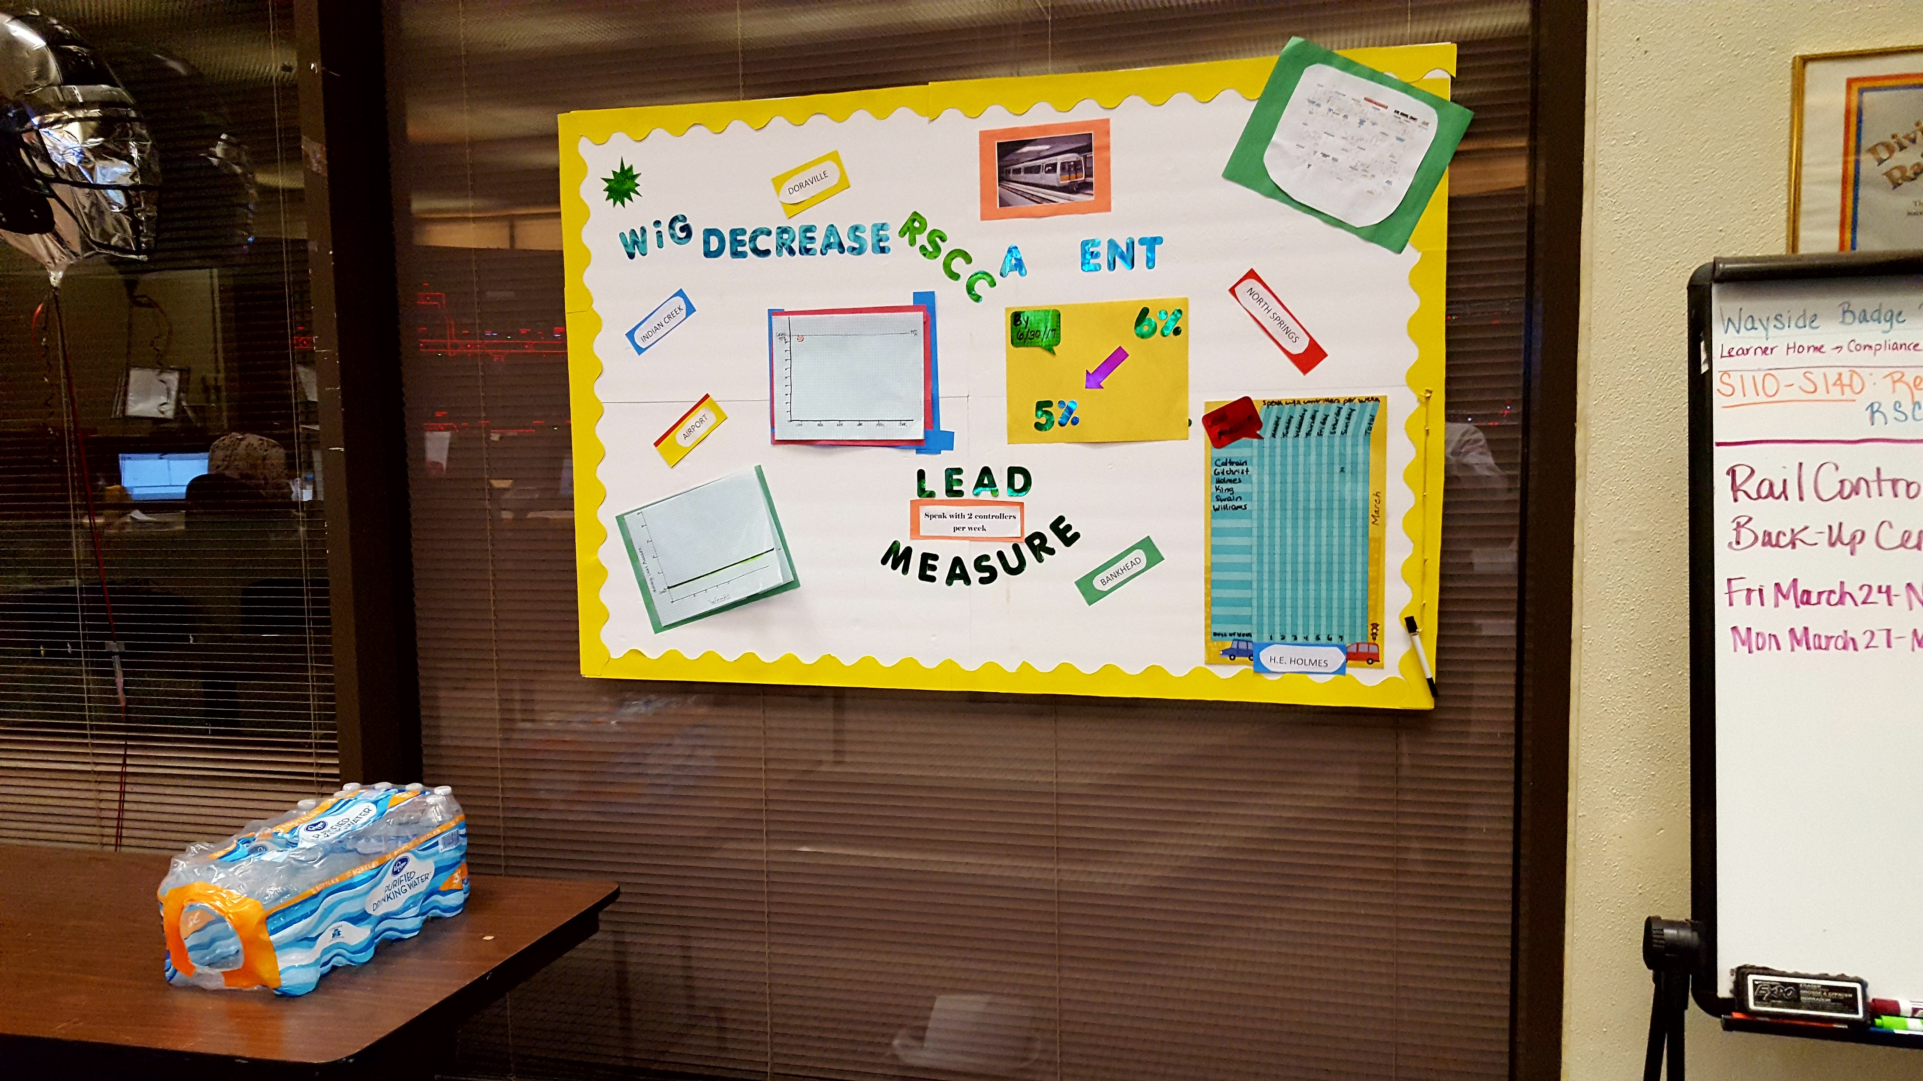
Location of Score boards
Indian Creek
Airport
Bankhead
RSCC Avondale

Slide 5
Scoreboard analysis for Bankhead
Solution: New location needed for better impact.

Slide 6
Scoreboard analysis for Airport
Corrections needed:
Missing WIG format: Reduce absenteeism by 1% from 6% to 5%.
Reason: Scoreboard too small
Solution: Move location in breakroom to opposite wall and make score bigger. Add correct format for WIG: X to Y by When.
Graph colors should only have Red and Green. This makes it easy to determine if they are winning or losing.

Slide 7
Rail Service Control Center
Line graphs need to be updated more frequently.

Slide 8
XPS Status
Weekly WIG Meetings are being held by all teams
Field Supervisors are speaking with Mentees
Current XPS: 75%

