Slide 1
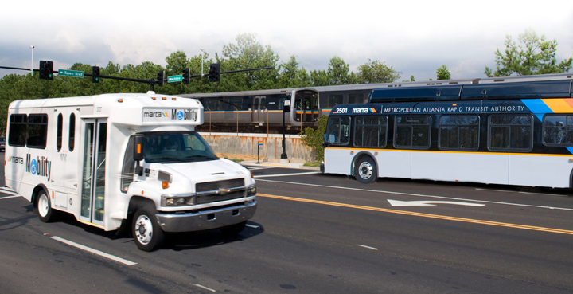
Multi Agency Exchange
May 16, 2017

Slide 2
Comprehensive Operations Analysis

Slide 3
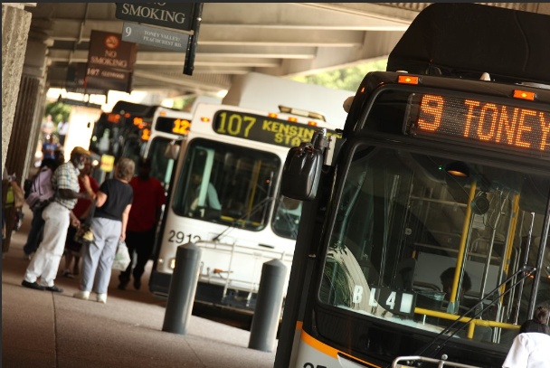
Comprehensive Operations Analysis
Comprehensive Operations Analysis
Improve transit operations efficiency
Identify alternative services
Improved service to current riders
Attract “choice” riders
Develop sustainable future service plans
Connect communities

Slide 4
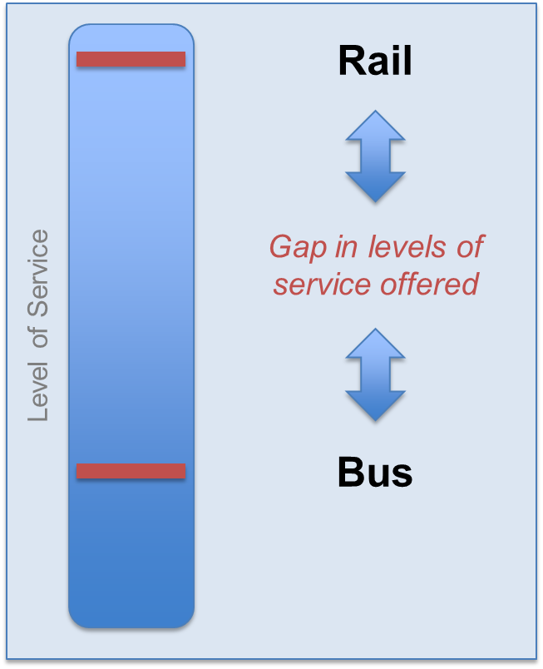
Comprehensive Operations Analysis
MARTA Bus Service Today
Two tiers of service
Significant gap between rail and bus
Rebrand bus network to attract “lifestyle” markets

Slide 5
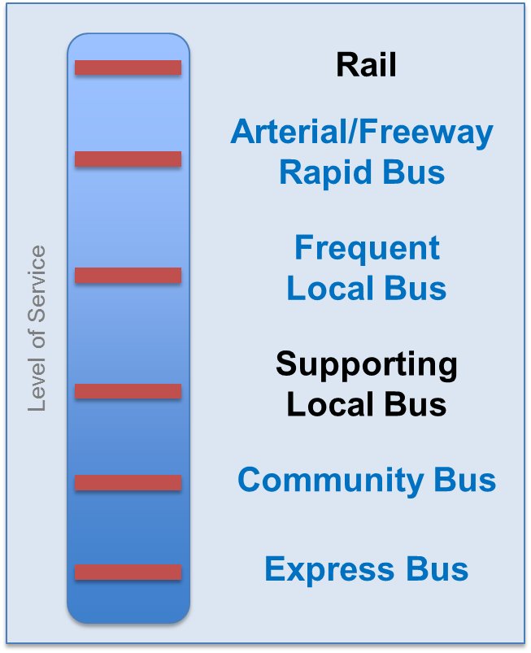
Comprehensive Operations Analysis
MARTA Bus Service Tomorrow
Two tiers of service
Significant gap between rail and bus
Rebrand bus network to attract “lifestyle” markets

Slide 6
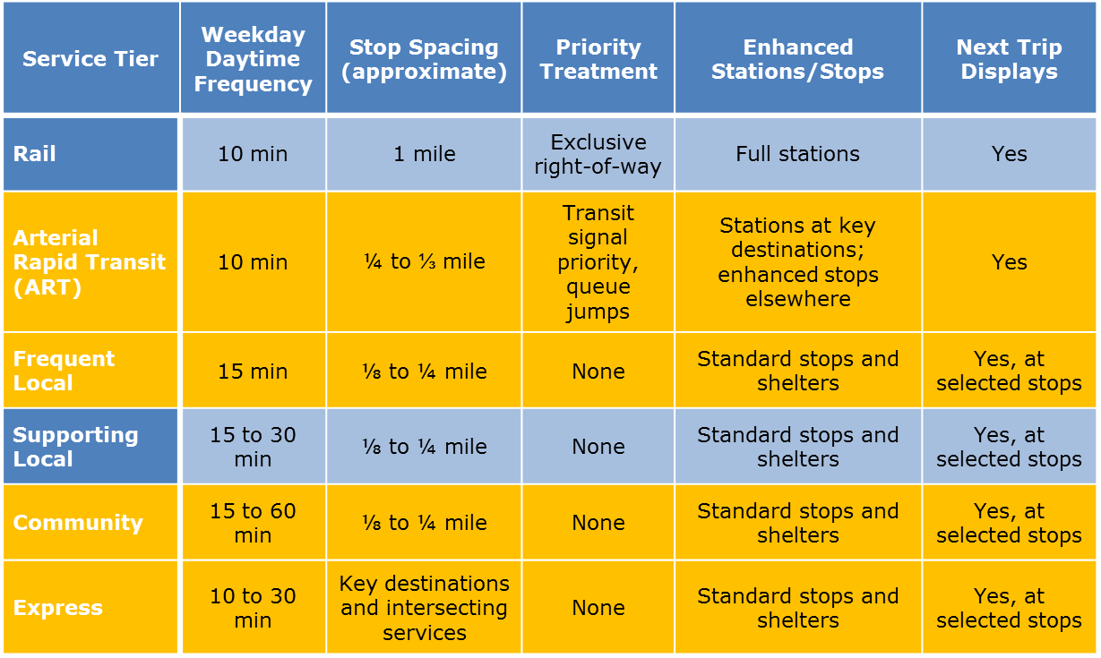
Comprehensive Operations Analysis
Future MARTA Bus Service

Slide 7
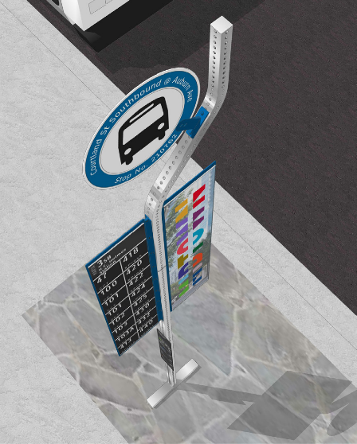
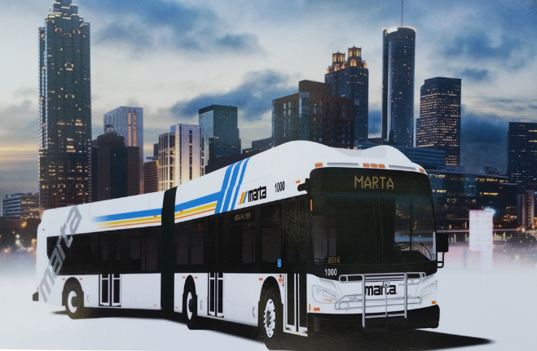
Comprehensive Operations Analysis
COA Recommendations: Bus
10 Arterial Rapid Transit
5 Express Routes
10 Circulators
17 Frequent Local
(15 min or less)
46 Supporting Local
(30 min or greater)

Slide 8
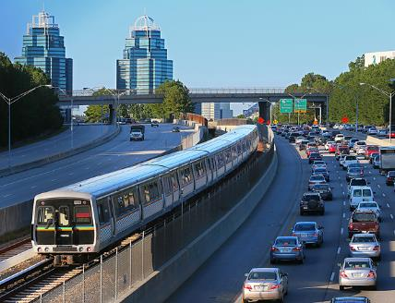
Comprehensive Operations Analysis
COA Recommendations: Rail
Maintain at least the 10 minute headways all day
Improve headways during peak periods
Improve wayfinding
Push forward with rail expansion

Slide 9
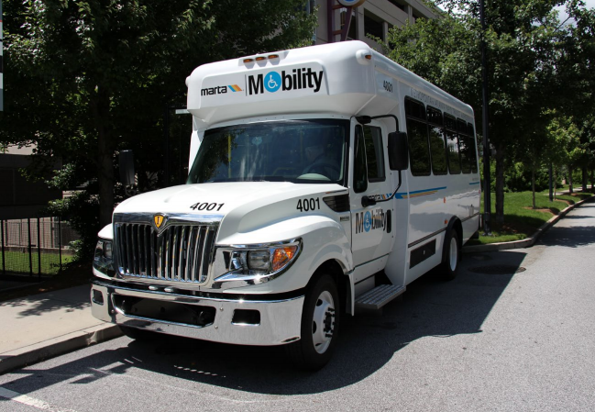
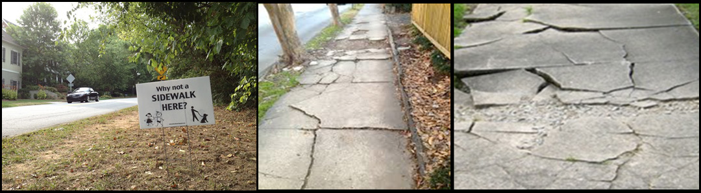
Comprehensive Operations Analysis
COA Recommendations: Mobility
Provide supplemental services to address demand peaks
One Stop Call Center
Promote Department of Human Services coordination
Work with local governments to improve sidewalks

Slide 10
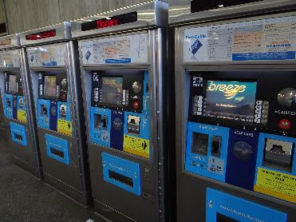
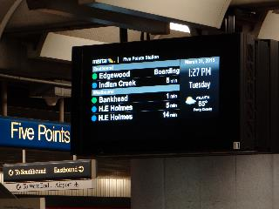
Comprehensive Operations Analysis
COA Recommendations: Others
Add new maintenance facility in northern area of region
Consider replacing current trip-based basic fare program with time-based

Slide 11
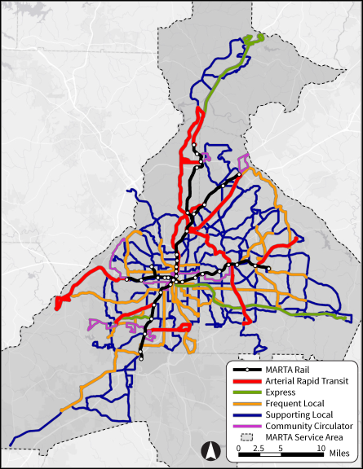
Comprehensive Operations Analysis
Put It All Together

Slide 12
More MARTA

Slide 13
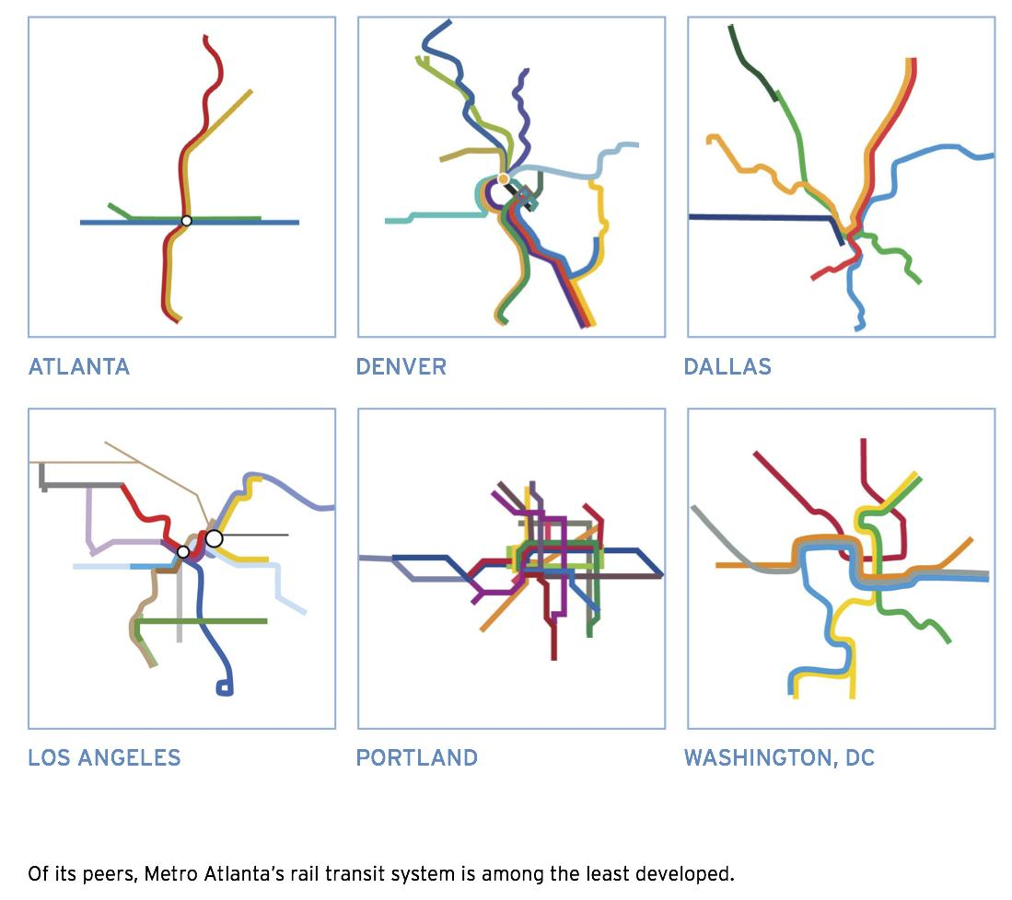
More MARTA
MARTA System

Slide 14
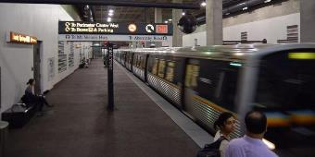
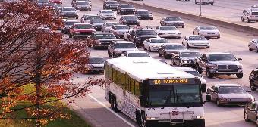
More MARTA
MARTA Sales Tax
Purpose is to significantly expand MARTA transit service
Receipts projected at $2.5 billion (2017$) over life of the tax
Project list approved
  MARTA Board of Directors (May)
  City of Atlanta City Council (June)
November 8 approval (71%)
Notes:
MARTA based its recommendations for the list of potential projects being presented today on the following criteria:
Deliver equitable service improvements and other benefits to communities across the city.
Support fast, efficient service by prioritizing transit investments in dedicated guideways.
Create a layered, integrated transportation network designed to accomplish specific kinds of trips or tasks.
Focus on investments that will shape future growth to create a more livable Atlanta.
Prioritize service needs and opportunities inside the City of Atlanta while laying a foundation for a more robust regional network.

Slide 15
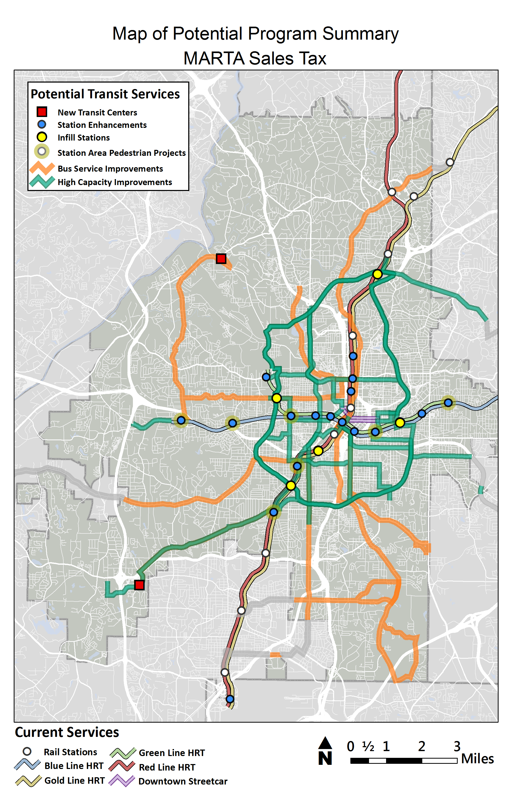
More MARTA
Potential Program Summary
Notes:
This summary map of potential projects illustrates the multimodal connections to ensure efficient connections between heavy rail, light rail, and bus service and improved pedestrian access; equitable distribution of projects; and a comprehensive transit network that balances need for investment in system expansion and for maintaining the existing system in a state of good repair
Rail:
30 miles of City of Atlanta Light Rail
(BeltLine Loop & Connectors)
2 miles of I-20 W Heavy Rail
7 miles of Northside Dr. Bus Rapid Transit
2 miles of Clifton Corridor Light Rail
3 miles of I-20 E Bus Rapid Transit
Infill Stations (5 stations)
Station Enhancement (17 stations)
Additional Rail Cars
Bus
5 Arterial Rapid Transit routes
2 Transit Centers - Greenbriar & Moore’s Mill
15-minute peak; 30-minute off-peak service on Routes 12, 49, 51, 55 and 60
Increased service during off-peak
Community circulator service
Pedestrian/ADA/Bicycle improvements

Slide 16
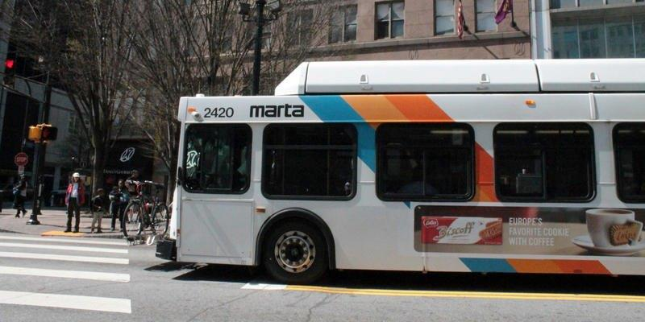

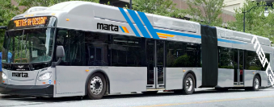
More MARTA
Bus Service Improvements
  Service changes three times per year
    April
    August
    December
  Service improvements in the near term
    February (expedited delivery)
    April
    Through 2018
  Service improvements to include
    Shelters
    New types of buses

Slide 17
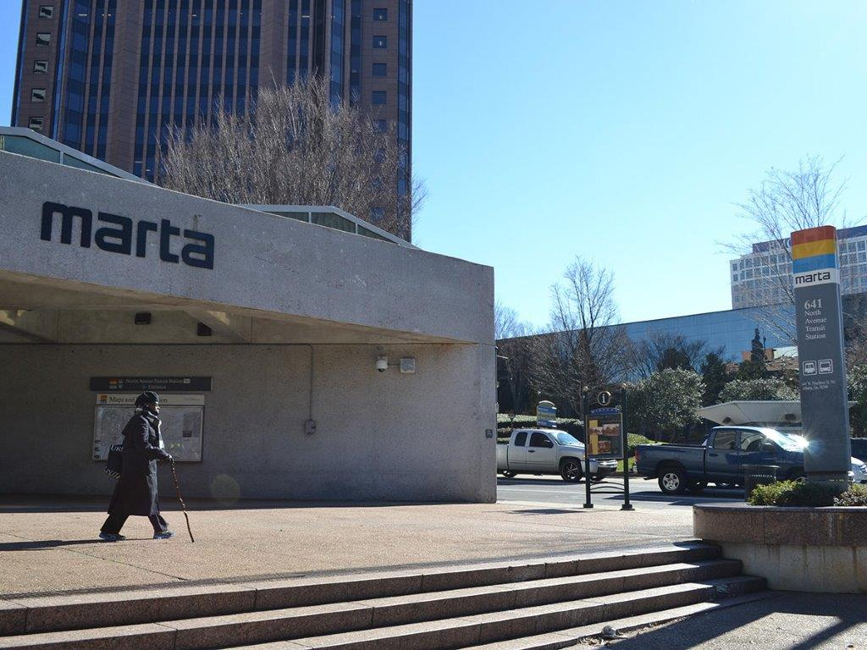
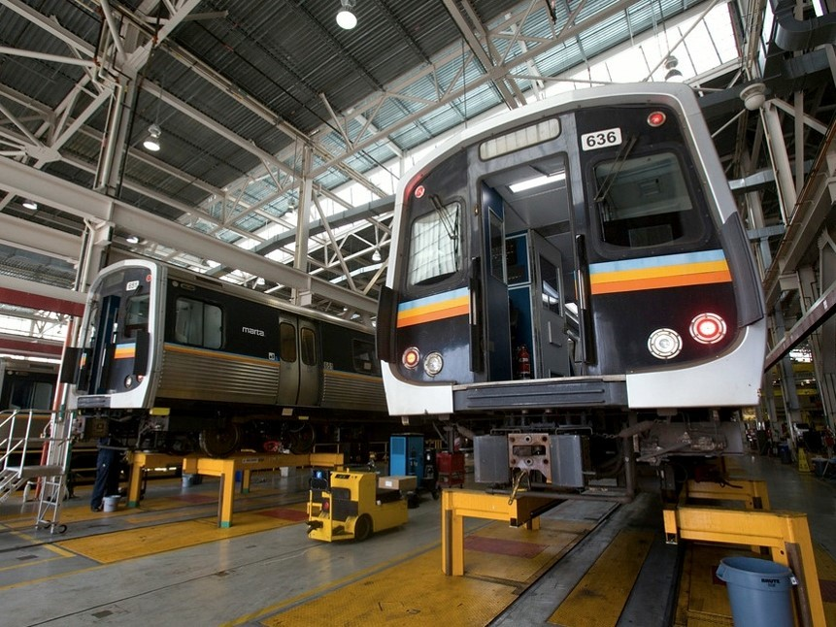
More MARTA
Short Term Capital Investment Projects
Non-Federal / Fixed Guideway
  Types of projects include:
  Rail station enhancements
    Station rehabilitation
    Signage/wayfinding
    Pedestrian/bicycle/ADA facilities
  Infill rail stations
  Transit centers
  New rail cars
  Project duration: 2 – 4 years

Slide 18

More MARTA
Long Term Capital Investment Projects
Federal / Fixed Guideway
  Discretionary grant program
  Funds heavy rail, light rail and commuter rail, streetcar and bus rapid transit
  Multi-step process
  Projects typically receive 50%
Notes:
Overview
Discretionary & Competitive Federal Grant Program
Funds light rail, heavy rail, commuter rail, streetcar, and bus rapid transit projects
FAST outlines: –Multi-year, multi-step process projects must follow to receive funds
Points during process when FTA must evaluate and rate projects
Evaluation criteria that must be used
5 point scale from low to high for ratings
Annual Report to Congress that must include ratings for each project and the Administration’s funding recommendations

Slide 19
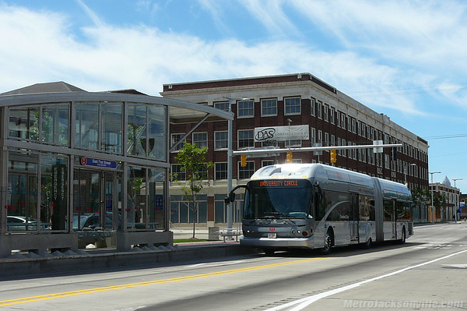
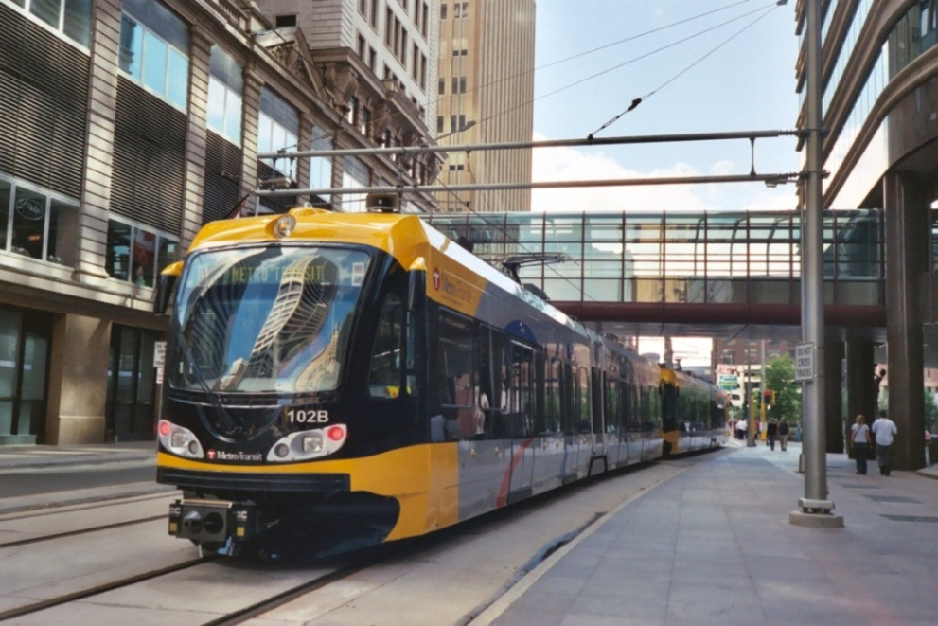
More MARTA
Potential Major Capital Projects
  Northside Drive Bus Rapid Transit
  I-20 West Heavy Rail Extension
  City of Atlanta Light Rail System
    Atlanta BeltLine Loop
    Irwin – AUC Line
    Downtown – Capitol Ave Line
    Crosstown Midtown Line
    Crosstown Crescent Line
    Peachtree – Ft Mac – Barge Rd Line
  I-20 East Bus Rapid Transit
  Clifton Light Rail Transit

Slide 20
More MARTA
Federal Project Development Timeline
Estimated Timeline for Federally Funded Capital Projects
Project
Development
Engineering
Grant Agreement
(Begin Construction)
Begin
Service
New Starts
Alternatives Analysis
≥ $300m
Planning
2 years
+
2 – 4 years
+
2 – 4 years
=
Years 8 - 12
Project
Development
Grant Agreement
(Begin Construction)
Begin
Service
< $300m
Year 1
Years 2-3
Small Starts
2 – 4 years
+
2 – 3 years
=
Years 6 - 10
Range of delivery dates depends upon size, complexity, and securing of local dedicated funding

Slide 21
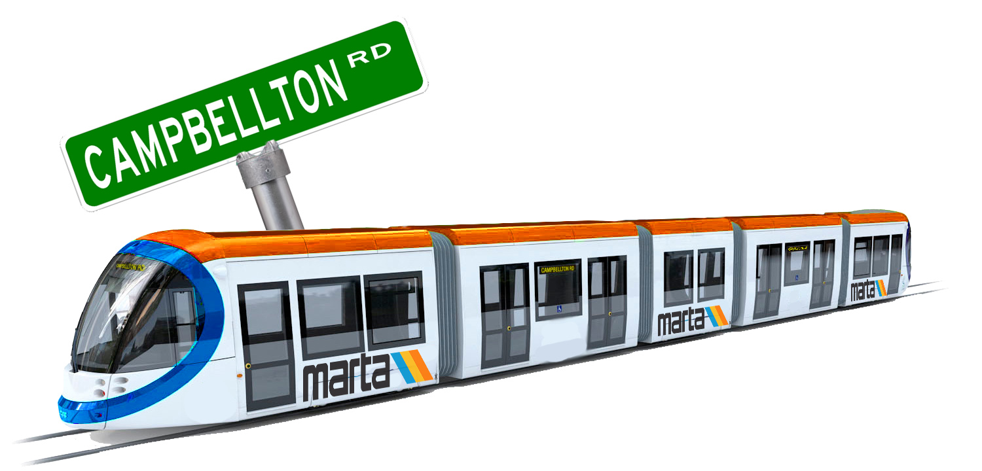
More MARTA
Next Steps
  Prepare scenarios
  Conduct public meetings
  Continue bus service implementation
  Initiate high capacity transit projects

Slide 22
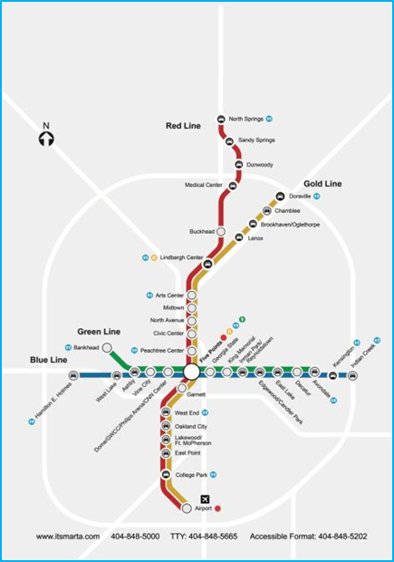
More MARTA
MARTA System

Slide 23
Benjamin Limmer, AICP
Assistant General Manager, Planning
404-848-4401
blimmer@itsmarta.com

