Slide 1
More Technology
Ming Hsi
AGM of Technology / CIO
May 18, 2017

Slide 2

Technology Core Functions
Service Desk
User Devices
Customer Facing Technology
5,000
2
2
3,000
Calls Answered by Service Desk per month
Websites
Mobile Apps
Desktops, Laptops and Tablets
52%
15%
145
1,600
3,000
First Contact Resolution
Abandon Rate
Office, Customer, ETS, Parking Deck and Elevator Phones
Digital Signs
Breeze Devices
Notes:
13 Call Agents – 24x7x365
4 Desktop Support
10 Server Administrators
5 Network Administrators
1 Storage Administrators

Slide 3
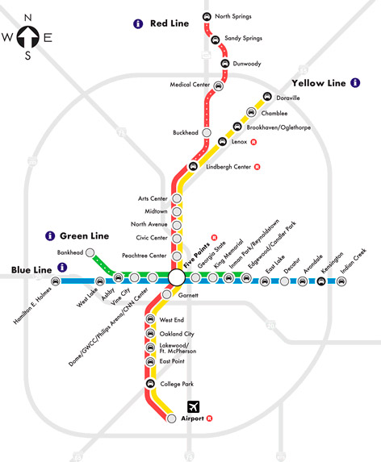

Technology Infrastructure

Slide 4



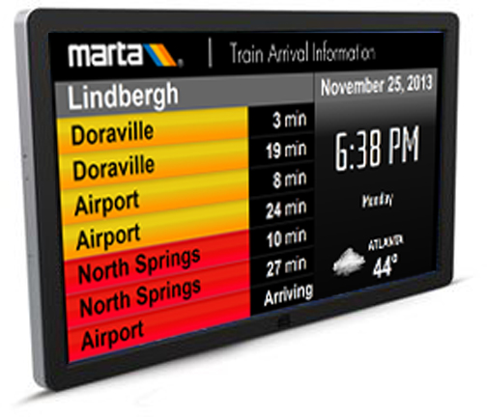



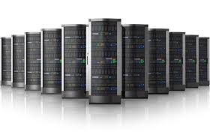




Technology Infrastructure
50
Enterprise Applications
830
1.6
500
Petabyte Storage
Network Routers & Switches
Virtual and Physical Servers
Notes:
Automatic Vehicle Locator (Trapeze)
Automated Fare Collection (Cubic)
Automated Dispatcher (Transched)
Badging System (C-Cure)
CCTV (Genetec/BRS/Apollo)
Database (Oracle/Microsoft)
Business Intelligence and Data Warehouse (Oracle and SAP)
Enterprise Asset Management (Trapeze)
Enterprise Resource Planning (Oracle)
Geographic Information System (ESRI)
Internet and Intranet
Microsoft Email, Office & SharePoint
Mobility (Trapeze)
Police Systems (PAMET)
Scheduling & Run Cutter (Trapeze)
Train Control (Alstom & Arinc)

Slide 5
FY 17 Operating Budget
FY17 Gross Operating Budget is $31M
146 FTEs and Contractors
Three areas:
  Infrastructure and Production Support
  Enterprise Application
  Project Management and Quality Assurance
46%
54%

Slide 6
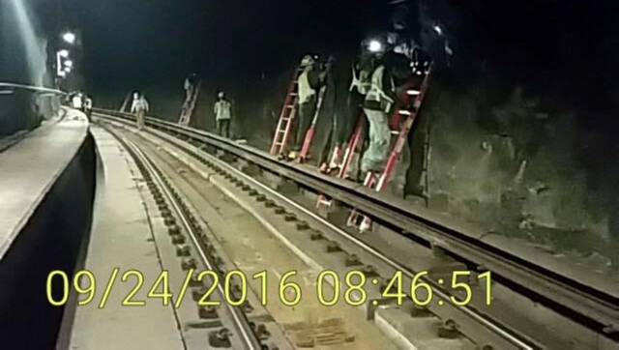
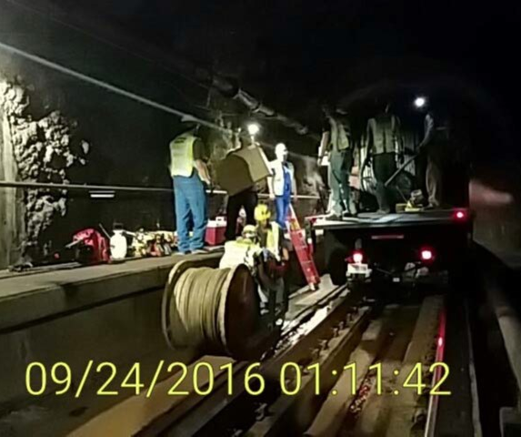
Cellular Services
Formed a public private partnership for distributed antenna system and Wi-Fi system at all rail stations
Construction completed at three pilot stations: Five Points, Peachtree Center and Dome
Two of four carriers signed up for the pilot
T-Mobile completed at pilot stations
AT&T completed at Five Point stations
System-wide implementation: Fall 2018

Slide 7
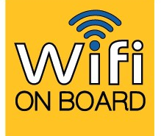
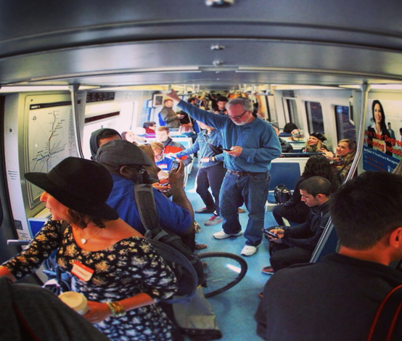
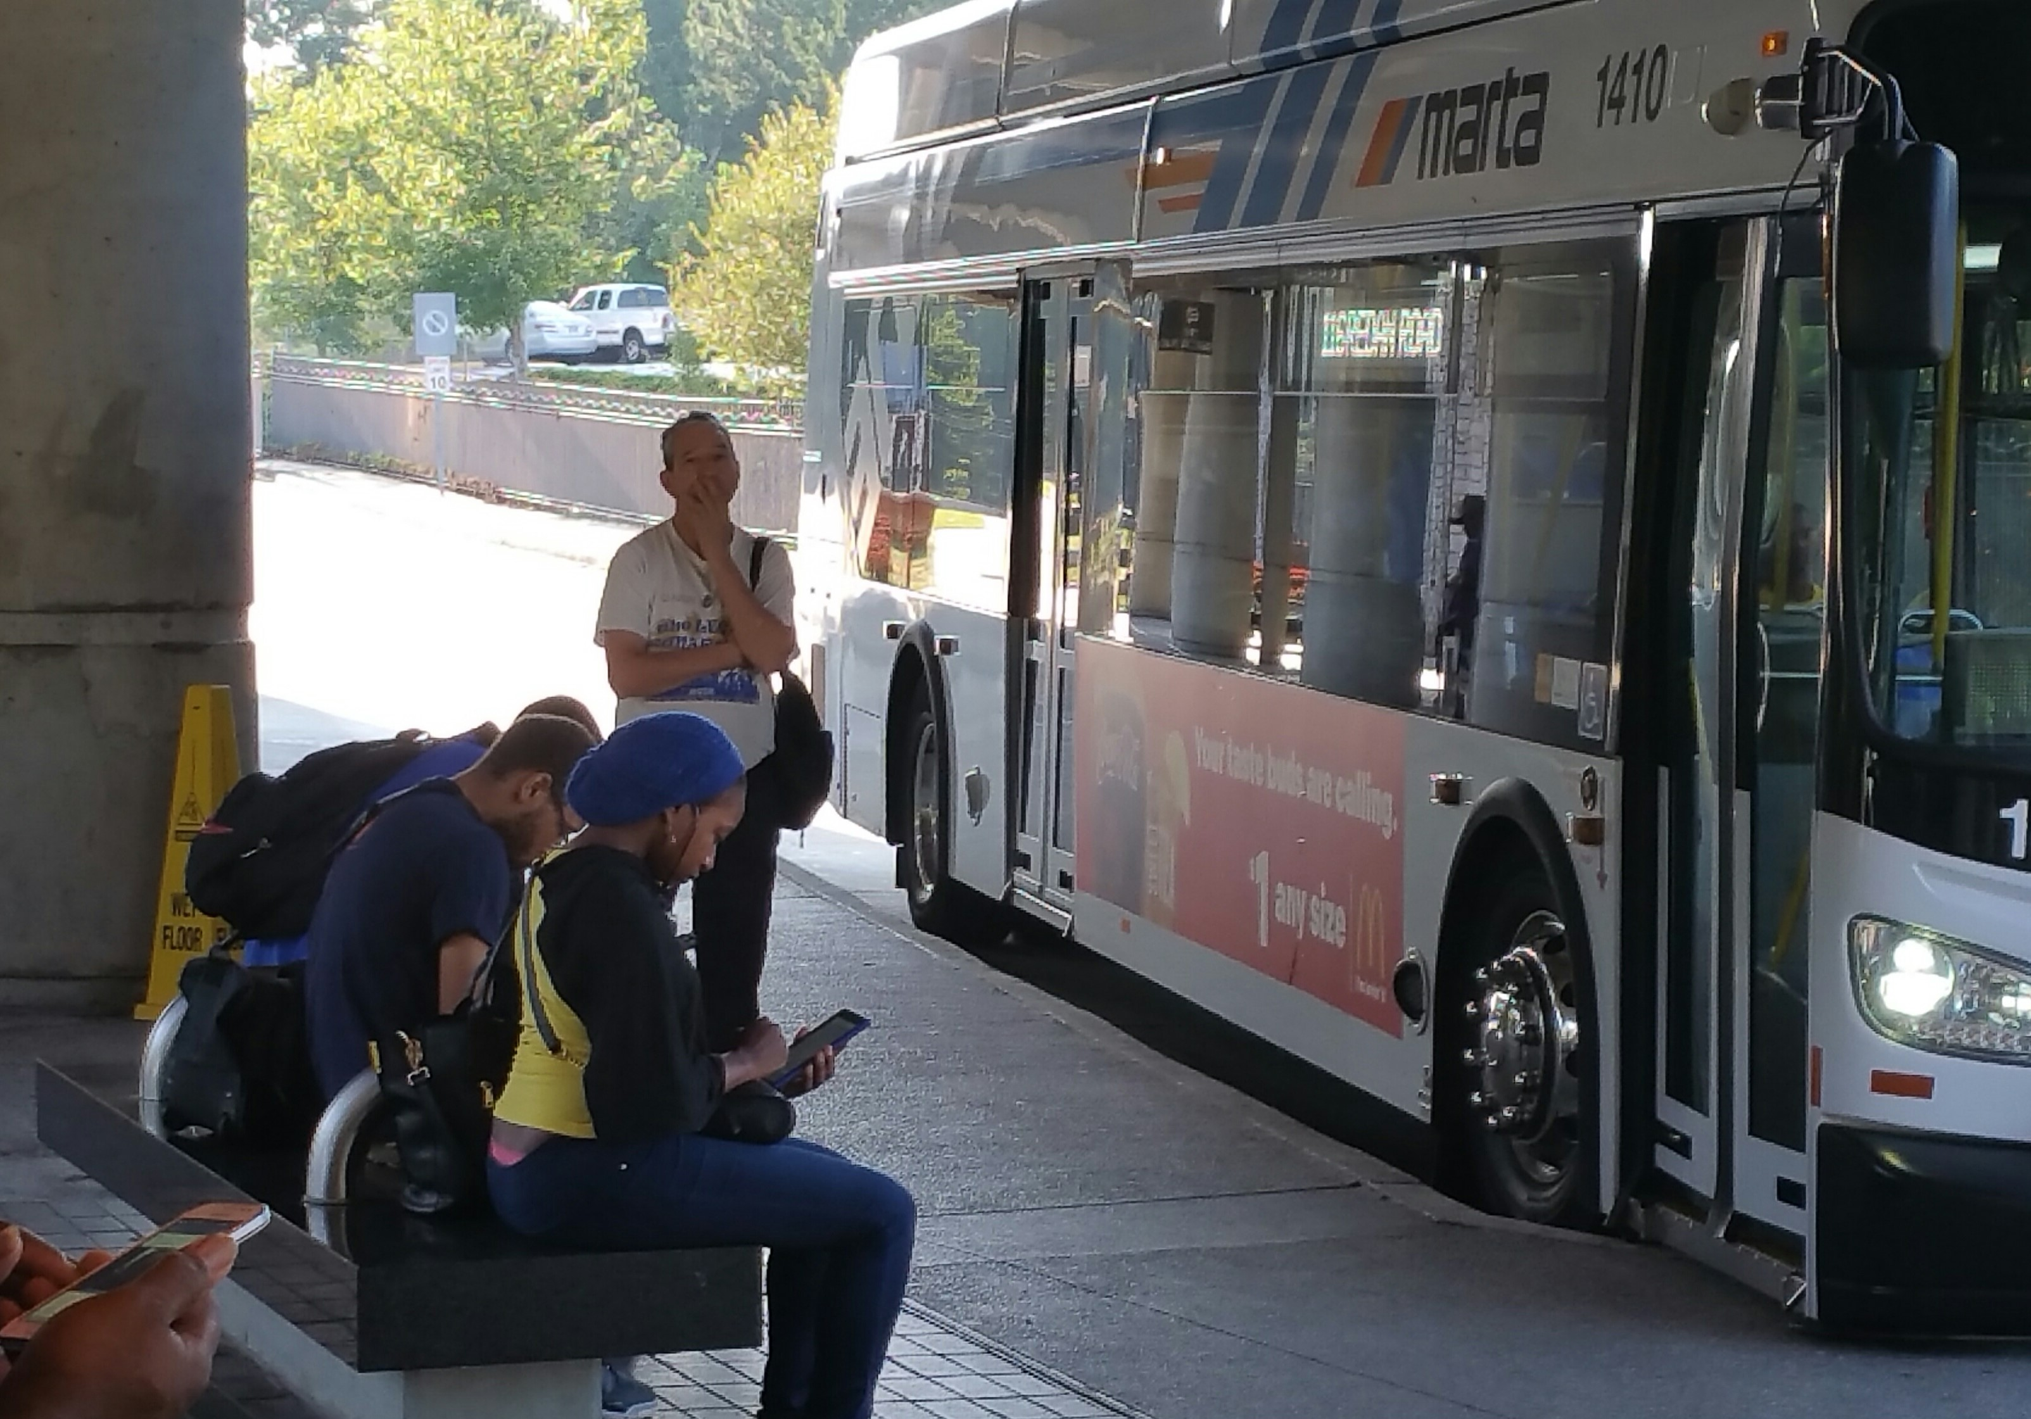
Wi-Fi on Rolling Stock
Piloted free Wi-Fi on 70 buses
Leveraged Wi-Fi infrastructures on the vehicles
Free Wi-Fi on all buses: available on 470 buses
Free Wi-Fi on all trains: Fall 2017

Slide 8
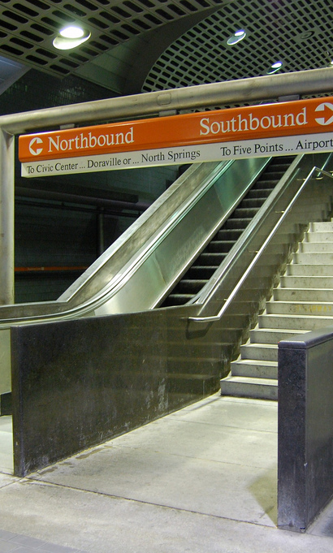
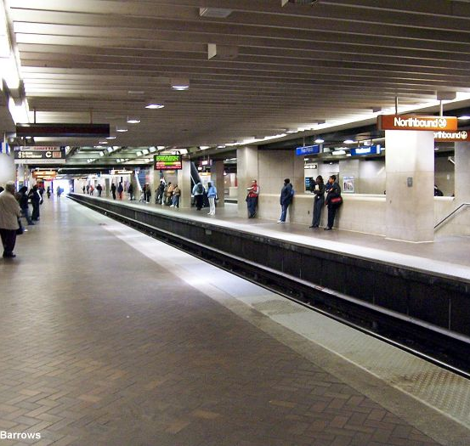
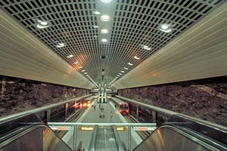
Wi-Fi Services for All Stations
A neutral host provider will design, build and maintain a Wi-Fi network for all of MARTA’s stations.
Comcast will provide free Wi-Fi to all MARTA patrons.
MARTA will forgo the revenue sharing from Wi-Fi and provide available fiber connectivity.
Contract modification in progress.
Anticipated completion date: 2018 Q1
Notes:
Est. $300 per station per month.
Est. $54,000 per year for all 15 stations
Est. $1M for 19 years.

Slide 9

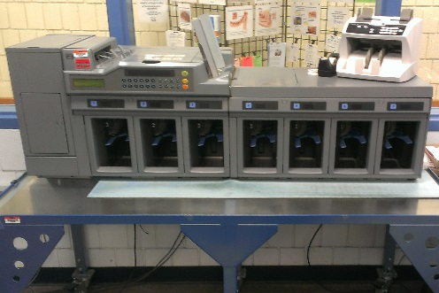
Breeze Improvements
Threshold auto-load completed
Money Room Upgrade Completed
Garage Computer Upgrades Completed
PCI Certification in progress
Fare Promotions (new weekend pass) – May 5, 2017
Retire blue cards – July 2017
AFC Disaster Recovery – Dec 2017
Bus DCU Upgrades – July 2018

Slide 10
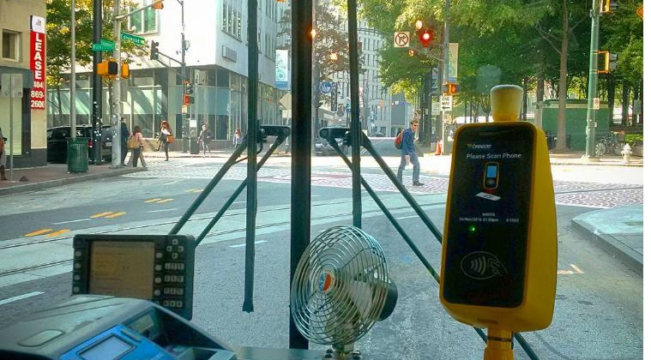
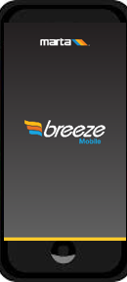
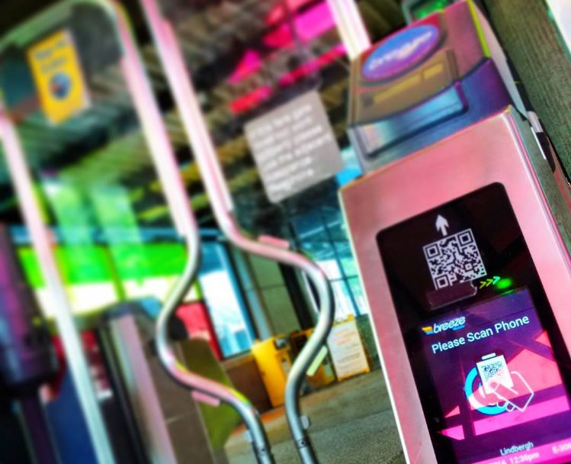
Mobile Ticketing System
Purchase and ride the system with smart phones
Pilot for mobile ticketing system finished in fall 2016
500 pilot users signed up
88% were satisfied and 83% would likely use Breeze Mobile
Full implementation scheduled for fall 2017

Slide 11
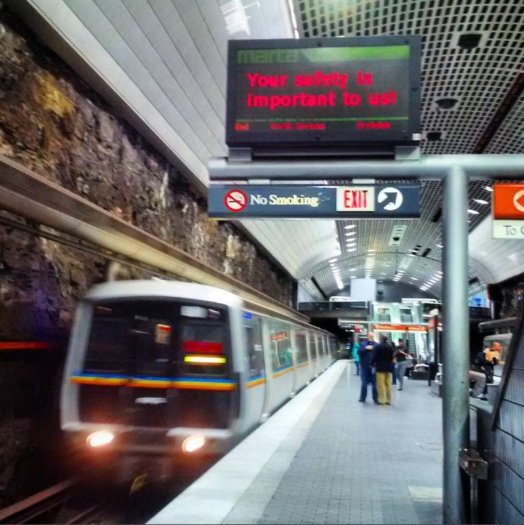
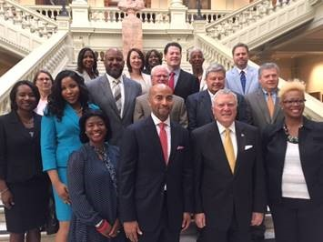
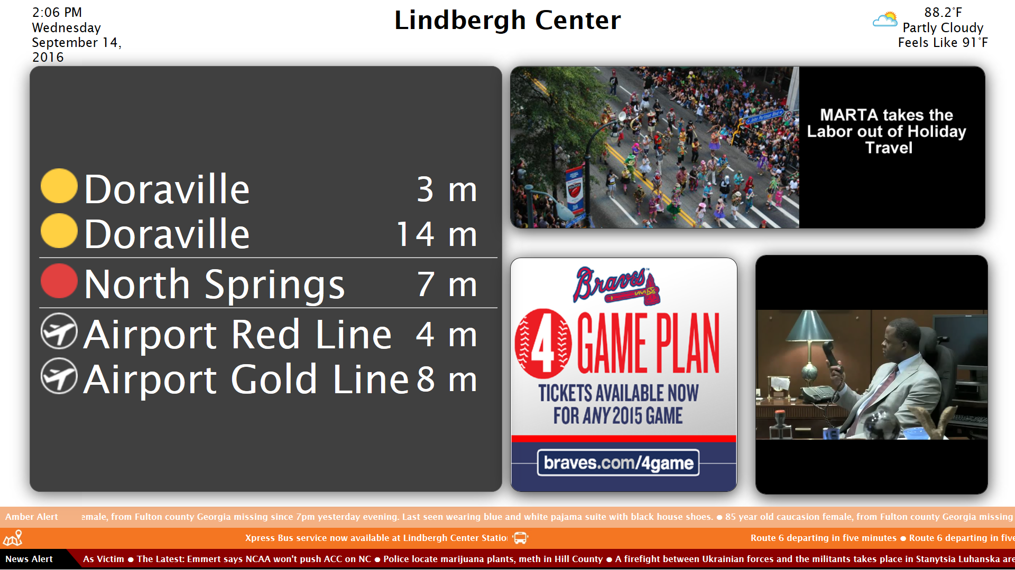
Audio Visual Information System
More relevant and consistent communication with our riders
Replacement of aging equipment
Better integration with regional transit data
Emergency alert capabilities
ADA compliance
$30M funding from the State of Georgia Go! Transit grant
320+ signs at entrances and on the concourse and platform level
4500+ speakers with ambient sensors and synchronizing with the signs

Slide 12
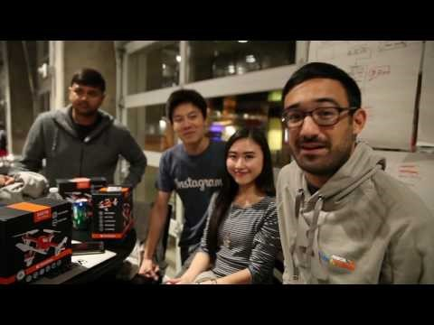



More Innovation
October Hackathon
Total Participants: 197
Team: 24
February Hackathon
Total Participants: 316
Team: 36

Slide 13
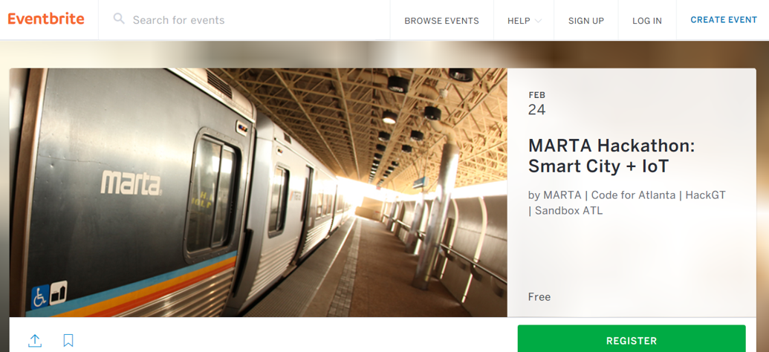

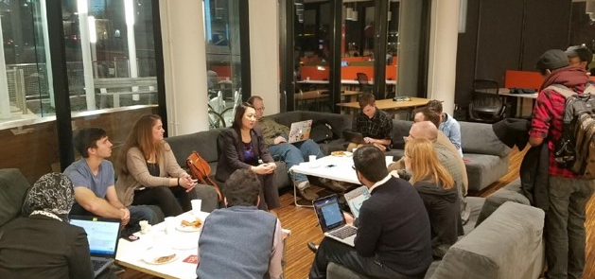
More Innovation
Smart City and IoT
Partner with City of Atlanta
Launch a regional open data source portal:
  http://opendata.itsmarta.com
  http://www.itsmarta.com/app-developer-resources.aspx
    MARTA Bus GTFS-Real-Time Data
    MARTA Bus Real-Time RESTful API
    MARTA Rail Real-Time RESTful API
  http://opendata.atlantaregional.com
  http://opendata.atlantapd.org

Slide 14
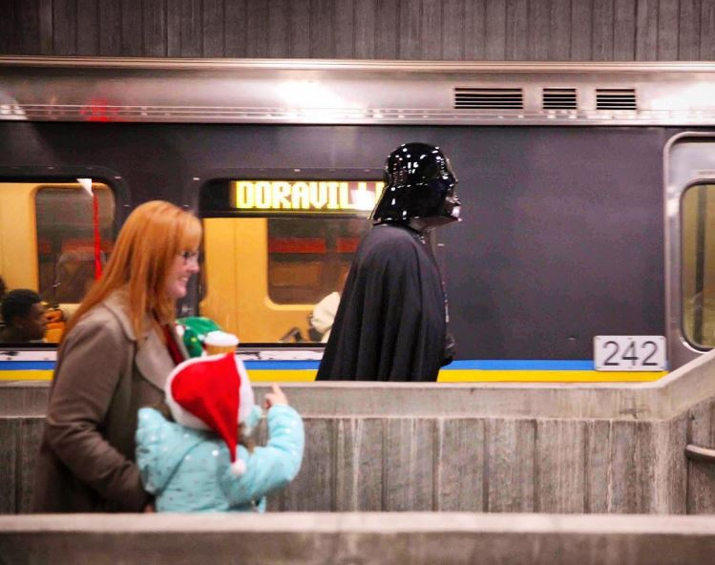
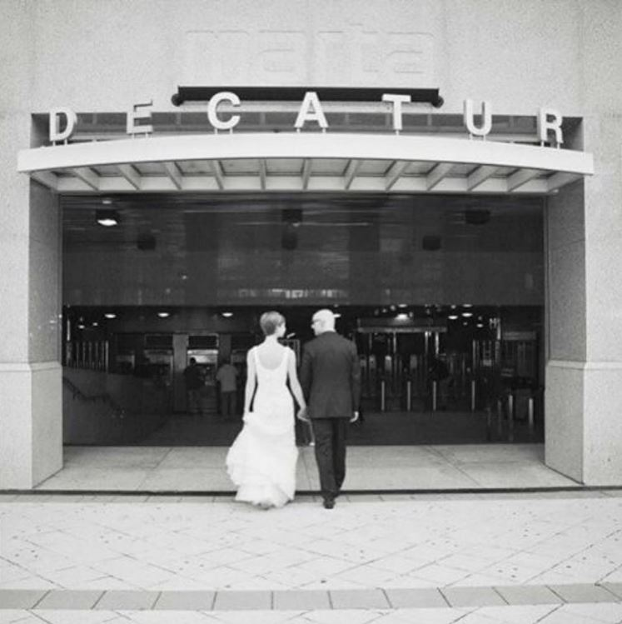
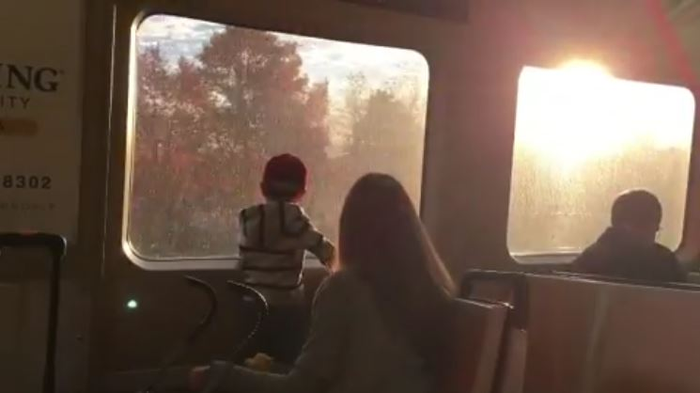
More Riders

