Slide 1
MAX Program – Leadership May 15, 2017
Keith T. Parker, AICP
General Manager/CEO
@CEOMARTA

Slide 2
PRESENTATION OVERVIEW
Mentorship and my journey to CEO
Transforming America’s 9th largest transit system
Leading More MARTA

Slide 3
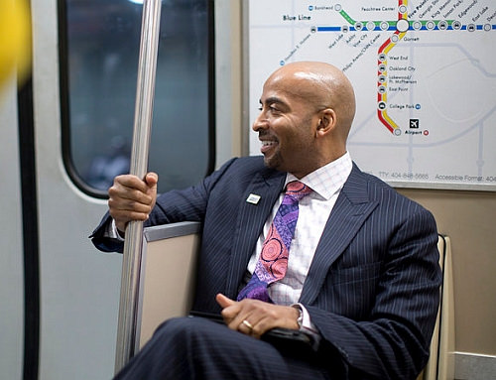
MY JOURNEY

Slide 4
Shirley Delibero Former CEO Metropolitan Transit Authority Harris County, TX Public Transit Hall of Fame

Slide 5
Pam Syfert Former City Manager Charlotte, NC

Slide 6
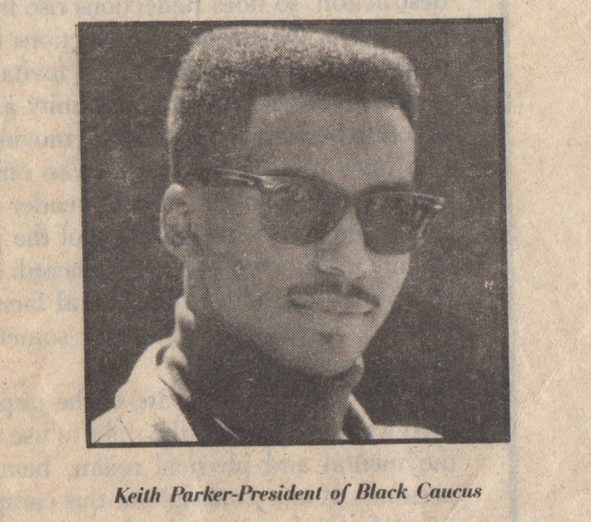
NETWORKING
Notes:
Power of networking and honing your leadership skills earlier in life
Vida Covington

Slide 7
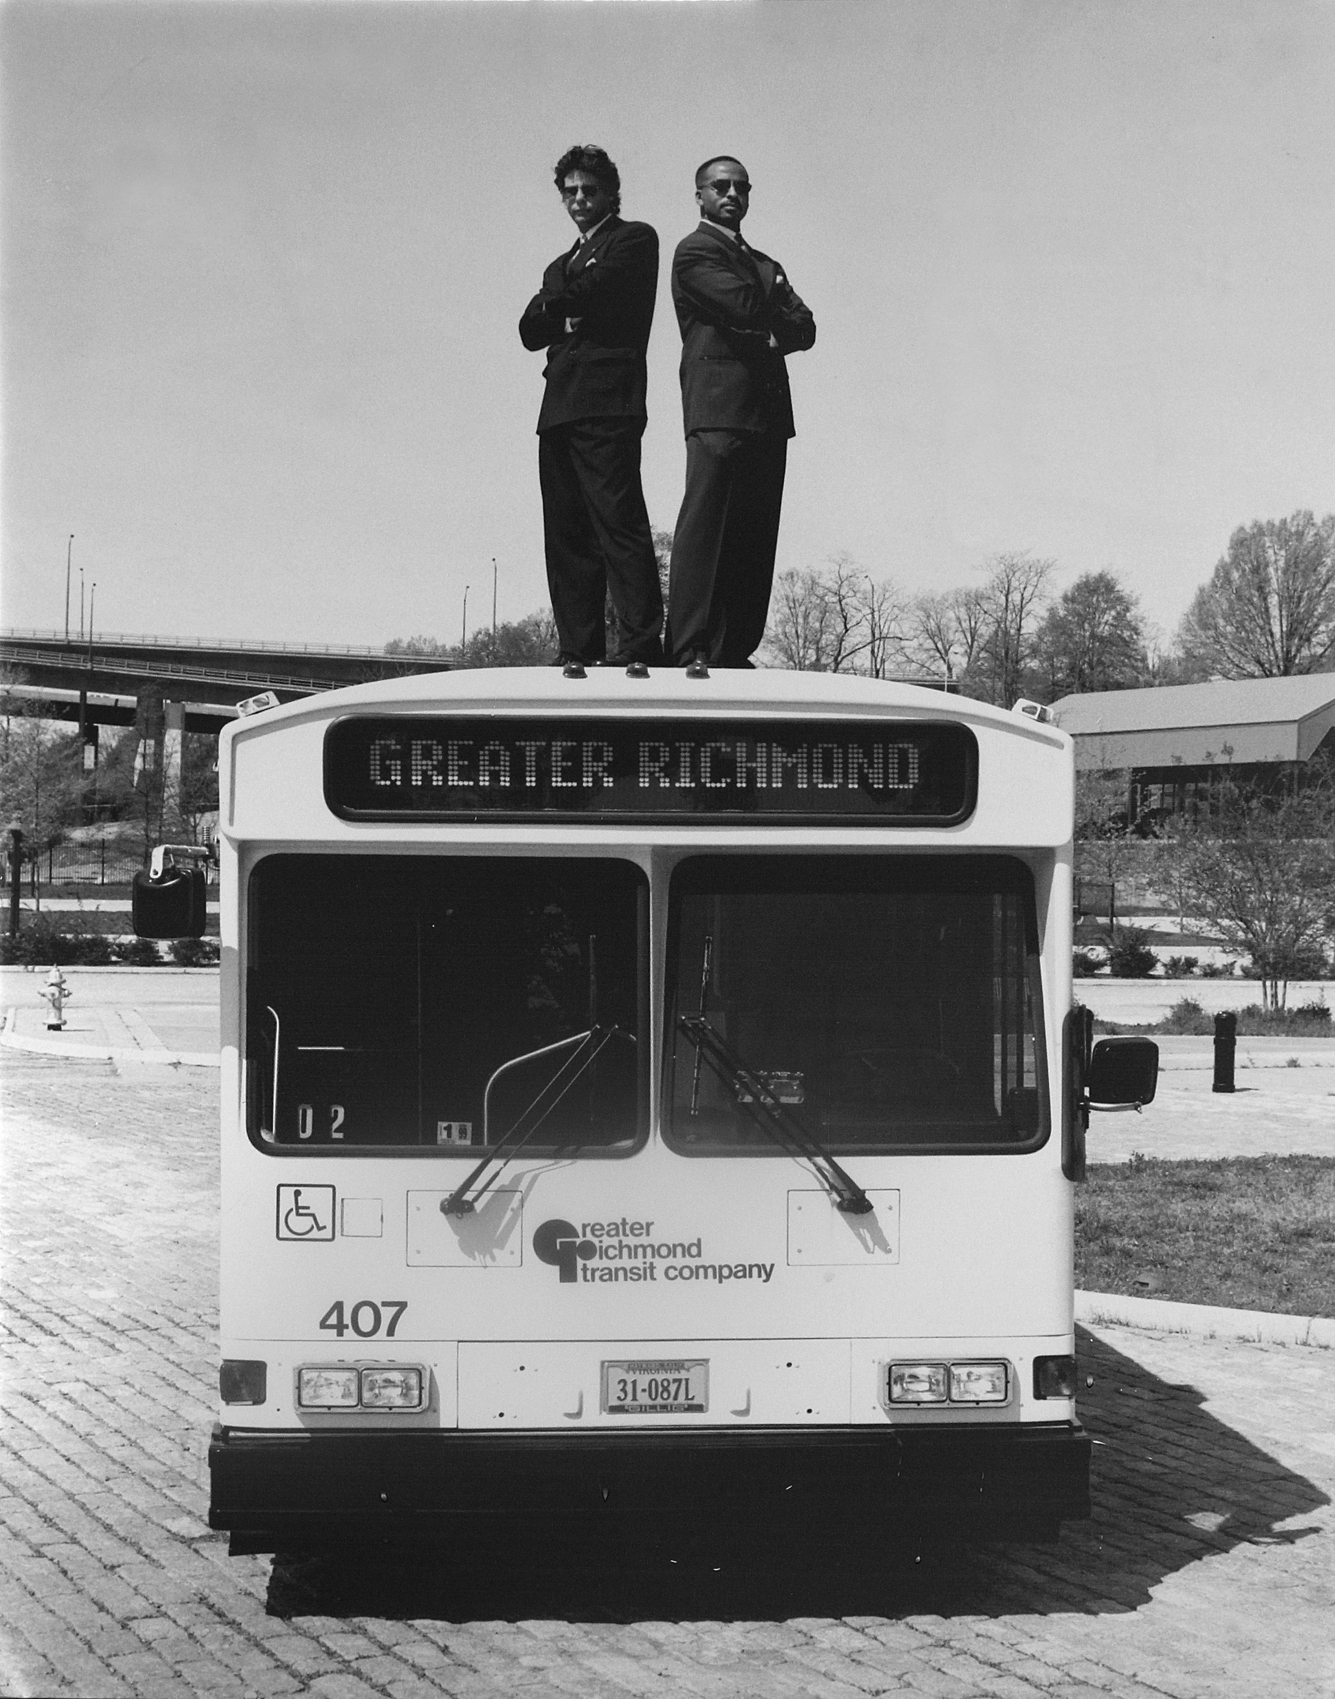
ROLLO AXTON Former CEO Greater Richmond Transit Company

Slide 8
POWER OF LEADERSHIP
“If your actions inspire others to dream more, learn more, do more and become more, you are a leader.” - John Quincy Adams

Slide 9
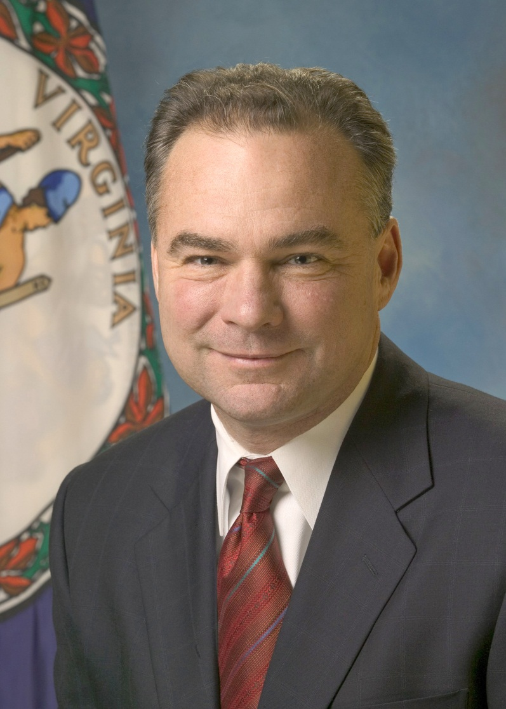
TIMOTHY KAINE U.S. Senator Virginia Former Vice Presidential Candidate

Slide 10
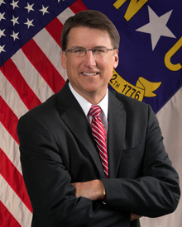
PATRICK MCCRORY Former Governor North Carolina

Slide 11
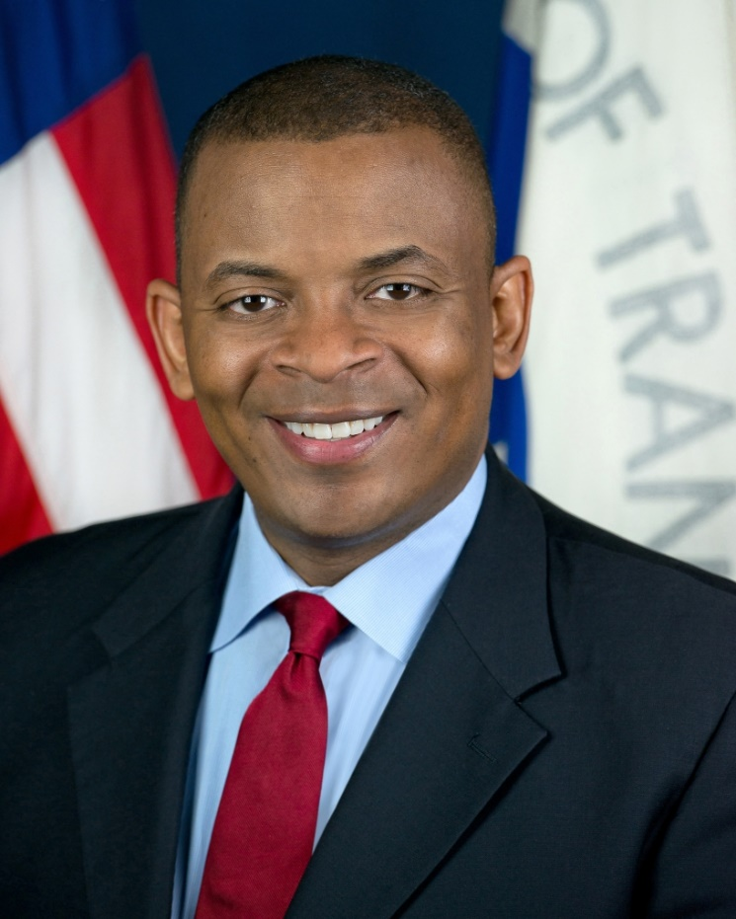
ANTHONY FOXX Former Secretary U.S. Dept. of Transportation

Slide 12
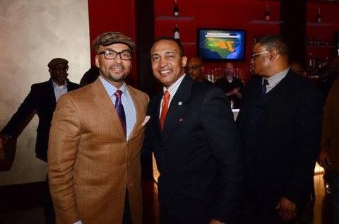
PATRICK CANNON Former Mayor Charlotte, NC

Slide 13
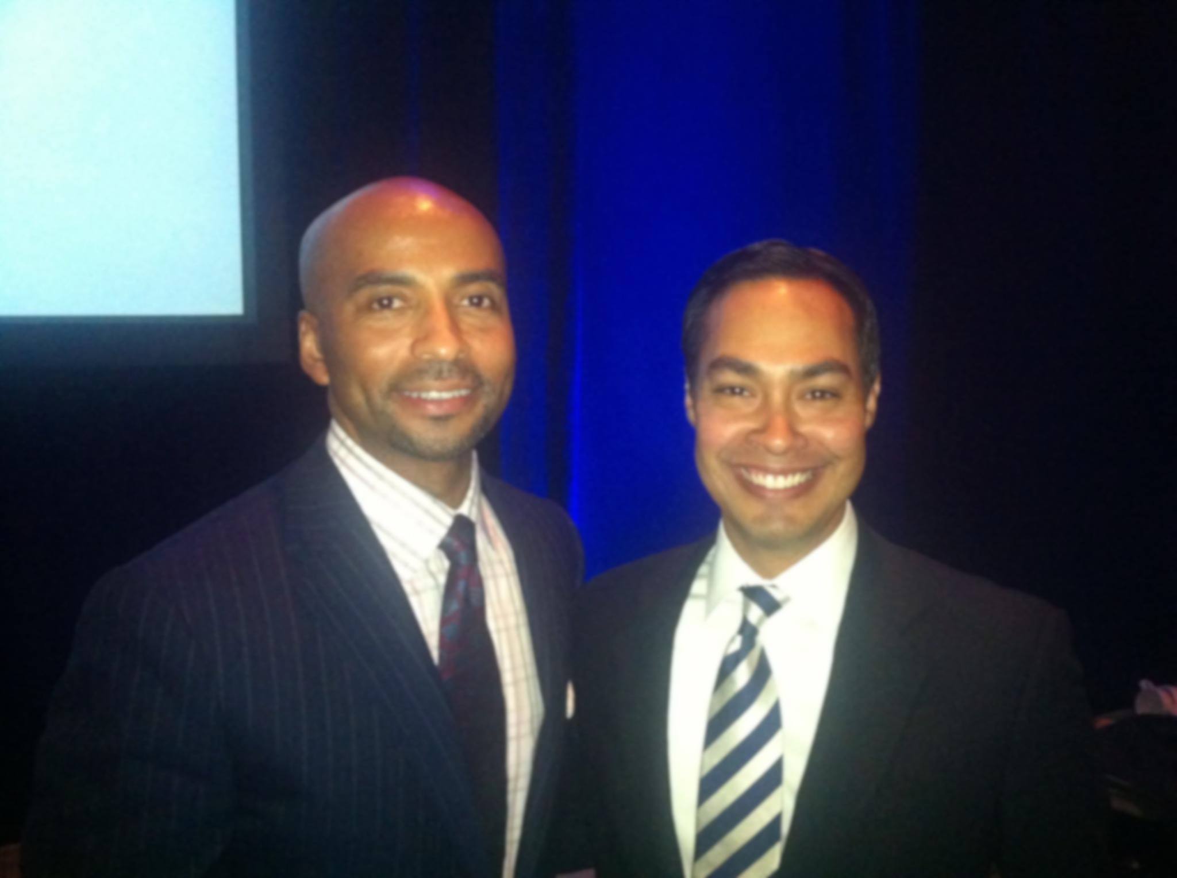
JULIAN CASTRO Former Secretary U.S. Department of HUD

Slide 14
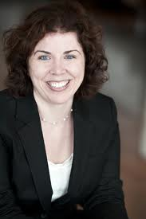
ELIZABETH PRESUTTI CEO Des Moines Transit Authority

Slide 15
GAIL SPOLAR Former CEO, Vancouver Transit System

Slide 16
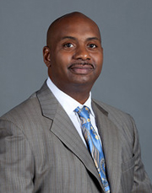
MATTHEW TUCKER CEO North County Transit District (San Diego)
Matthew Tucker, CEO
North County Transit District San Diego, California

Slide 17
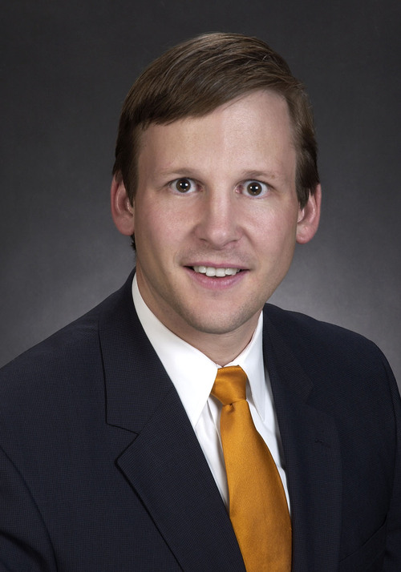
BRADFORD J. MILLER CEO Pinellas Suncoast Transit Authority

Slide 18
MICHAEL MELANIPHY Former CEO American Public Transportation Association

Slide 19
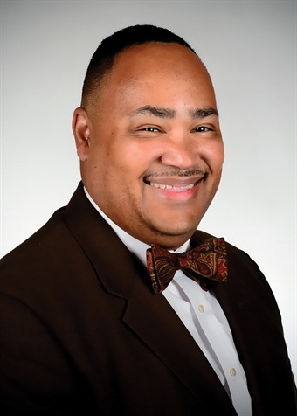
EDWARD JOHNSON CEO/GM Orlando LYNXS

Slide 20
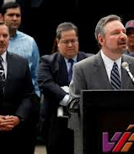
JEFFREY ARNDT CEO VIA Metropolitan Transit

Slide 21
ELDRIDGE COLES CEO Greater Richmond Transit Company

Slide 22
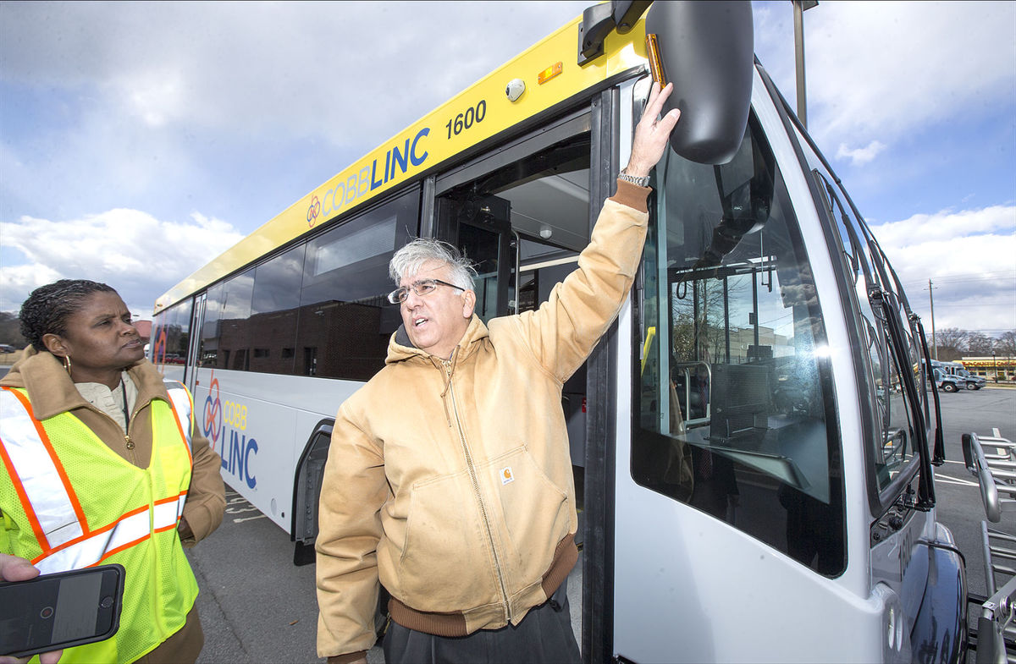
VIDA COVINGTON General Manger Cobb County Transit
Notes:
Power of mentoring
She just rolled out a rebranding of the Cobb County Transit agency

Slide 23
It cannot be overstated how important it is to be able to work with, lead, manage, follow, teach and learn from women. And that goes for women and men. Women quite often struggle more working for another woman than they do working for a man.

Slide 24
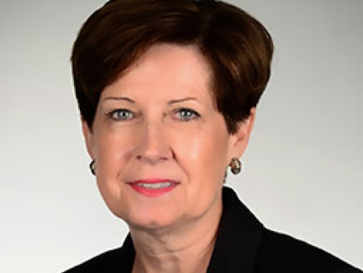
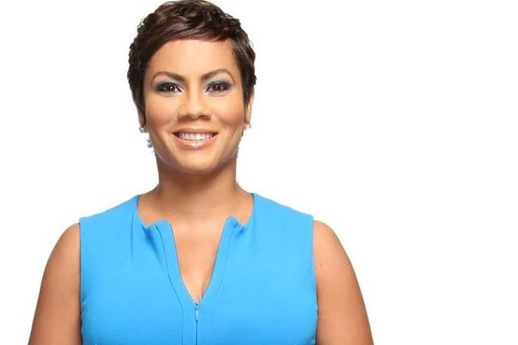
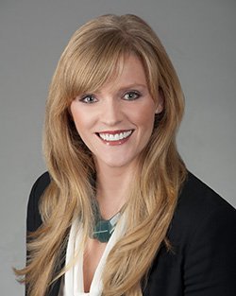
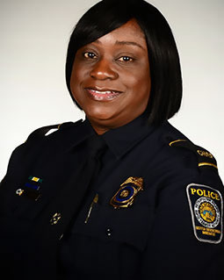
Executive Management Team

Slide 25
SPENDING WITH WOMEN-OWNED BUSINESSES
 | FY2014 | FY2015 | FY2016 | Three-year $ / % Totals
Dollars Spent w/ Women-owned Businesses | $21,374,838 | $17,020,523 | $59,601,433 | $97,996,794
Authority’s Overall Goal | 27.75% | 30% | 30%
% Spend w/ Women | 10% | 13% | 13% | 13%

Slide 26
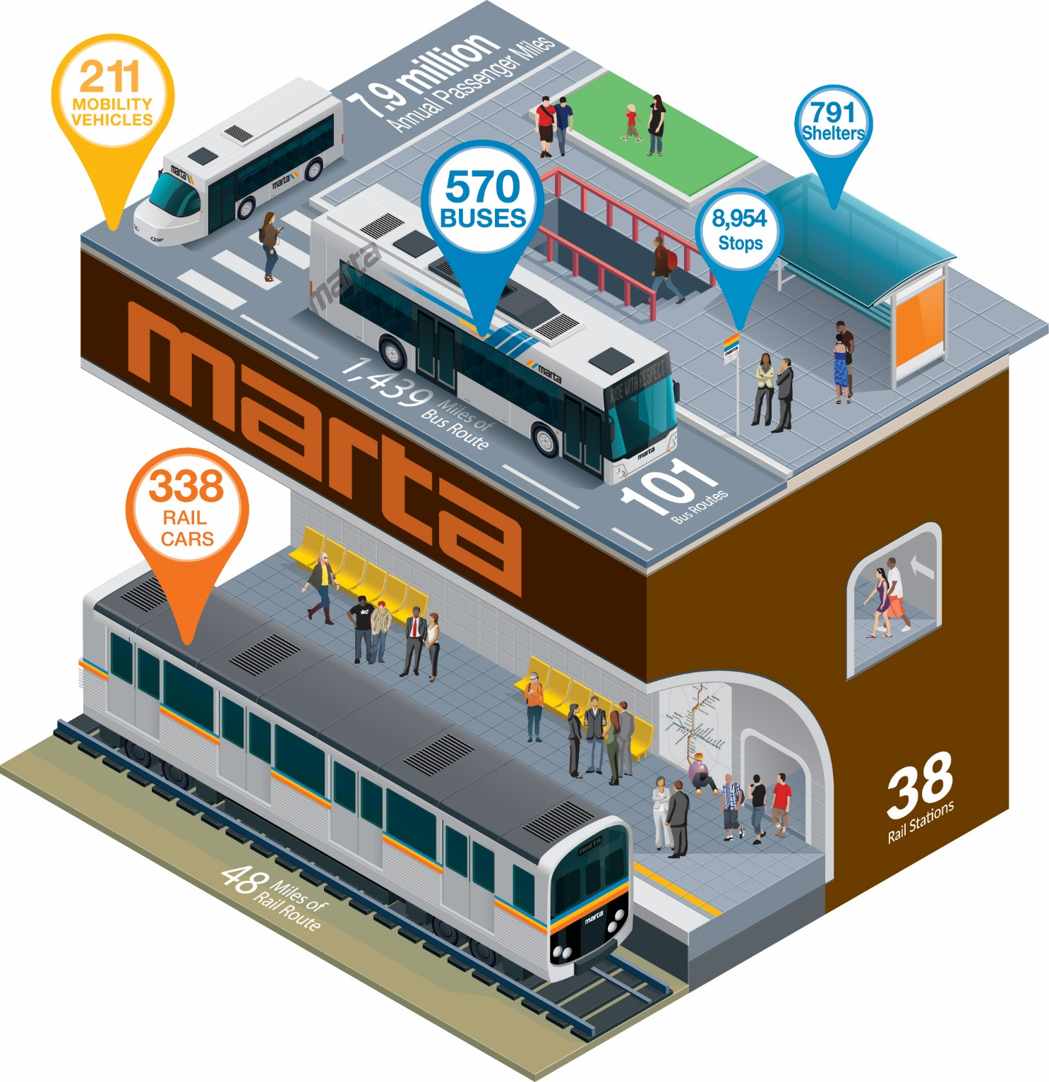
MARTA

Slide 27
ABOUT MARTA
9th largest transit system in US, largest in the Southeast
Bus, rail and paratransit services
38 Rail stations
48 miles of track
570 Buses
101 Bus routes
738M Annual passenger miles (all modes)
200 Mobility vehicles
433,064 Average weekday unlinked passenger trips
6 Police Precincts

Slide 28
CHALLENGES
2008 Recession
Cut $100M in expenses
Eliminated 734 positions
10-days Furlough for non-represented employees
Increased Healthcare and Pension Contributions
No annual cost of living or merit for employees
Reduced bus routes from 131 to 91
Increased headways on bus and rail

Slide 29
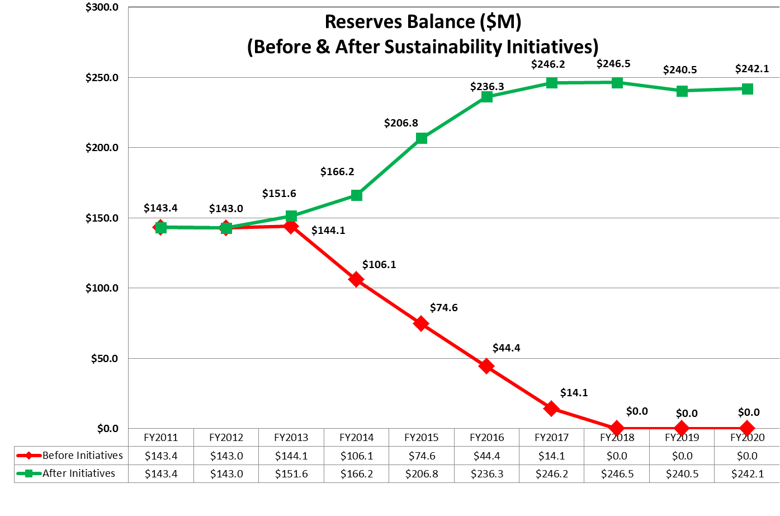
CONSECUTIVE SURPLUSES
Notes:
Add other graphics

Slide 30
REBUILDING THE BRAND

Slide 31
STRENGHTHEN THE FINANCIALS

Slide 32
RIDERS’ CODE OF CONDUCT
Notes:
Celebrity participation including Mayor Kasim Reed, Jeff Foxworthy and Ludacris
Greatly improved customer experience
No “knucklehead behavior”

Slide 33
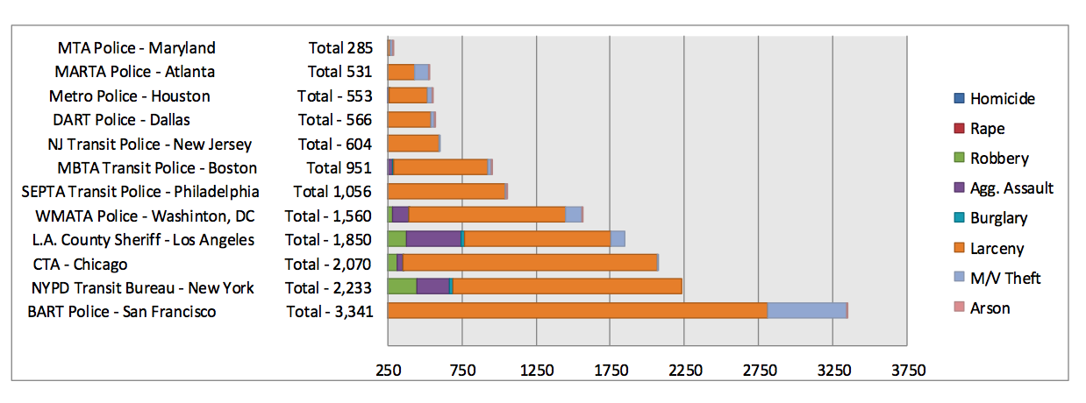
2014 PART ONE CRIMES

Slide 34
#1 RANKED AIRPORT SERVICE

Slide 35
CORPORATE RELOCATIONS

Slide 36
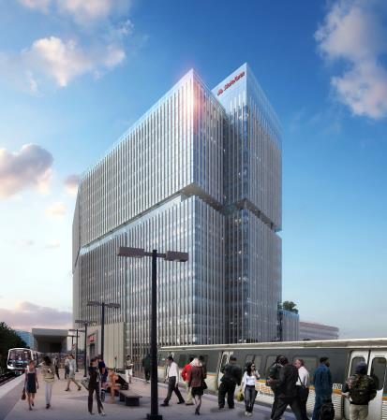
TRANSIT-ORIENTED DEVELOPMENT

Slide 37
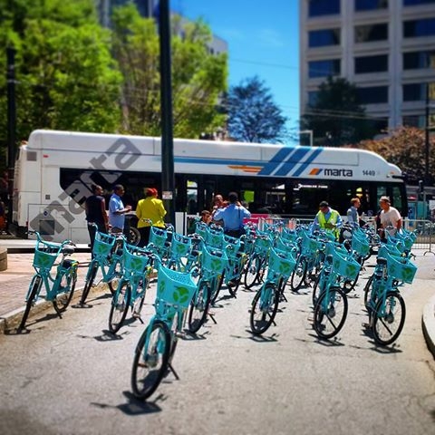
FIRST AND LAST MILE CONNECTIVITY

Slide 38
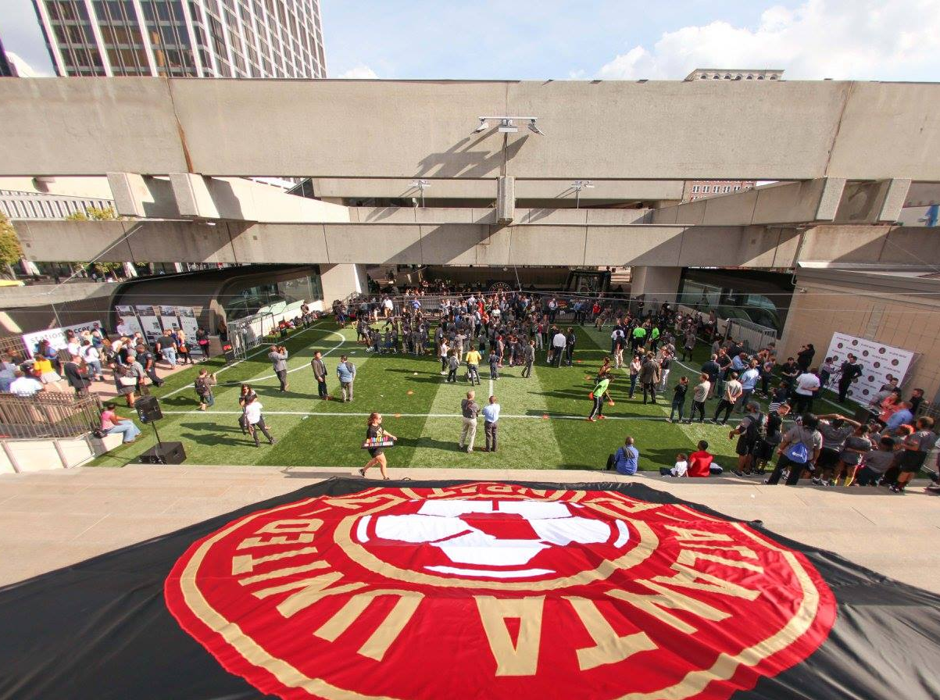
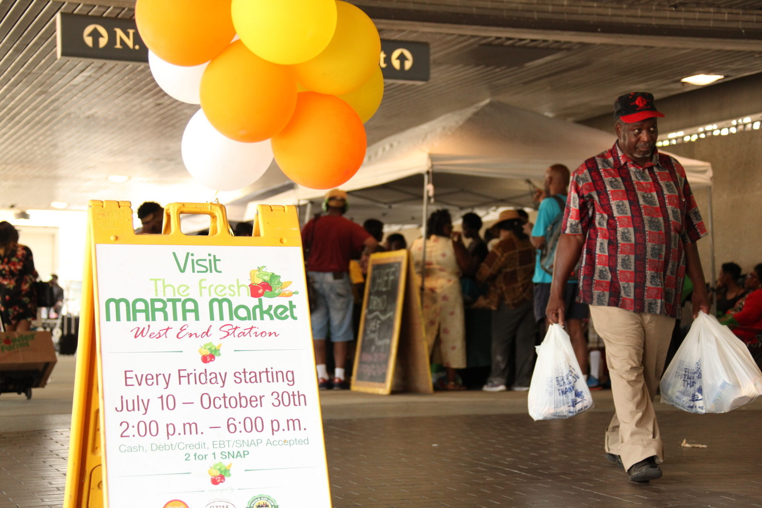
MORE THAN A TRAIN STATION
Notes:
Bringing healthy produce directly to our customers and improving quality of life of our customers and the community. This program was so popular, we expanded it to two more stations.
Partnering with Atlanta United – the new Major League Soccer team – to create the first ever soccer field at a train station. At-risk youth have a safe, convenient place to play soccer.
We’ve also partnered with local artists to paint murals at select stations. All of this, with our T-O-D program, will make our MARTA rail stations and the surrounding neighborhood thriving live, work and play communities.

Slide 39
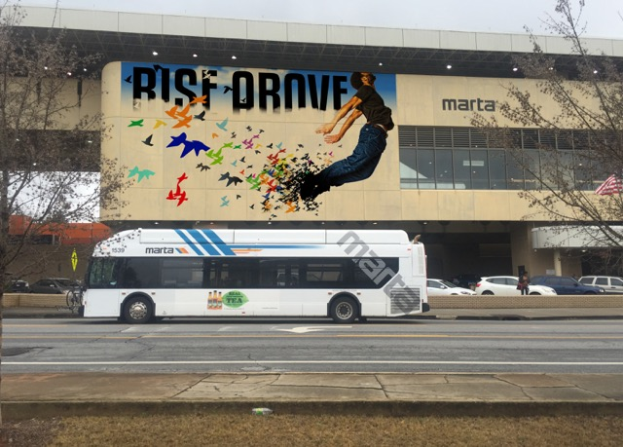
ART IN TRANSIT
Notes:
Art in every station from when the system was first built
Re-energizing our arts program
Taking care of existing art, adding new art and cultural performances
Forming an Arts Council

Slide 40
OVERALL CUSTOMER SATISFACTION
Blue shading represents systemwide ridership (number of unlinked trips in millions)

Slide 42
ATLANTA TRANSIT EXPANSION
72% passage Half-penny sales levy in the City of Atlanta
$2.5 billion projected revenue
LRT
BRT
Rail infill stations
Transit centers
Bus and rail service improvements

Slide 43
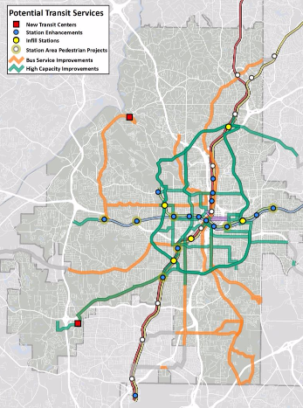
MORE ACCESS

Slide 44
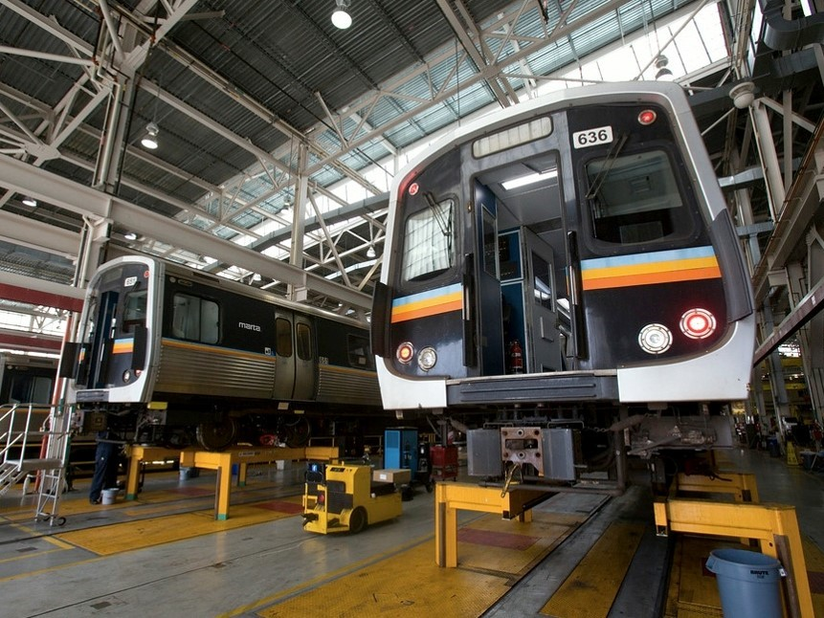
UPGRADING FLEET

Slide 45
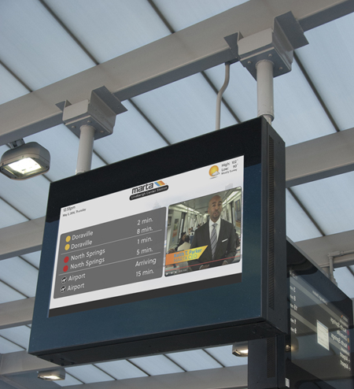
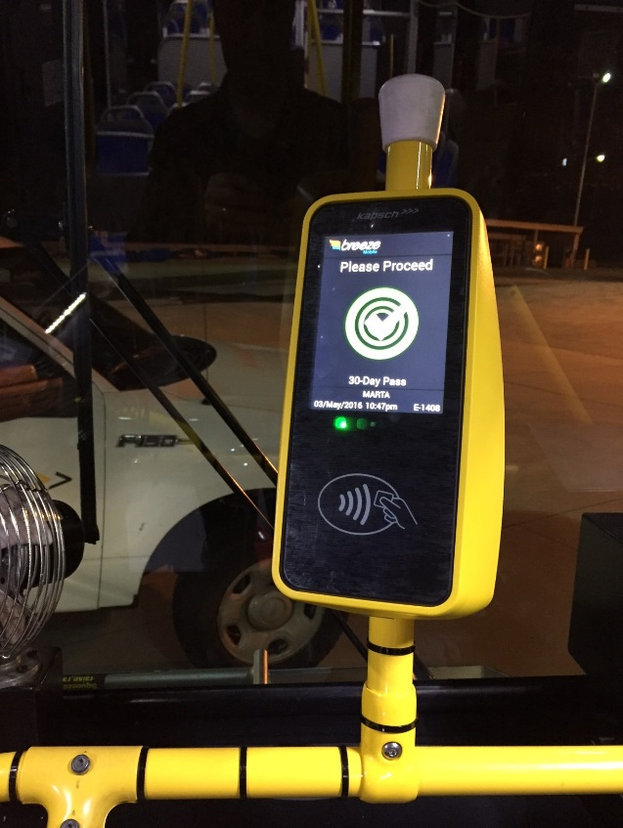
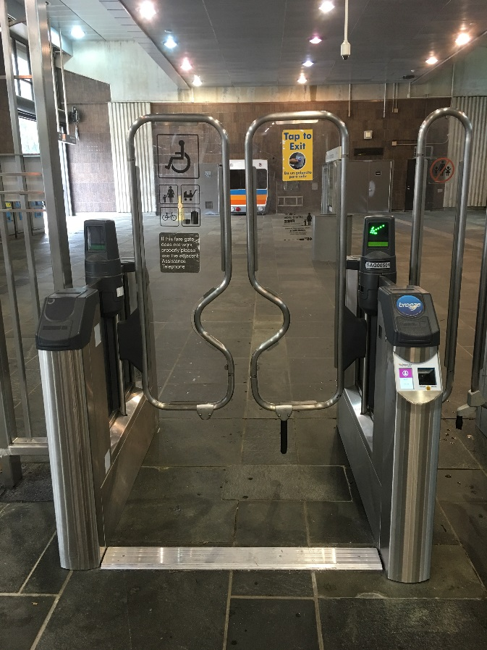
TECHNOLOGY INNOVATIONS
Notes:
We are making a number of technology improvements – from signage (AVIS), to adding Wi-Fi to buses and trains, to mobile ticketing.

Slide 46
SUPPORTING MORE MAJOR EVENTS
Notes:
Celebration Bowl, SEC Championship, Final Four, Atlanta United soccer games, Chick-Fil-A Peach Bowl and the Super Bowl

Slide 47
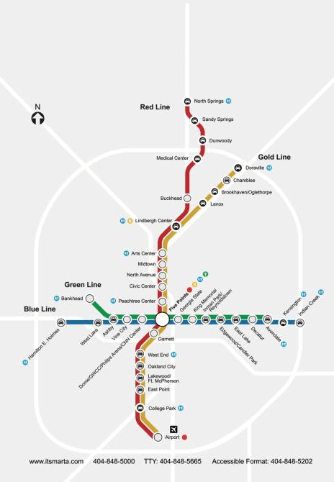
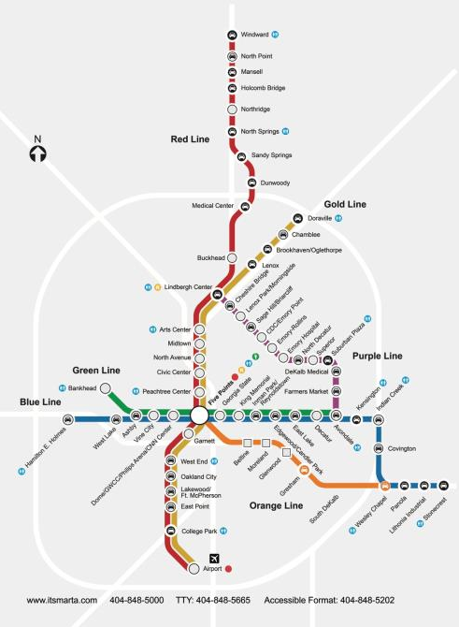
MARTA SYSTEM EXPANSION
TODAY
FUTURE

Slide 48
THANK YOU

