Slide 1
MARTA Funding Presentation
Department of Finance
Sources of Operating and Capital Funds
Presented by
Kevin L. Hurley, Treasurer
May 18, 2017

Slide 2
Agenda…
Oversight and Governance
Jurisdictional Funding Support
MARTA Tax Collections
Operating Sources of Funds
Capital Sources of Funds
Notes:
Provides strong oversight and partnership. Strong visionary leadership.

Slide 3
Experienced oversight and governance…
THE METROPOLITAN ATLANTA RAPID TRANSIT OVERVIEW COMMITTEE (MARTOC)
Joint (House/Senate) committee, comprised of 12 legislators
________________________________________________________
Board of Directors
MARTA is governed by a 14 member Board
Twelve members representing Clayton, DeKalb and Fulton Counties and the City of Atlanta
City of Atlanta (3) DeKalb County (4)
Fulton County (3) Clayton County (2)
Two ex-officio members appointed by the State of Georgia
GDOT (non-voting) (1) GRTA (voting) (1)
MARTA Act is governing legislation identifying sales tax proceeds
Notes:
Provides strong oversight and partnership. Strong visionary leadership.

Slide 4
Who supplies MARTA revenue…
Jurisdictions directly supporting MARTA with funding
Clayton County
DeKalb County
Fulton County
City of Atlanta
Patrons
Federal Government
State Government
Contractual Sources

Slide 5
MARTA Tax Collections

Slide 6
MARTA benefits from a broad balanced sales tax base…
1% Sales Tax collected from Clayton, DeKalb, Fulton Counties and 1.5% collected from City of Atlanta
Title Ad Valorem Tax (TAVT) received from Fulton and DeKalb Counties
Broad and balanced - low reliance on volatile sectors
Source: Georgia Department of Revenue, June 2015

Slide 7
MARTA benefits from increasing sales tax receipts…
Actual
Forecast
Millions
Forecast Growth in Sales Tax provided by Georgia State University Economic Forecasting Center – March 2017

Slide 8
MARTA benefits from pledging TAVT…
Millions
Actual
Make Whole
Forecast Source: Carl Vinson Institute of Government at The University of Georgia
TAVT started March 1, 2013
House Bill 202 Section 23 amends Section 48-5C-1, Official Code of Georgia Annotated upgraded MARTA to the levels of counties in the “make whole” provision with bipartisan support

Slide 9
Flow of Tax Receipts

Slide 10
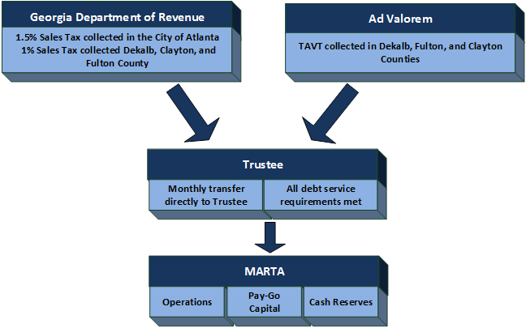
Tax revenue flow of funds…

Slide 11
Operating and Capital Sources

Slide 12
FY17 Adopted Operating Budget
MARTA Operating Revenue Sources…
FY17 Sources – 458.2M
11

Slide 13
FY17 Adopted Capital Budget
MARTA Capital Revenue Sources…
12

Slide 14
Questions

Slide 15
MARTA Federal and State Grant Programs
Presented by
Onyinye F. Akujuo Director of Federal and State Grant Programs

Slide 16
Agenda
Grant Department Activities
What types of funding does MARTA pursue
How the received funding is split up
What core initiatives receives funding
Non Traditional Initiatives

Slide 17
Who we serve
Departmental Partnerships
Grants
Capital Programs
Operations
Accounting
Procurement
HR
MARTA Police
Legal
Safety
Real Estate/TOD

Slide 18
Grant Program Oversight
FTA Legislation, Regulation, and Guidance
Grants
Federal Funding Compliance
Grant Audits
Triennial Review
A-133 Single Audits
Grant Project Management Oversight
National Transit Database

Slide 19
Grants Department Initiatives
Pre-award activities
Award activities
Post-Award activities
UZA Allocations
Coordinate with the FTA and our MPO, ARC
Notes:
The MARTA Grants Department, housed in the Office of Federal and State Programs is responsible for the pre-award, award and post-award activities as it relates to the pursuit of federal, state, local and non traditional funding sources available to fund all of MARTA’s programs and non traditional initiatives. We research grant opportunities and review federal legislature in the form of Notices of Funding Opportunities or Award and avidly pursue by applying for grants and submitting them in whatever mechanism is available like grants.gov or on various agency based websites. During the award phase we coordinate with Agency officials and ensure that scope and budgets are versed in our CIP Capital Improvement Plan and vetted for the grant development process. Once the grant document is submitted and we are given the powers vested to obligate the project we provide compliance oversight to the grant funded projects to ensure that the agency is doing what it said it will do with the funding and that the project is being completed on time. We coordinate with our regional Federal Transit Administration to ensure that our grant activities are in compliance to 5010.1D and our MPO to ensure that regional planning activities like the TIP, LRTP, and UZA Allocations for our FTA programs are being split in the most equitable fashion.

Slide 20
Pre-award
Award
Post-award

Slide 21
FTA Annual Apportionment
5337
5307
5339
Money, Money, Money
MARTA is the designated recipient for the Atlanta UZA
MARTA Grants is responsible for splitting up the allocation amongst the various transit partners and counties in the Atlanta UZA

Slide 22
MARTA Funding Split
Other MARTA Initiatives
Capital
Operating

Slide 24
Non Traditional Initiatives
Transit Oriented Development (TOD Planning)
Incidental Use Requests
Mobility Management (Rides to Wellness)

Slide 25
Questions???

Slide 26
Let’s Stay in Touch!
Onyinye Akujuo, Director of Grant Programs
Metropolitan Atlanta Regional Transit Authority
oakujuo@itsmarta.com

