Slide 1
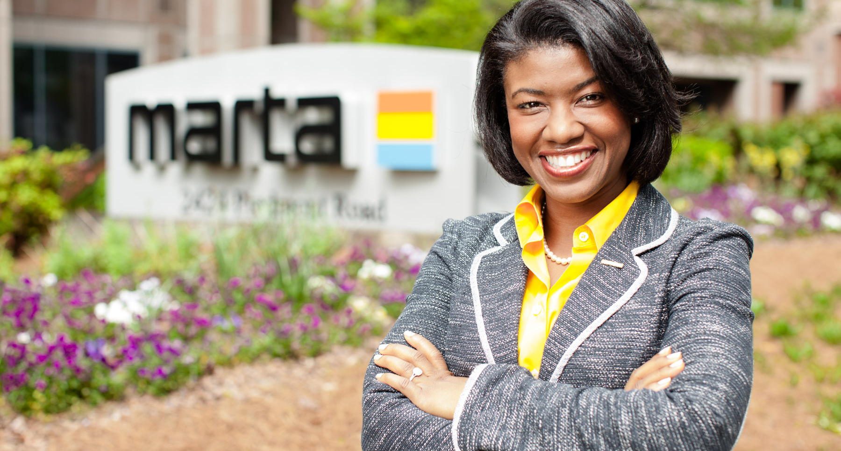
The Office of the Chief of Staff
Rukiya S. Thomas

Slide 2

Employee Engagement Efforts
May 15, 2017
Rukiya S. Thomas
Chief of Staff

Slide 3

The Office of the Chief of Staff
Rukiya S. Thomas
Chief of Staff

Slide 4


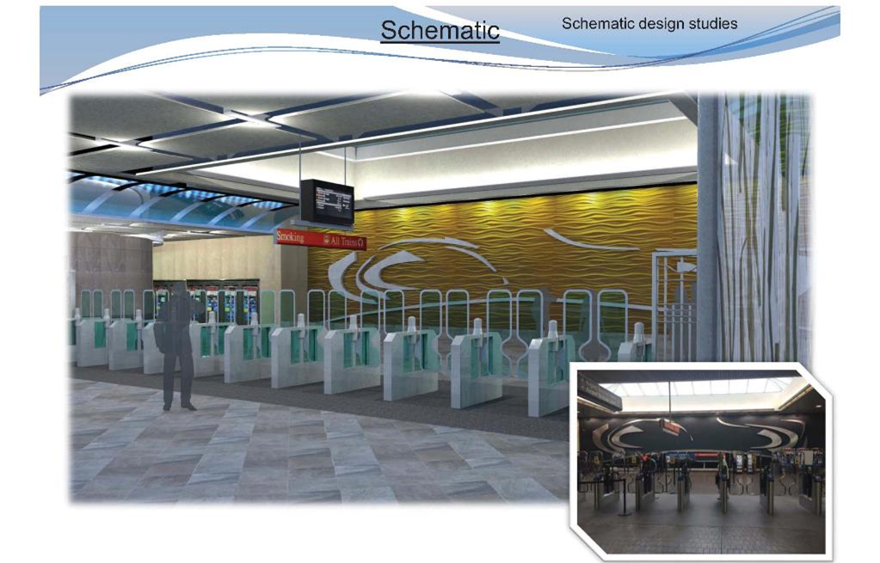



Functions
& Responsibilities
Artbound
Art in Transit
Artbound
Human Resources
Attract, develop, motivate and retain staff
Enhance Customer Experience
Increase Ridership
Generate Revenue
Organizational Assessments
Sustainability Programs
Transit-Oriented Development
Notes:
COS finds a variety of ways to focus on employee engagement as she oversees programs.

Slide 5
Encouraging Innovation
Investing in People
3
2
Developing Habits of Excellence
Networking and Collaboration
4
1
Establishing Core Values
5

Slide 6




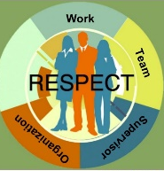
Employee Engagement Programs
2015
2014
2016
Initiated Clean Sweep Challenge
Implemented The Four Disciplines of Execution
Established External Leadership Development Program
2015
2013
2014
2017
2016
Created Women of MARTA Forum
Launched Work with Respect Program
2013
2017

Slide 7

Women of MARTA
Emergency Preparedness
Managing Your Digital Footprint
Mindfulness
Pink Power – Celebrating Breast Cancer Survivors
Build Relationships
Breakdown Silos
Increase Morale
Self-Defense Awareness
The Secret to Chicks in Charge
Stress Management
Women and Retirement
Notes:
Forum was created to build relationships, breakdown silos, increased morale. Meet every other month during lunch time and encourage women and men to bring their lunch and participate. Sampling of topics discussed over the years is shown. We are also reaching out to various organizations to

Slide 8











External Leadership Development Program
Midway through Year 4
18 Programs Identified
158 Self-nominations
41 Graduates
3 Promotions
Notes:
Some of the organizations/programs are shown here.

Slide 9
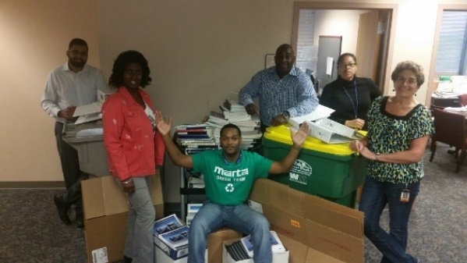
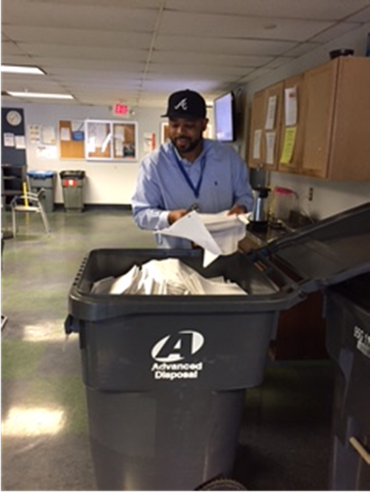
Clean Sweep Challenge
E-Waste
Team Spirit
Paper
Fun
Social Media
EMS
ISO Certification
Rally
Individual/Team Awards
Sustainability Focus around Earth Day
Individual/Team Prizes
Clean Sweep Rally
Pizza Party
Recycled over 44 tons of paper and electronics at 11 facilities over 3 years

Slide 10
The Four Disciplines of Execution
The 4DX Process
Discipline 1: Focus on the Wildly Important
Discipline 2: Act on the Lead Measures
Discipline 3: Keep a Compelling Scoreboard
Discipline 4: Create a Cadence of Accountability
Methodology to:
Achieve consistent execution of critical goals
Increase morale while increasing accountability
Develop the next generation of senior leaders
Notes:
The four disciples center around focus, leverage, engagement, and accountability. The principles of 4DX are designed to implement (behavioral) change without disrupting the existing operating environment. Authority-wide initiative
Leaders thought of how their teams affect absenteeism or employee engagement.
Set goal for their team
Determine lead measures (habits of excellence) to help achieve goal
Teams created scoreboards to display on walls
Celebrate success

Slide 11
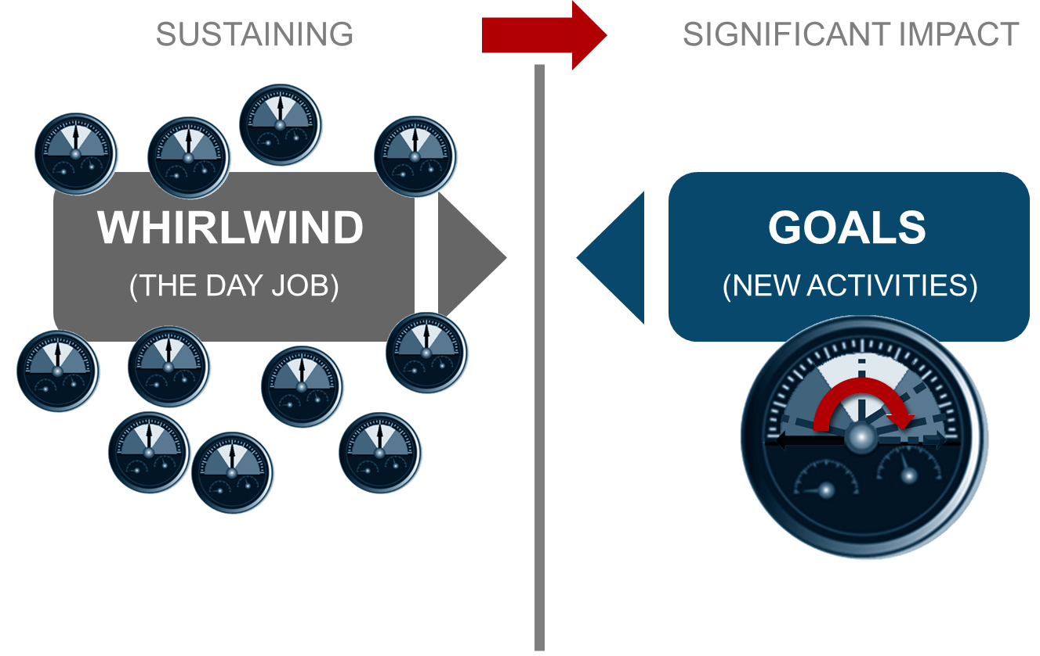
Discipline 1:
Focus on the Wildly Important
Notes:
Leaders thought of how their teams affect absenteeism or employee engagement.
Set goal for their team

Slide 12
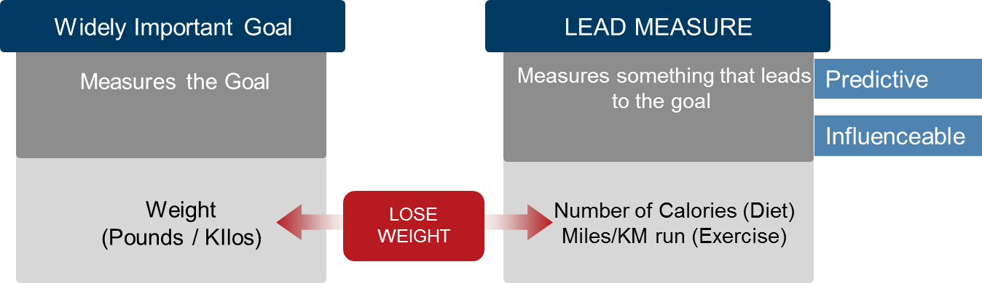
Discipline 2:
Act on the Lead Measures
Notes:
Determine lead measures (habits of excellence) to help achieve goal

Slide 13
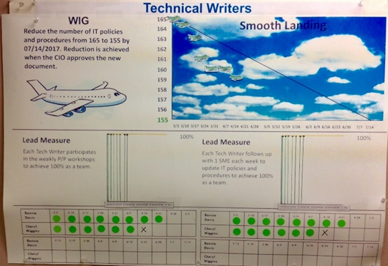
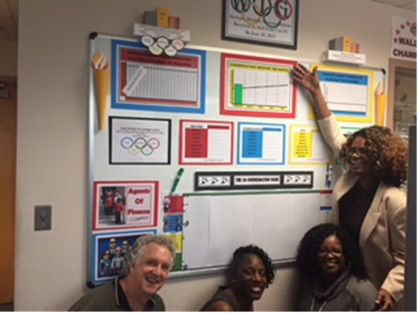
Discipline 3:
Keep a Compelling Scoreboard
Are simple
Are highly visible to the player
Have the right “WIG’s” and “Lead’s” measures
Tell us immediately if we are winning or losing!

Slide 14
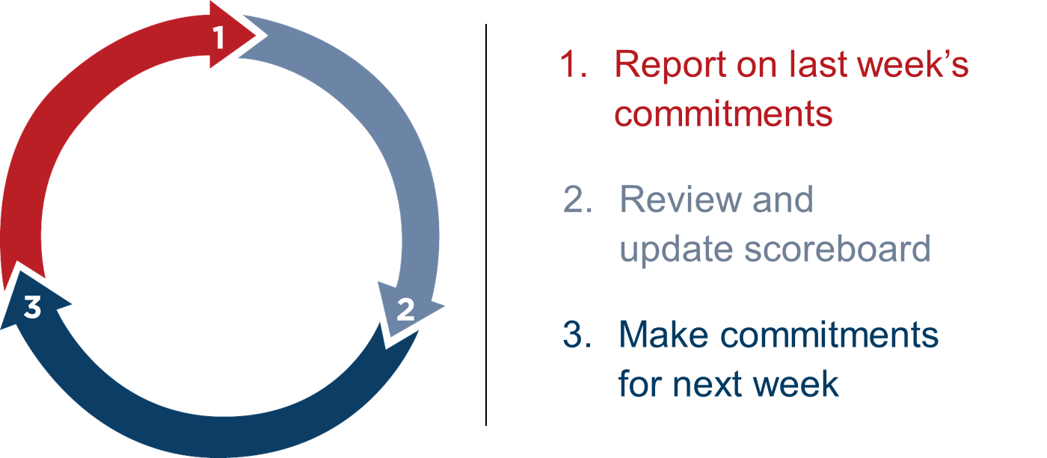

Discipline 4:
Create a Cadence of Accountability

Slide 15
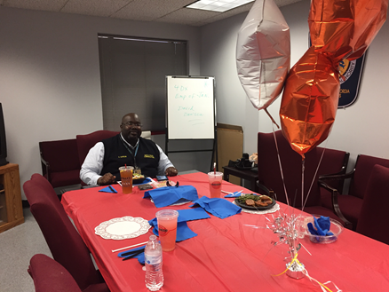
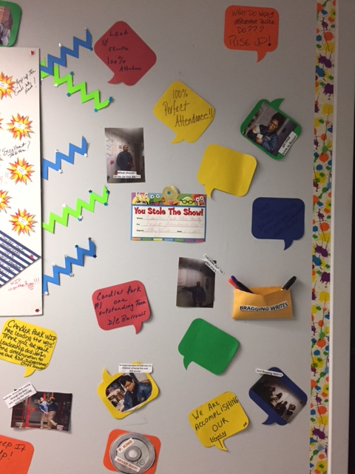
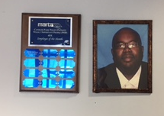
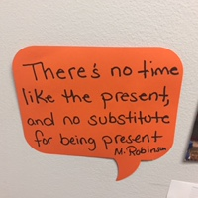
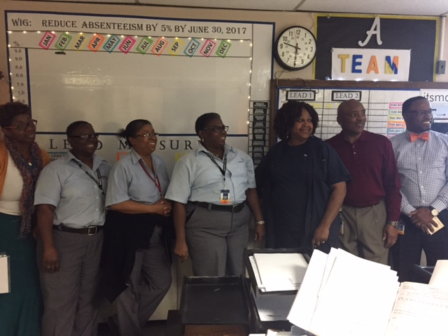
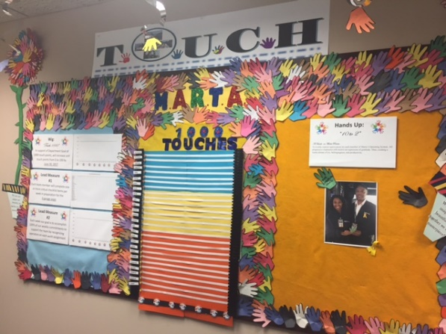
Is it Working?

Slide 16
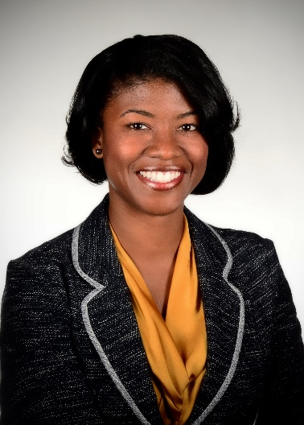
Work with Respect
Facilitated in person focus groups
Conducted electronic and manual surveys
Analyzed data
Create a Code of Conduct
Establish a Set of Core Values
Sense of Purpose
Acknowledgement
Trust
Hard Work
Notes:
What is important to you as an employee?
What does working with respect mean at MARTA?
What makes you proud to wear the MARTA badge?

Slide 17



Impact of Engaged Employees
Committed Employees
High Performing Workforce
Proactive & Profitable Organization
Satisfied & Loyal Customer

Slide 19




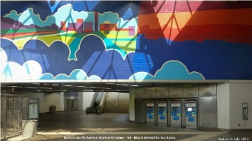




Slide 20
Clean Sweep Challenge
E-Waste
Team Spirit
Paper
Fun
Social Media
EMS
ISO Certification
Sustainability Focus around Earth Day
Individual/Team Prizes
Clean Sweep Rally
Pizza Party
Recycled over 44 tons of paper and electronics at 11 facilities over 3 years

Slide 21

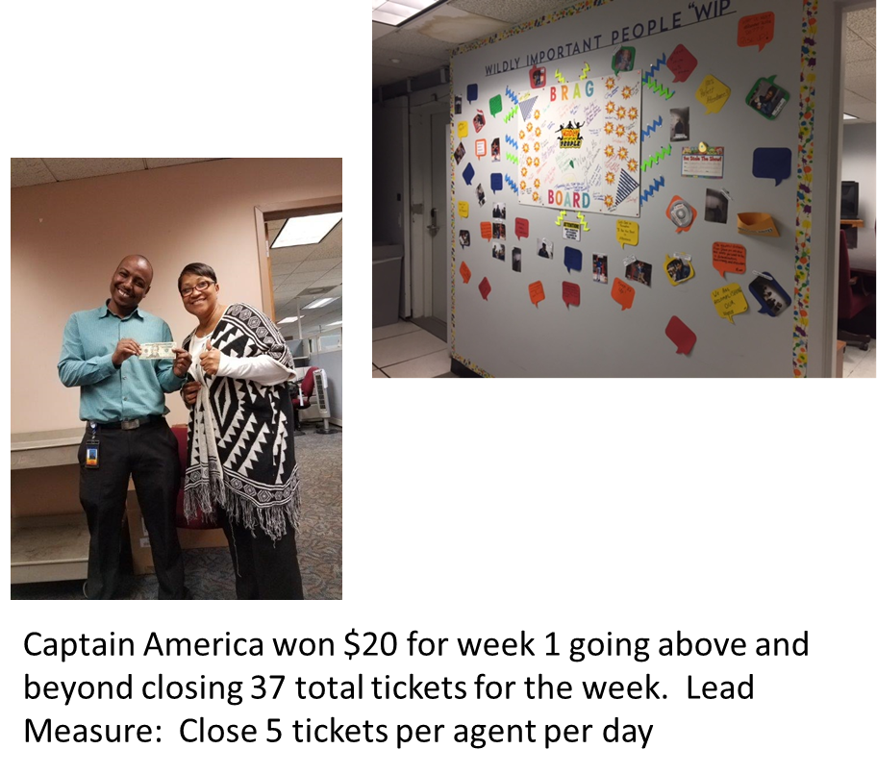
Results

Slide 22
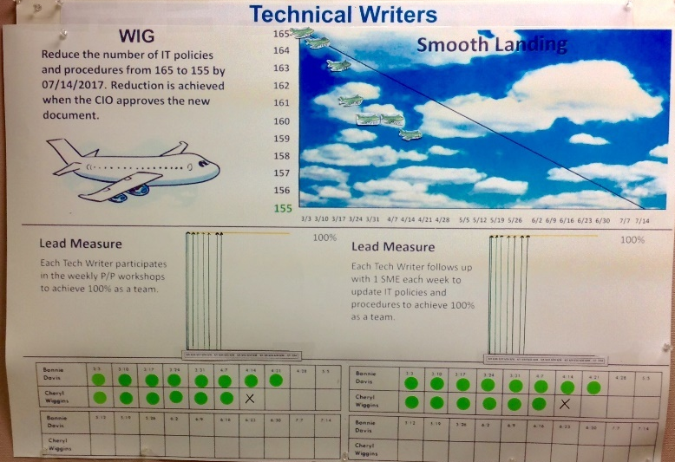
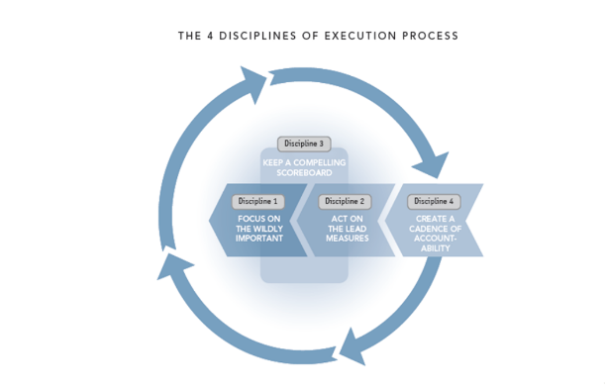
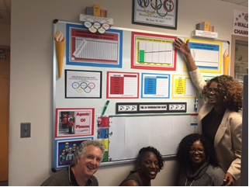

The Four Disciplines of Execution
WILDLY IMPORTANT GOAL: Reduce unscheduled absenteeism
Authority-wide initiative
Celebrate success
Notes:
Teams created scoreboards to display on walls

Slide 23
Clean Sweep Challenge
E-Waste
Team Spirit
Paper
Fun
Social Media
EMS
ISO Certification
Rally
Individual/Team Awards
Sustainability Focus around Earth Day
Individual/Team Prizes
Clean Sweep Rally
Pizza Party
Recycled over 44 tons of paper and electronics at 11 facilities over 3 years

Slide 24
Work with Respect
Engaged a third party consultant to gather feedback
  Facilitated in person focus groups
  Conducted electronic and manual surveys
Create a Code of Conduct
Establish a Set of Core Values
What is important to you as an employee?
What does working with respect mean at MARTA?
What makes you proud to wear the MARTA badge?
Notes:
No formal employee handbook

Slide 25
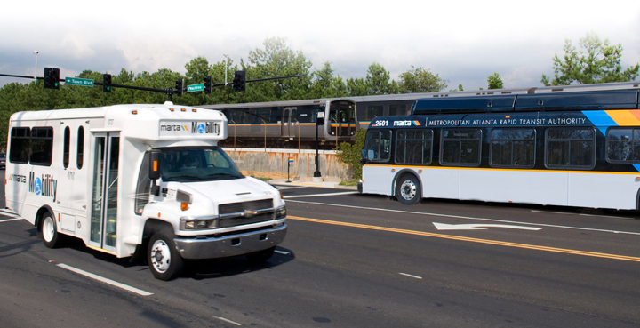
The Office of the Chief of Staff

Slide 27
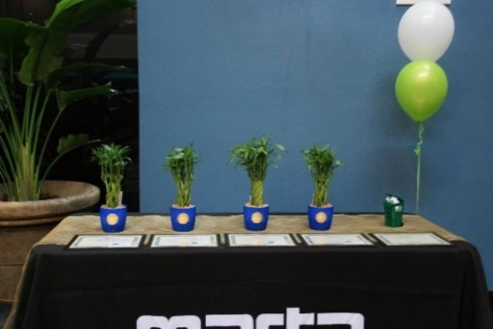
Clean Sweep Challenge
Sustainability Focus around Earth Day
Individual/Team Prizes
Clean Sweep Rally
Pizza Party
Recycled over 44 tons of paper and electronics at 11 facilities over 3 years

Slide 28


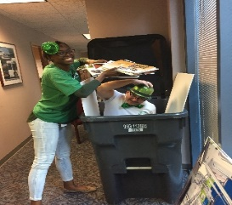
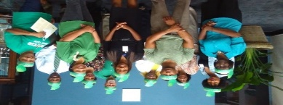
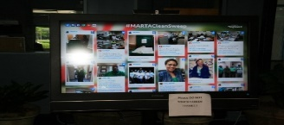
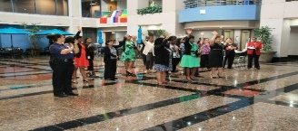

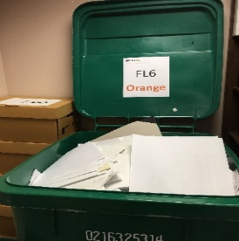
Clean Sweep Challenge
E-Waste
EMS
ISO Certification
Paper
Sustainability Focus around Earth Day
Individual/Team Prizes
Clean Sweep Rally
Pizza Party
Recycled over 44 tons of paper and electronics at 11 facilities over 3 years
Fun
Team Spirit
Social Media
Rally
Individual/Team Awards

